Slide 1
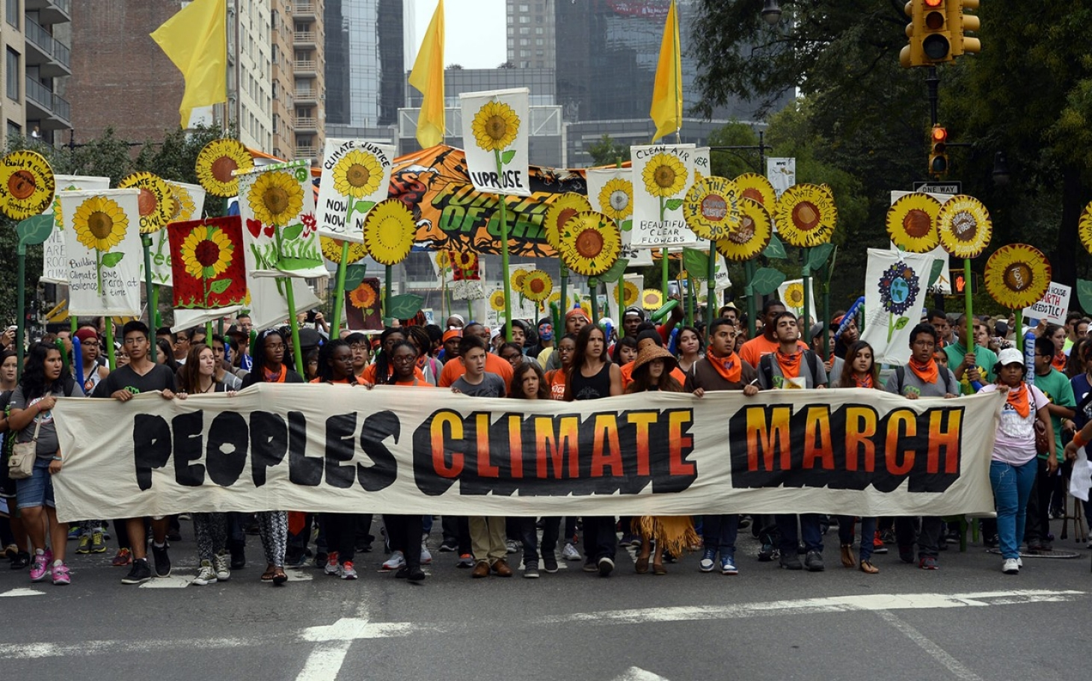
A Sociology of Climate Change: Responses

Slide 2

Responses
Society
Climate Change

Slide 3
Societal responses to climate change
13 The science: discovery; communication; activism
14 Climate activism, the social movements
15 Climate denial, the counter-movement
16 Private sector actors, pro and con
17 Non-environmental “civil society” actors, pro and con
18 Traditional media – print (newspapers), network television
19 On line media – websites, blogs, social media
20 Public opinion
21 Policy – international; other nations
22 Policy – federal (US)
23 Policy – State, local (US)
24 Technological innovation (clean, renewable energy); green cities
25 “Plan B”: geoengineering

Slide 4
Societal responses to climate change
13 The science: discovery; communication; activism
14 Climate activism, the social movements
15 Climate denial, the counter-movement
16 Private sector actors, pro and con
17 Non-environmental “civil society” actors, pro and con
18 Traditional media – print (newspapers), network television
19 On line media – websites, blogs, social media
20 Public opinion
21 Policy – international; other nations
22 Policy – federal (US)
23 Policy – State, local (US)
24 Technological innovation (clean, renewable energy); green cities
25 “Plan B”: geoengineering

Slide 5
Societal responses to climate change
13 The science: discovery; communication; activism
14 Climate activism, the social movements
15 Climate denial, the counter-movement
16 Private sector actors, pro and con
17 Non-environmental “civil society” actors, pro and con
18 Traditional media – print (newspapers), network television
19 On line media – websites, blogs, social media
20 Public opinion
21 Policy – international; other nations
22 Policy – federal (US)
23 Policy – State, local (US)
24 Technological innovation (clean, renewable energy); green cities
25 “Plan B”: geoengineering

Slide 6
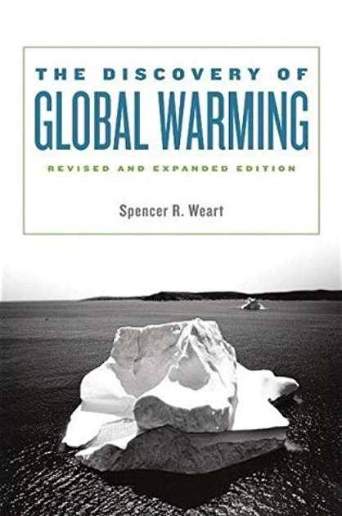

Slide 7
Societal responses to climate change
13 The science: discovery; communication; activism
14 Climate activism, the social movements
15 Climate denial, the counter-movement
16 Private sector actors, pro and con
17 Non-environmental “civil society” actors, pro and con
18 Traditional media – print (newspapers), network television
19 On line media – websites, blogs, social media
20 Public opinion
21 Policy – international; other nations
22 Policy – federal (US)
23 Policy – State, local (US)
24 Technological innovation (clean, renewable energy); green cities
25 “Plan B”: geoengineering

Slide 8
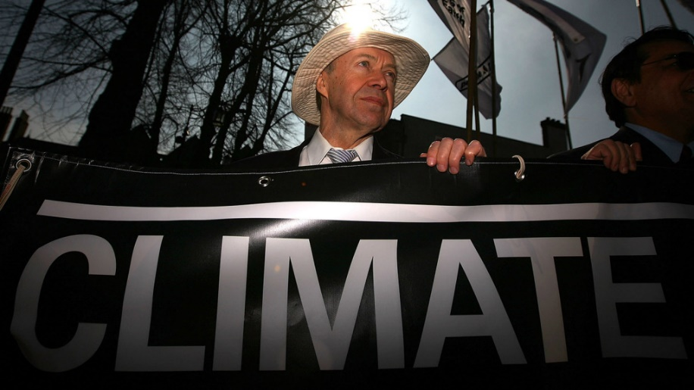
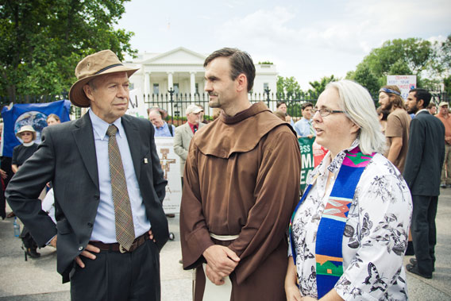
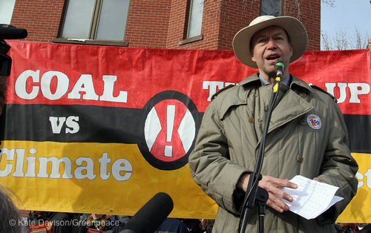
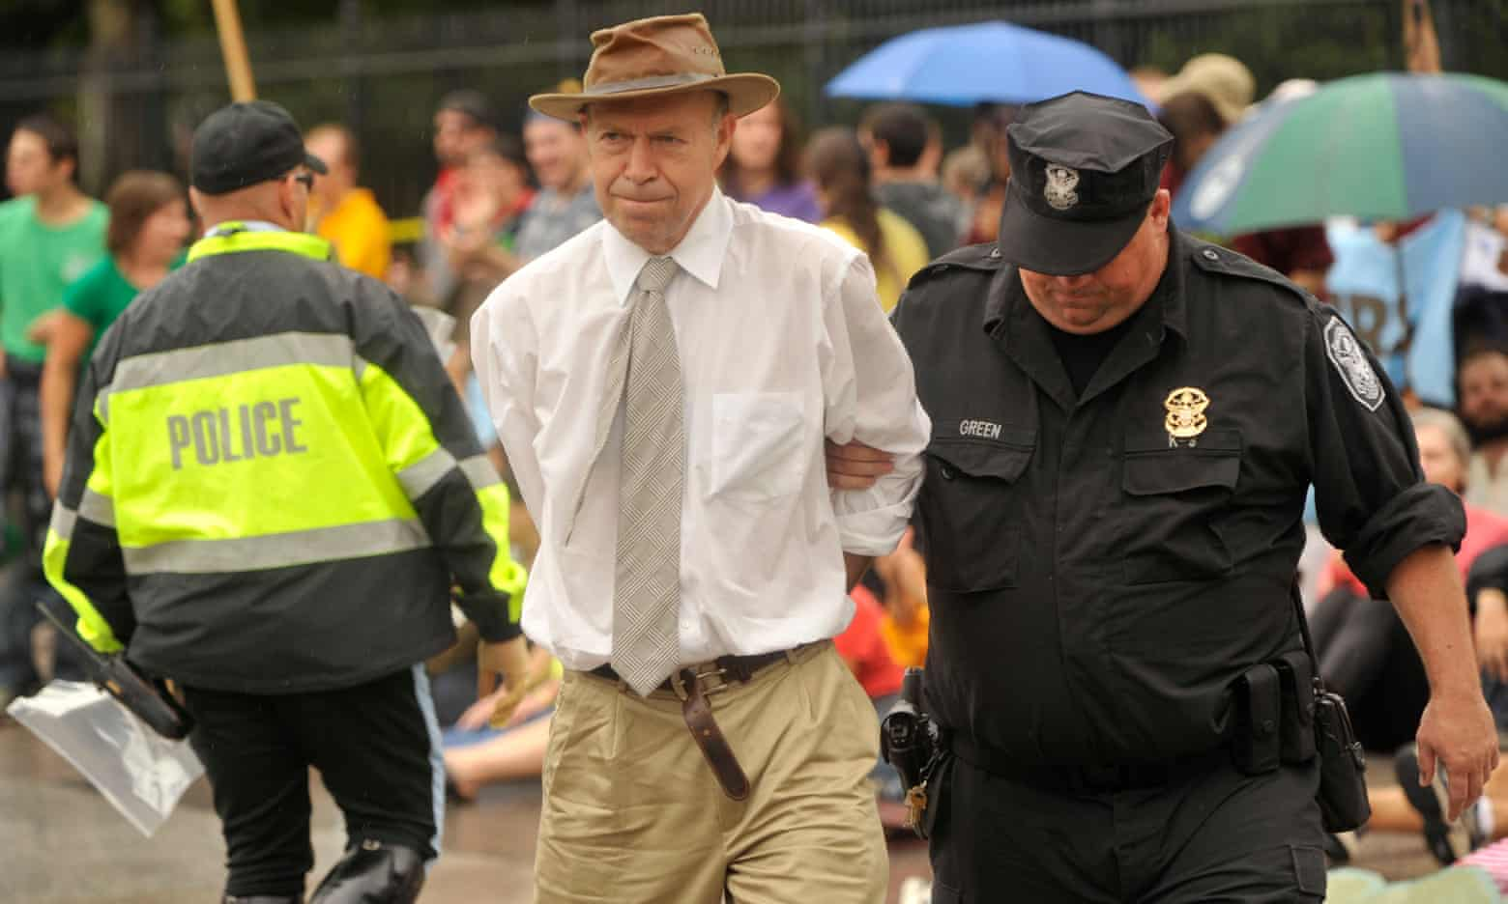

Slide 9
Societal responses to climate change
13 The science: discovery; communication; activism
14 Climate activism, the social movements
15 Climate denial, the counter-movement
16 Private sector actors, pro and con
17 Non-environmental “civil society” actors, pro and con
18 Traditional media – print (newspapers), network television
19 On line media – websites, blogs, social media
20 Public opinion
21 Policy – international; other nations
22 Policy – federal (US)
23 Policy – State, local (US)
24 Technological innovation (clean, renewable energy); green cities
25 “Plan B”: geoengineering

Slide 10
Societal responses to climate change
13 The science: discovery; communication; activism
14 Climate activism, the social movements
15 Climate denial, the counter-movement
16 Private sector actors, pro and con
17 Non-environmental “civil society” actors, pro and con
18 Traditional media – print (newspapers), network television
19 On line media – websites, blogs, social media
20 Public opinion
21 Policy – international; other nations
22 Policy – federal (US)
23 Policy – State, local (US)
24 Technological innovation (clean, renewable energy); green cities
25 “Plan B”: geoengineering

Slide 11







Slide 12
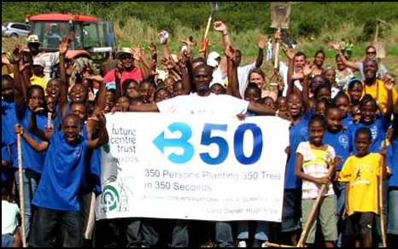
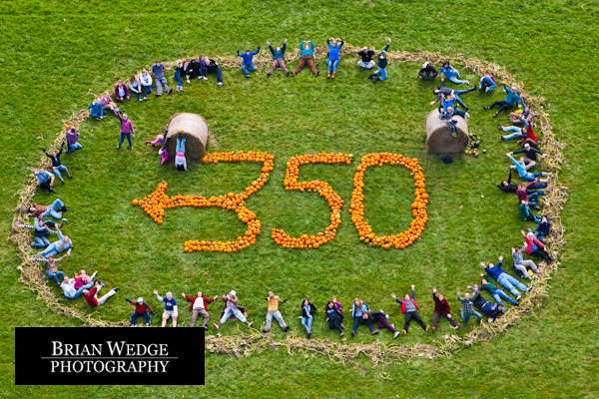

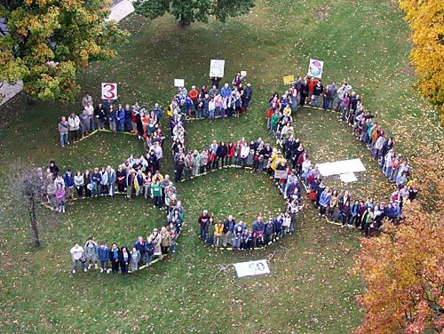
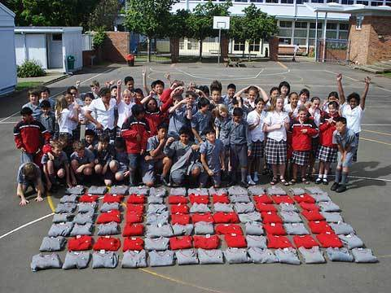

Slide 13
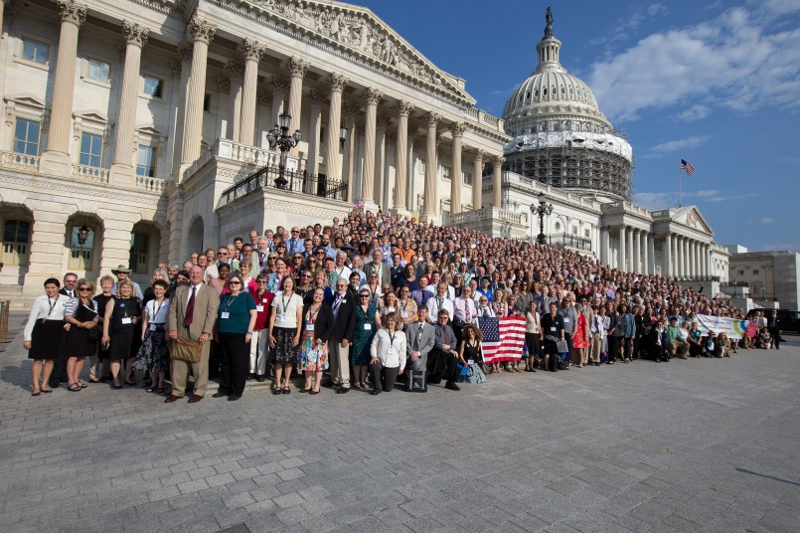
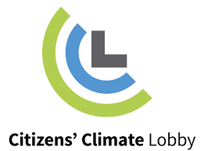

Slide 14
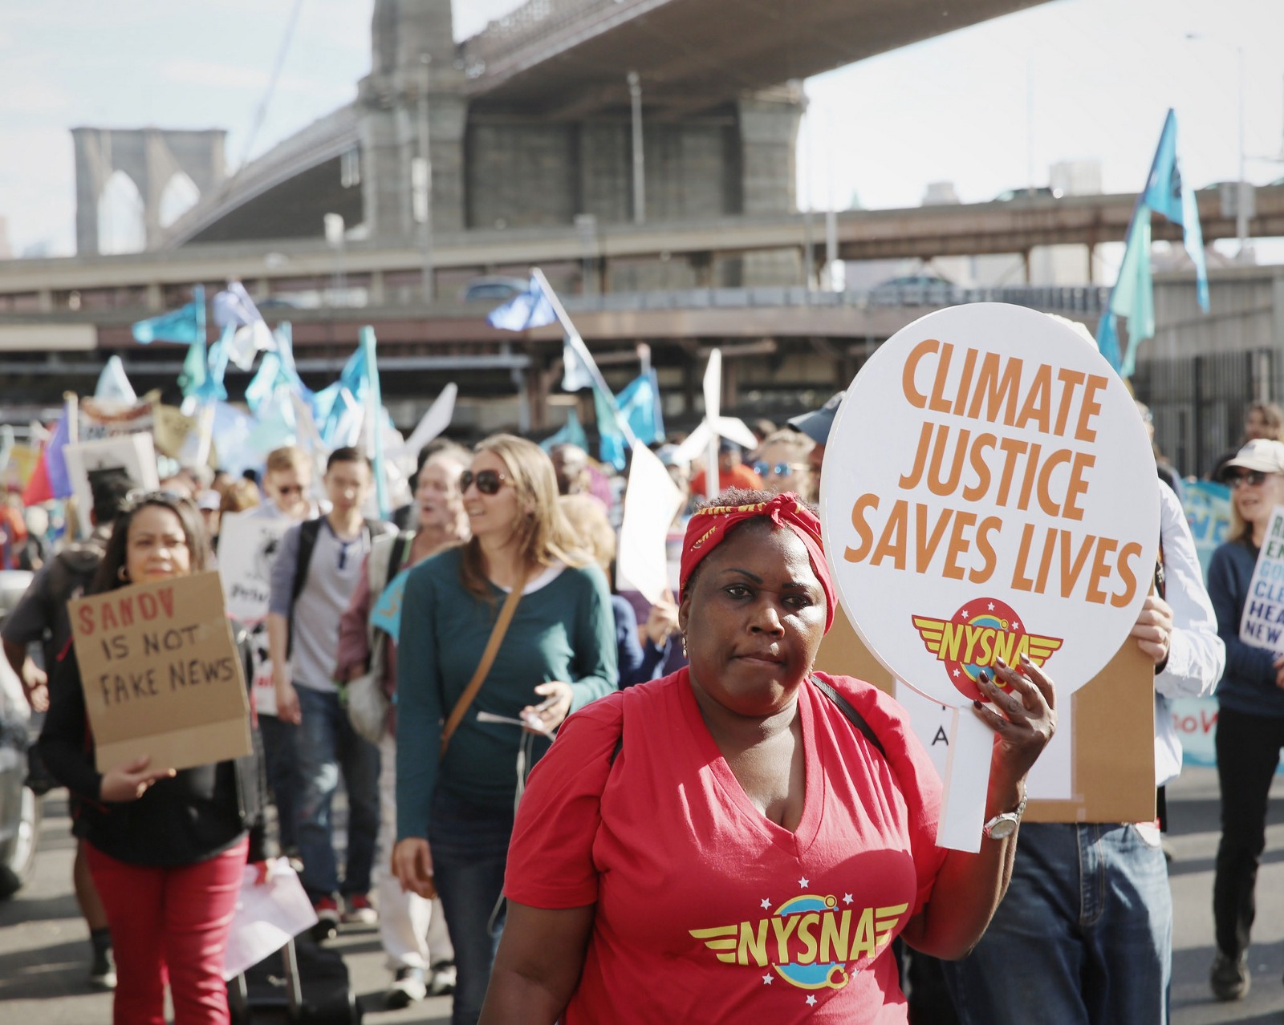

Slide 15
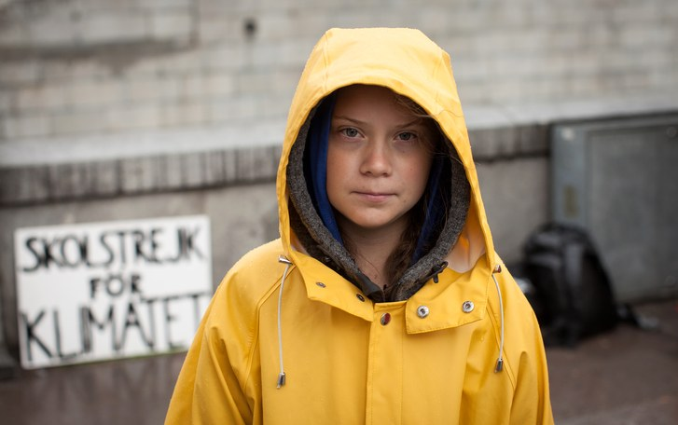
https://commons.wikimedia.org/wiki/File:Greta_Thunberg_01.jpg

Slide 16
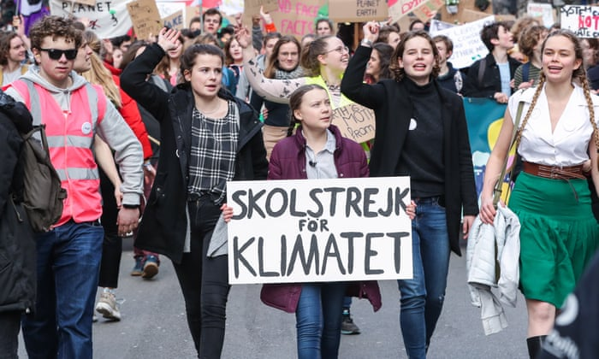

Slide 17
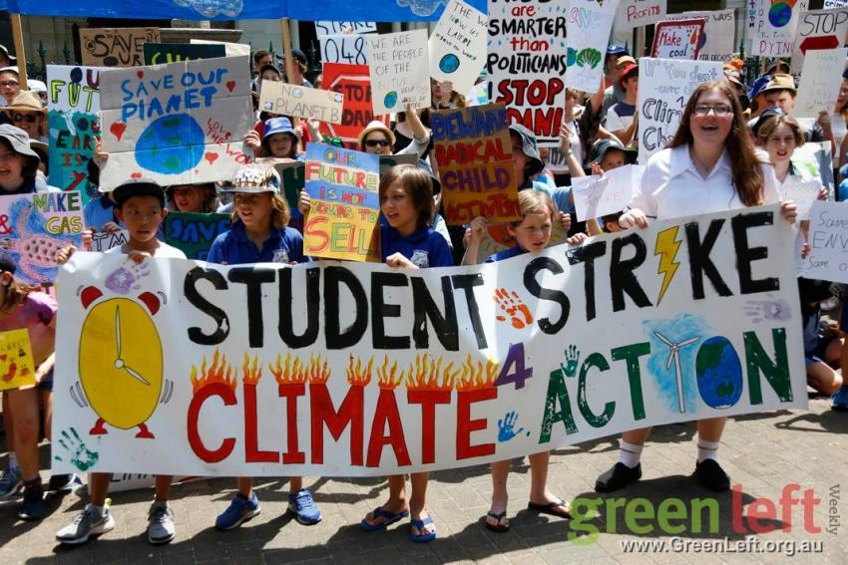
http://www.tcjzh.com/Article/guoji/2019/01/397976.html

Slide 18
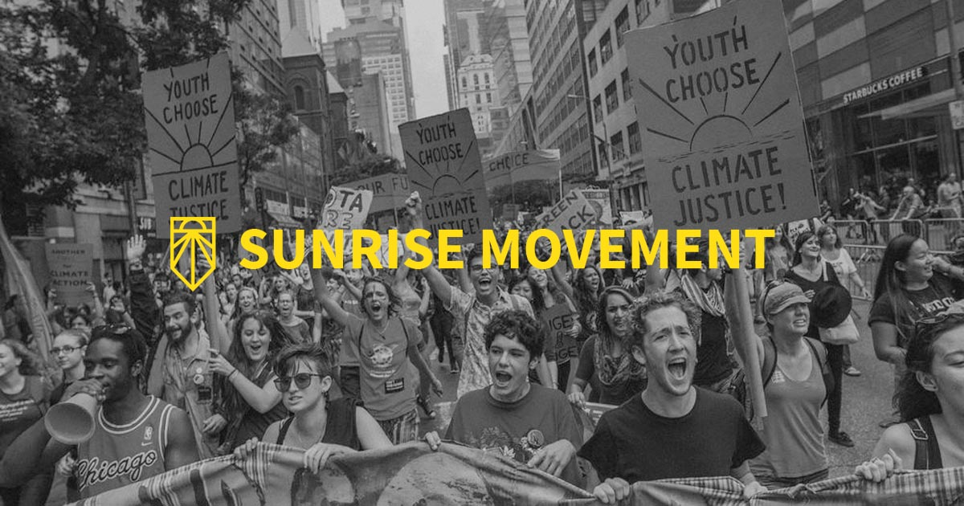

Slide 19
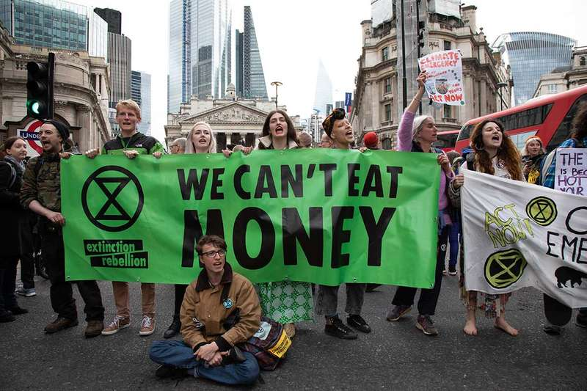

Slide 20
Societal responses to climate change
13 The science: discovery; communication; activism
14 Climate activism, the social movements
15 Climate denial, the counter-movement
16 Private sector actors, pro and con
17 Non-environmental “civil society” actors, pro and con
18 Traditional media – print (newspapers), network television
19 On line media – websites, blogs, social media
20 Public opinion
21 Policy – international; other nations
22 Policy – federal (US)
23 Policy – State, local (US)
24 Technological innovation (clean, renewable energy); green cities
25 “Plan B”: geoengineering

Slide 21
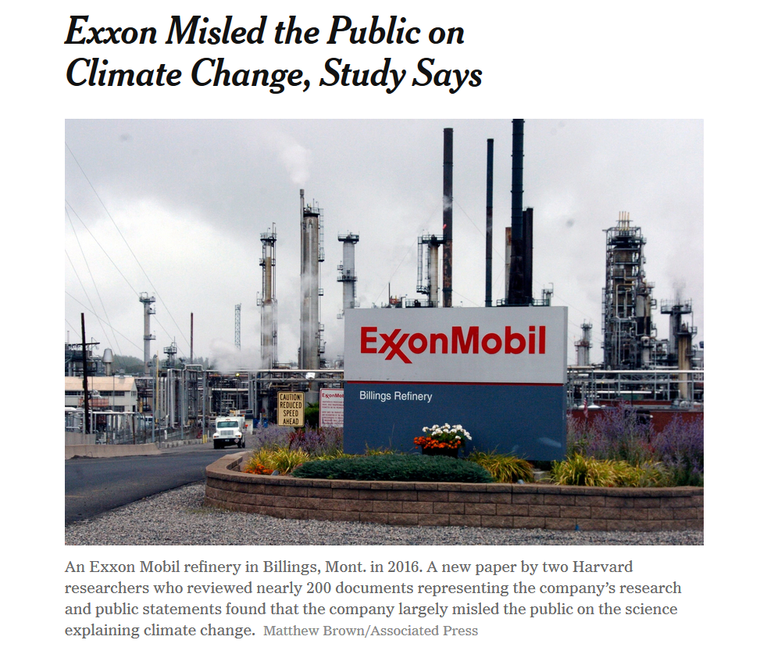
The New York Times, August 23, 2017

Slide 22
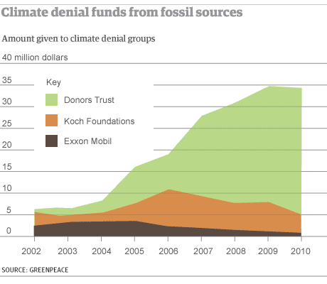

Slide 23
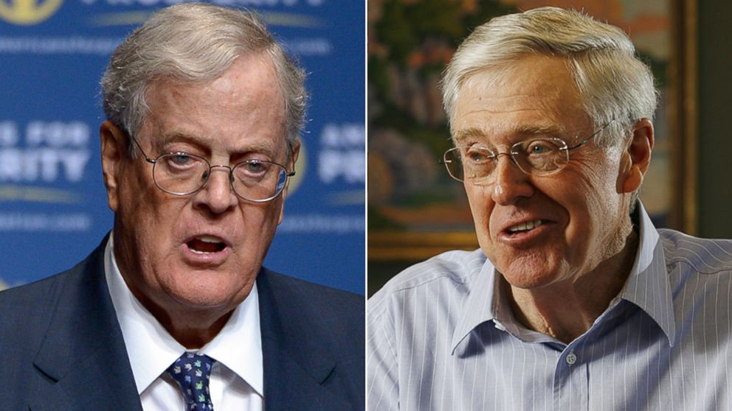
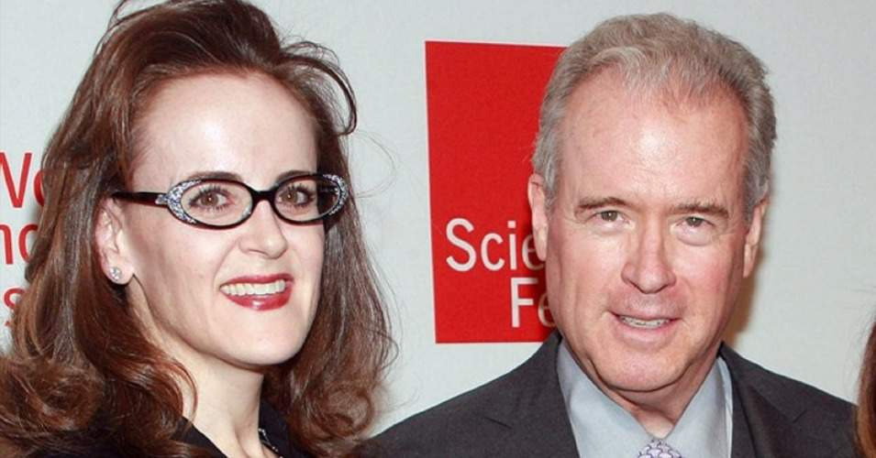

Slide 24





Slide 25
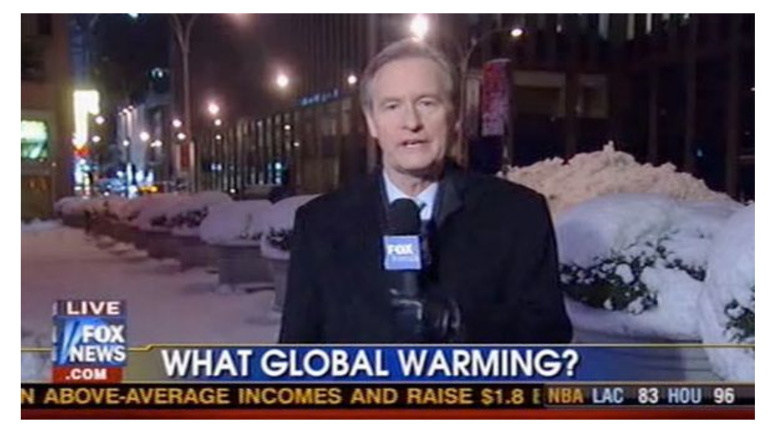
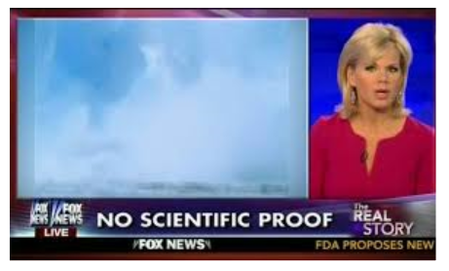
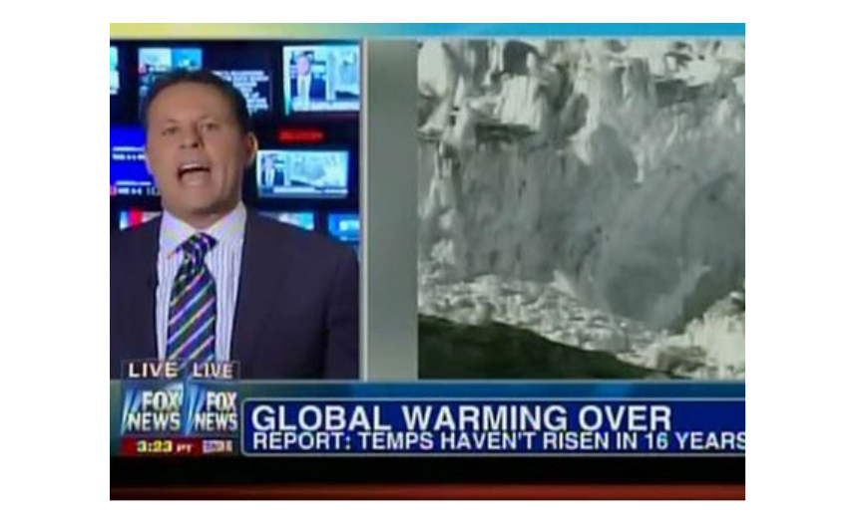
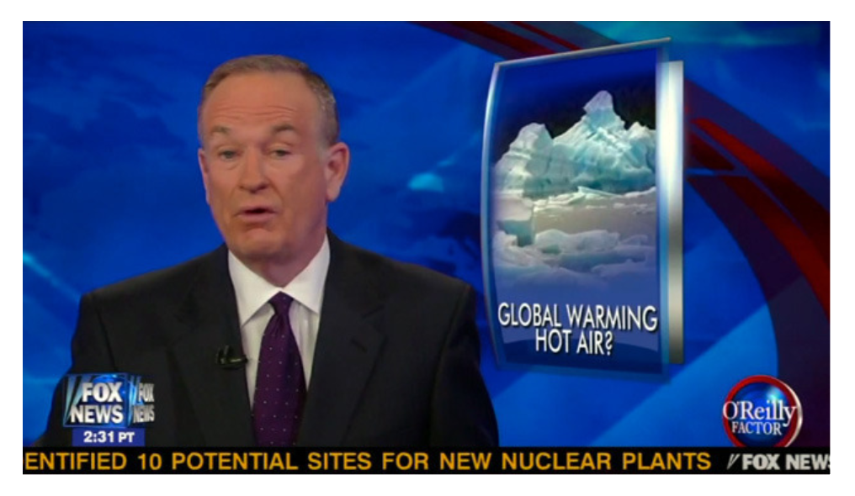

Slide 26
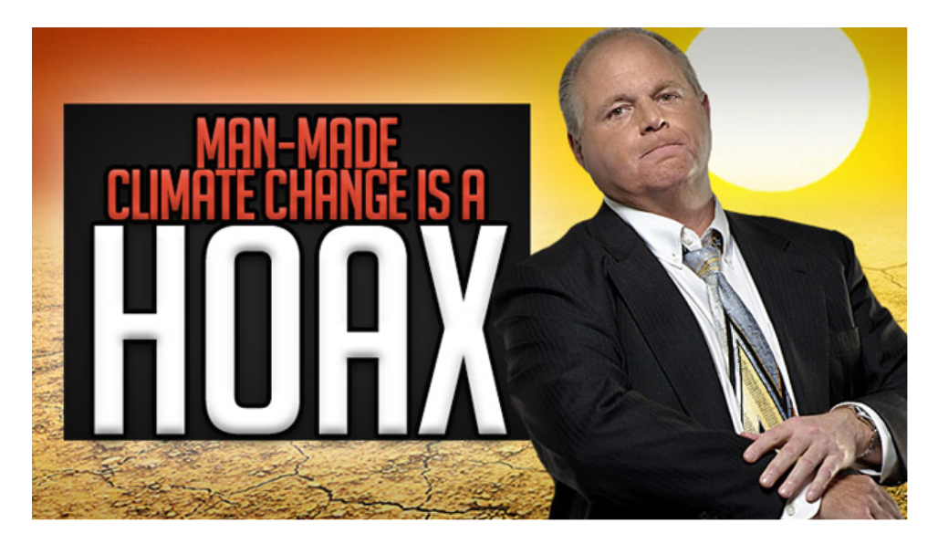
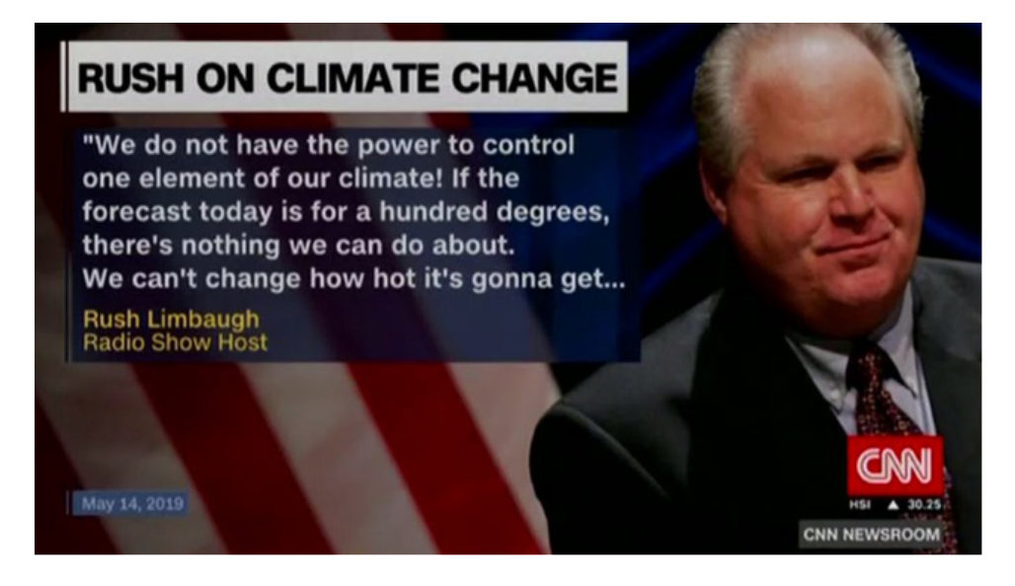

Slide 27
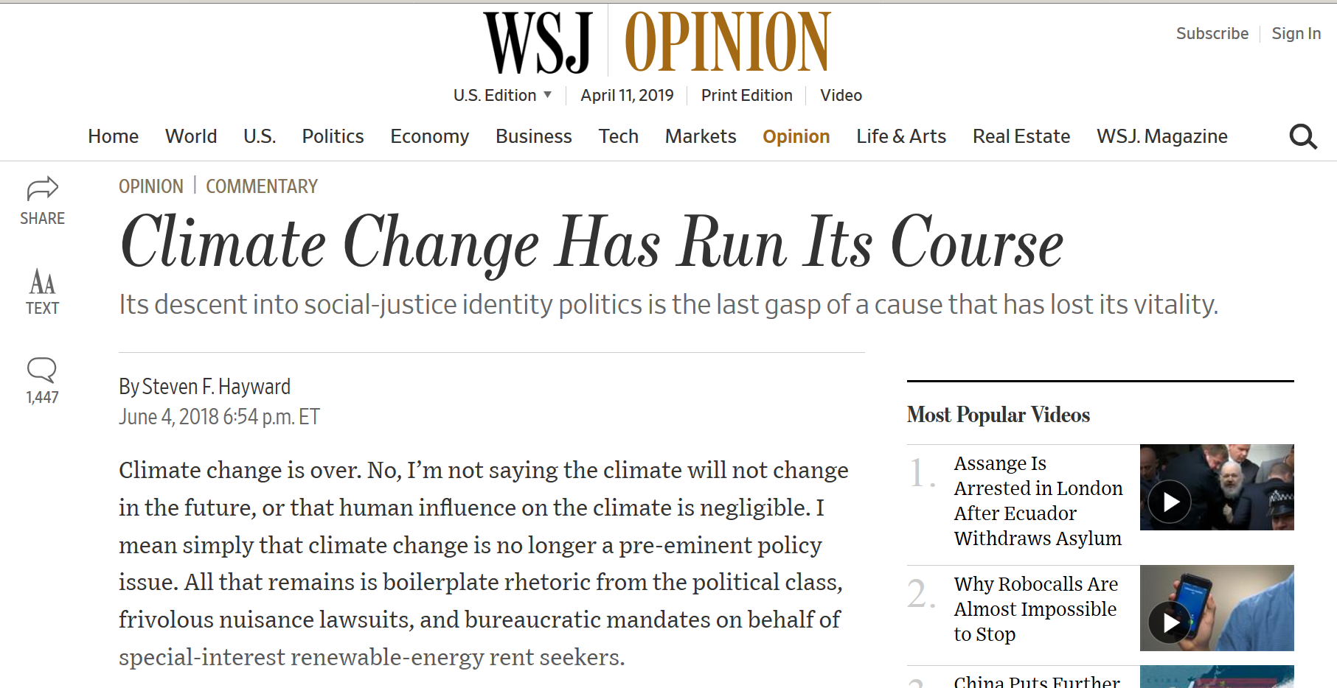

Slide 28
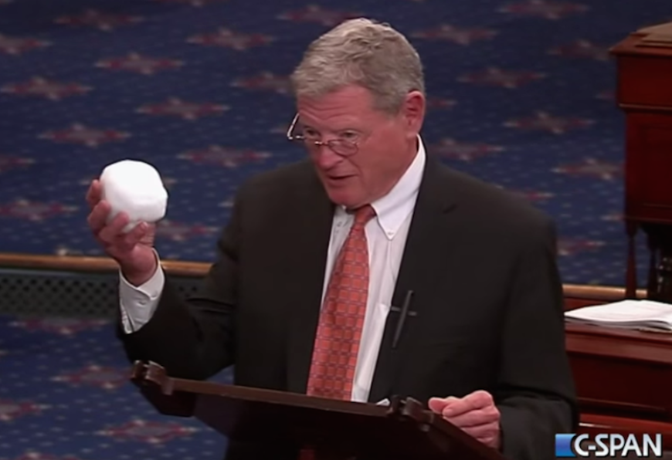

Slide 29
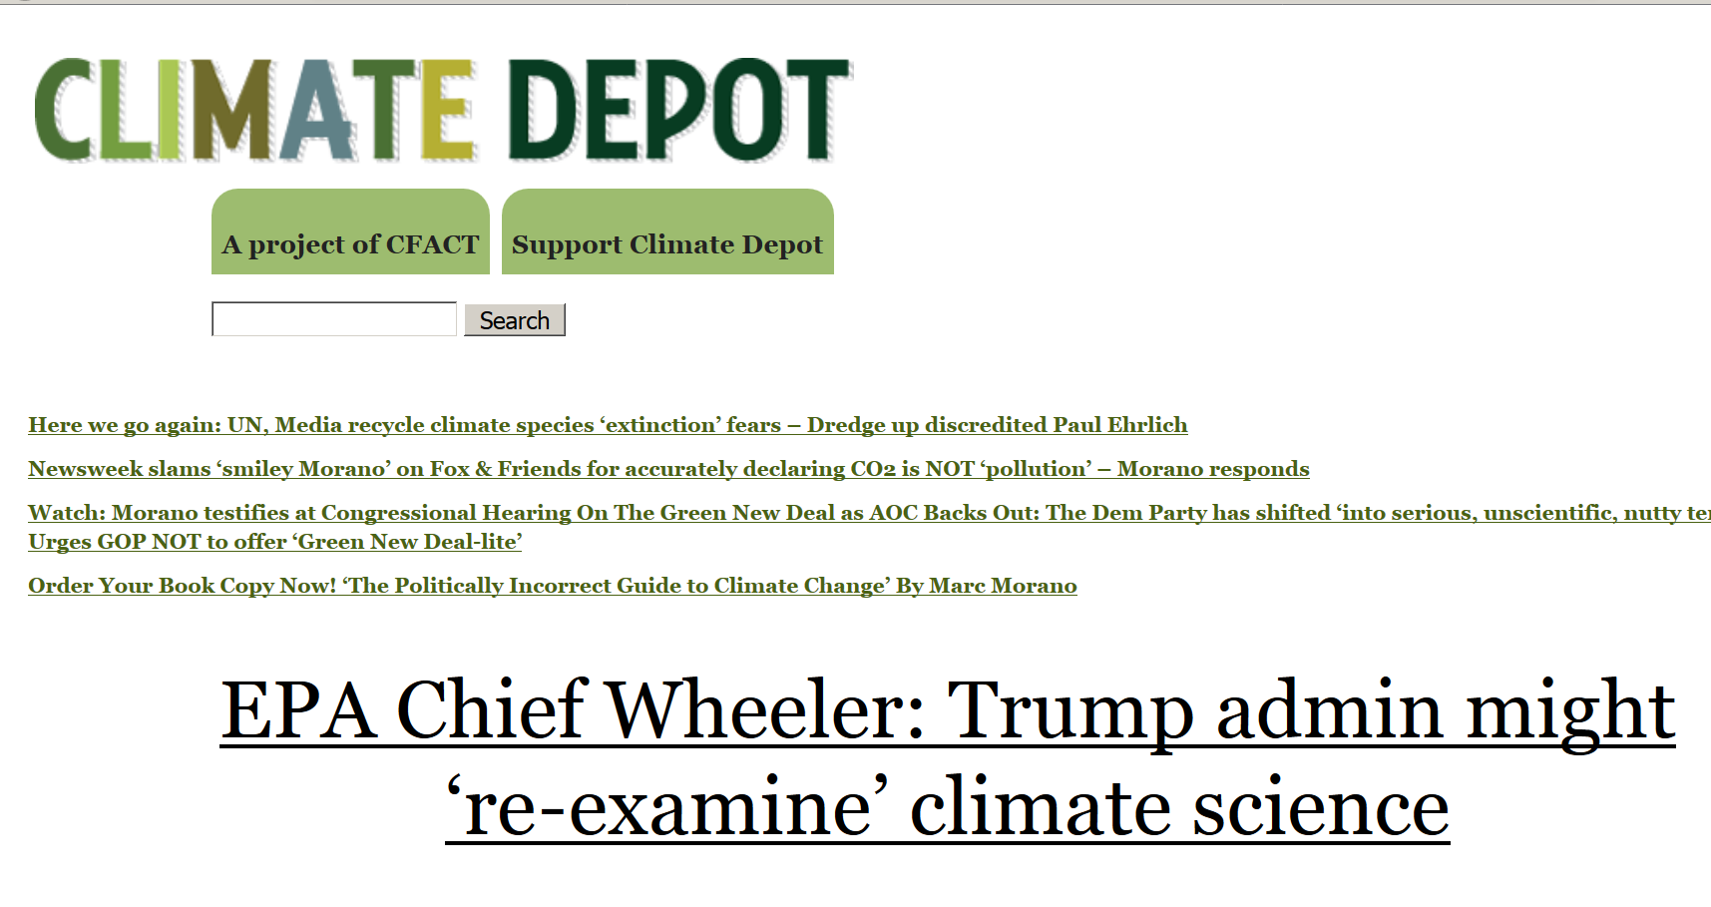
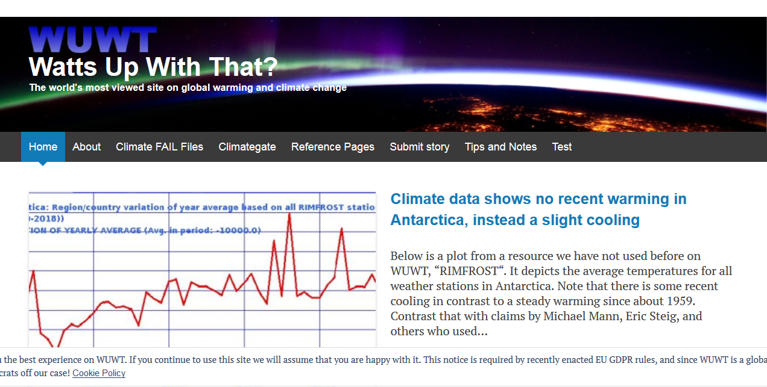

Slide 30
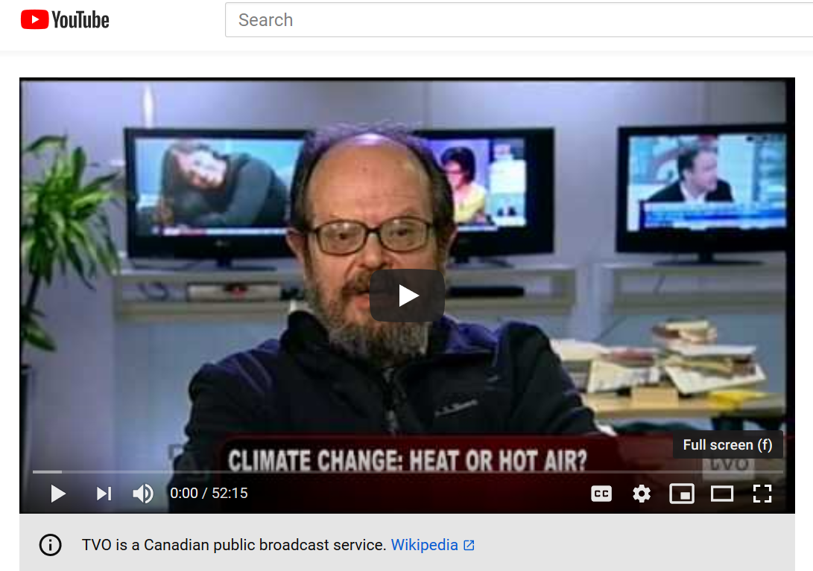
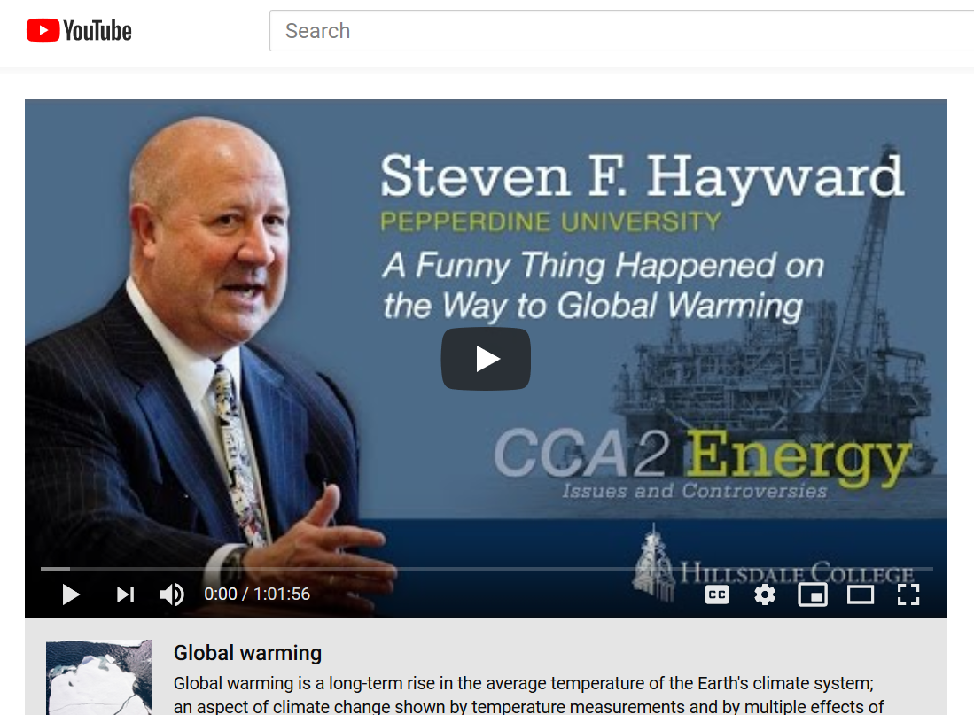
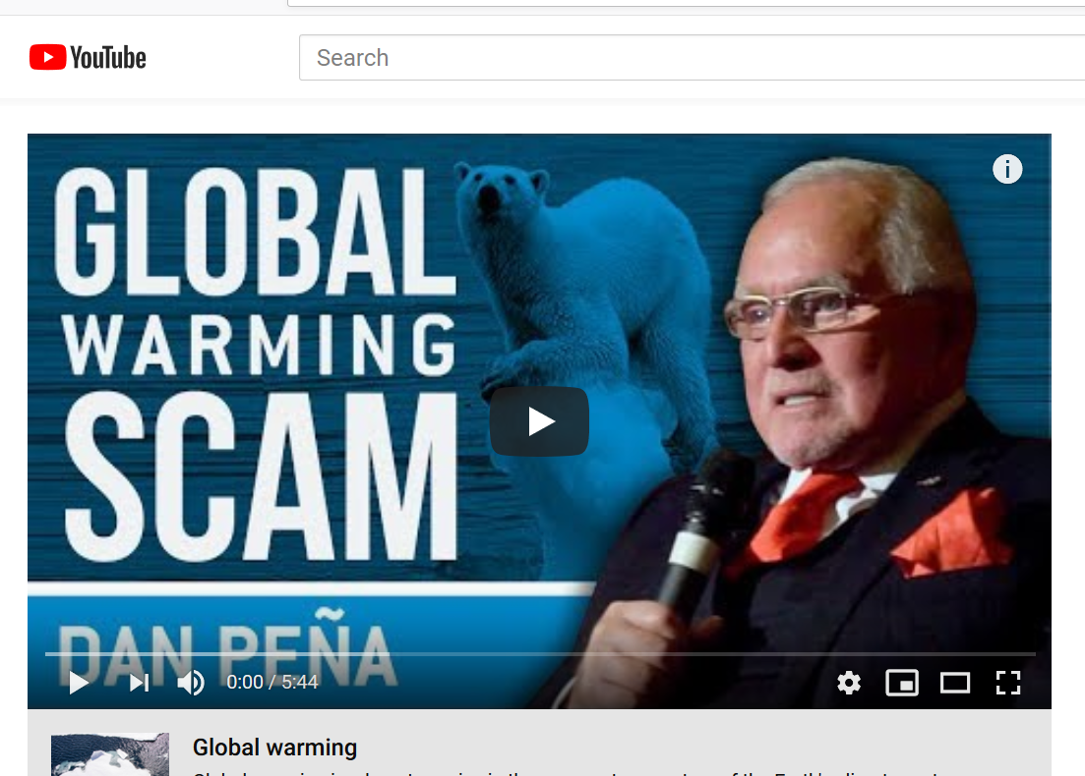
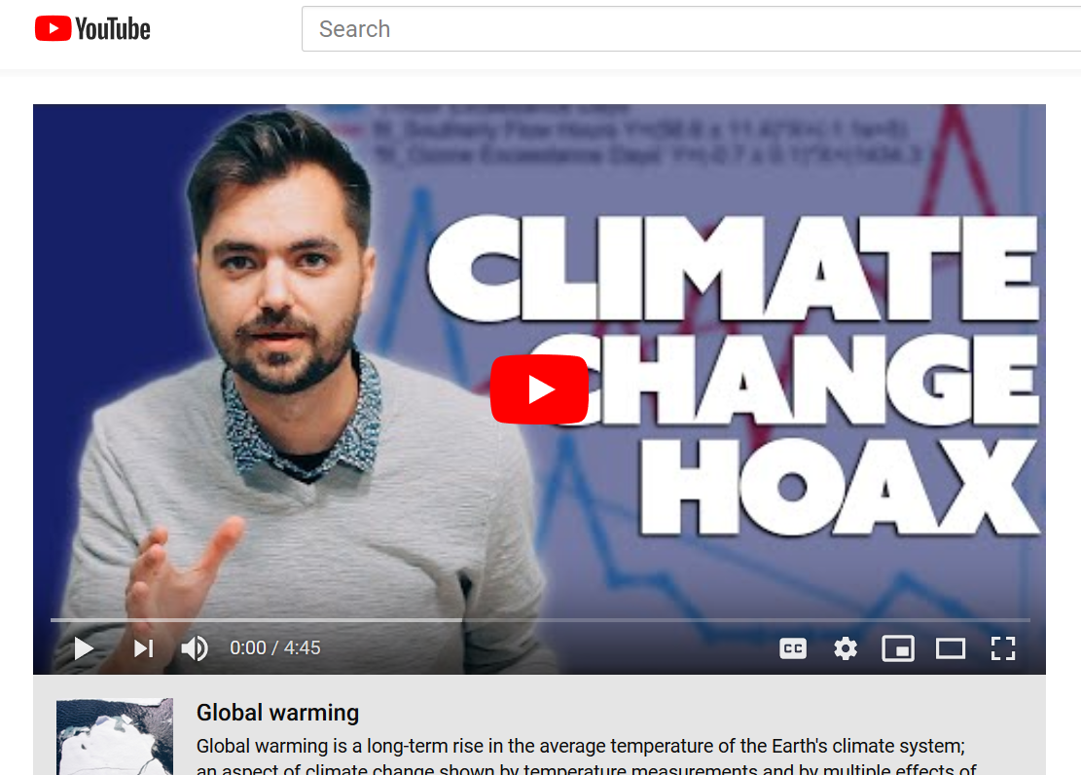

Slide 31
Societal responses to climate change
13 The science: discovery; communication; activism
14 Climate activism, the social movements
15 Climate denial, the counter-movement
16 Private sector actors, pro and con
17 Non-environmental “civil society” actors, pro and con
18 Traditional media – print (newspapers), network television
19 On line media – websites, blogs, social media
20 Public opinion
21 Policy – international; other nations
22 Policy – federal (US)
23 Policy – State, local (US)
24 Technological innovation (clean, renewable energy); green cities
25 “Plan B”: geoengineering

Slide 32
The New York Times, August 23, 2017

Slide 33
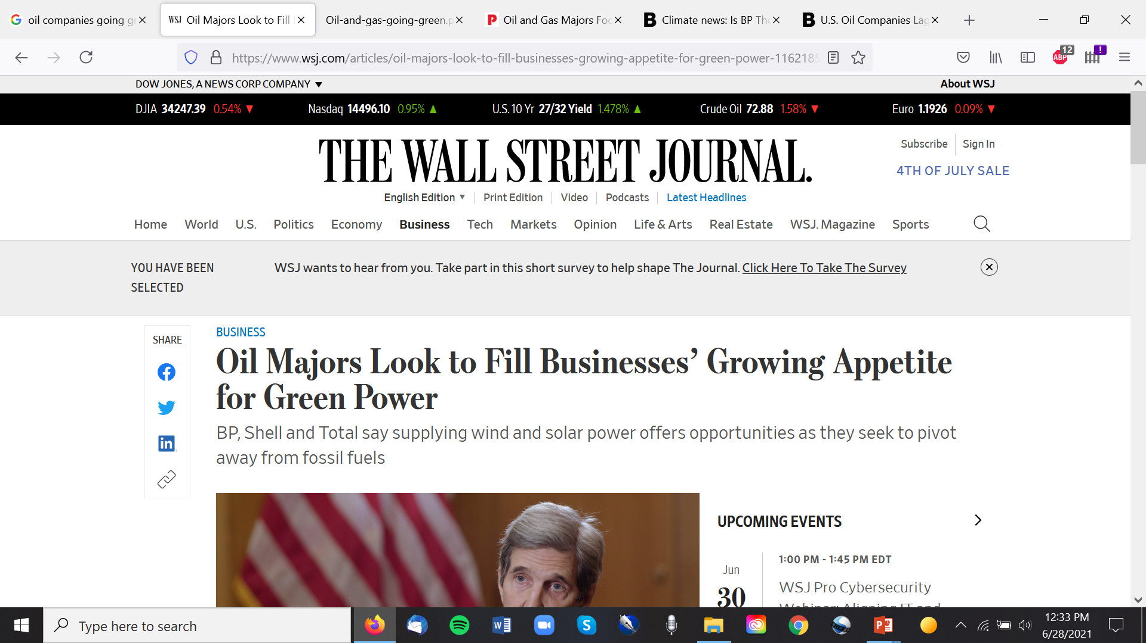
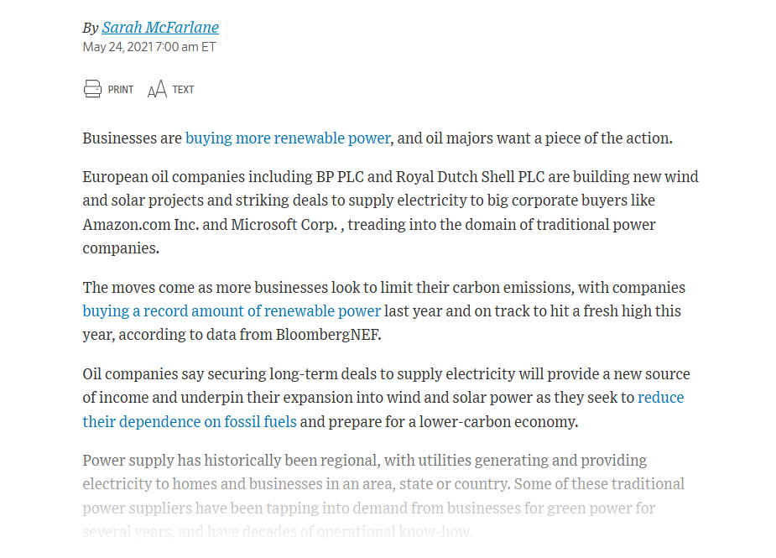

Slide 34
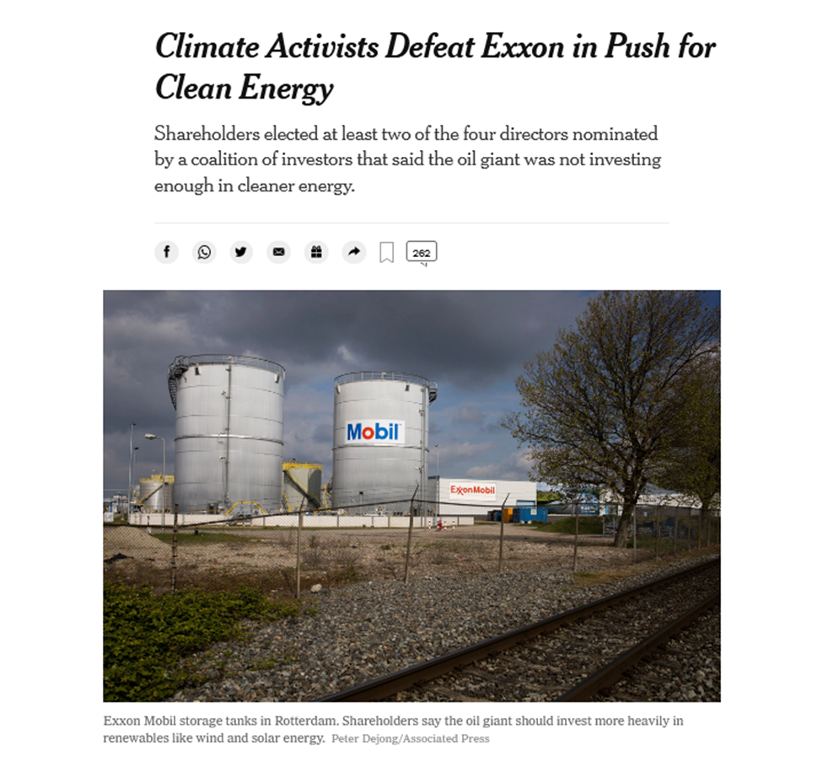
The New York Times, May 26, 2021

Slide 35
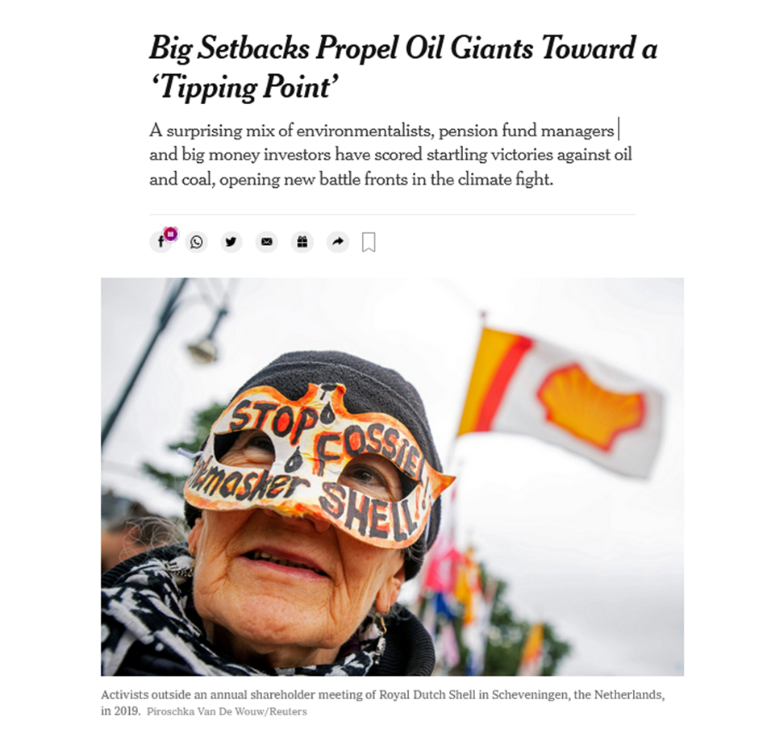

Slide 36
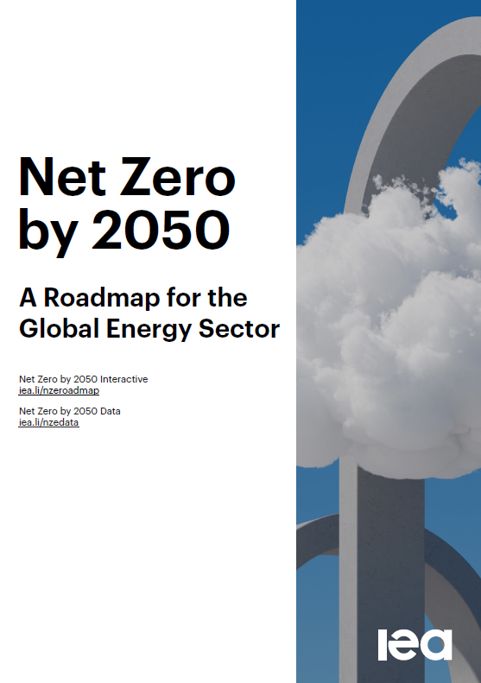

Slide 37
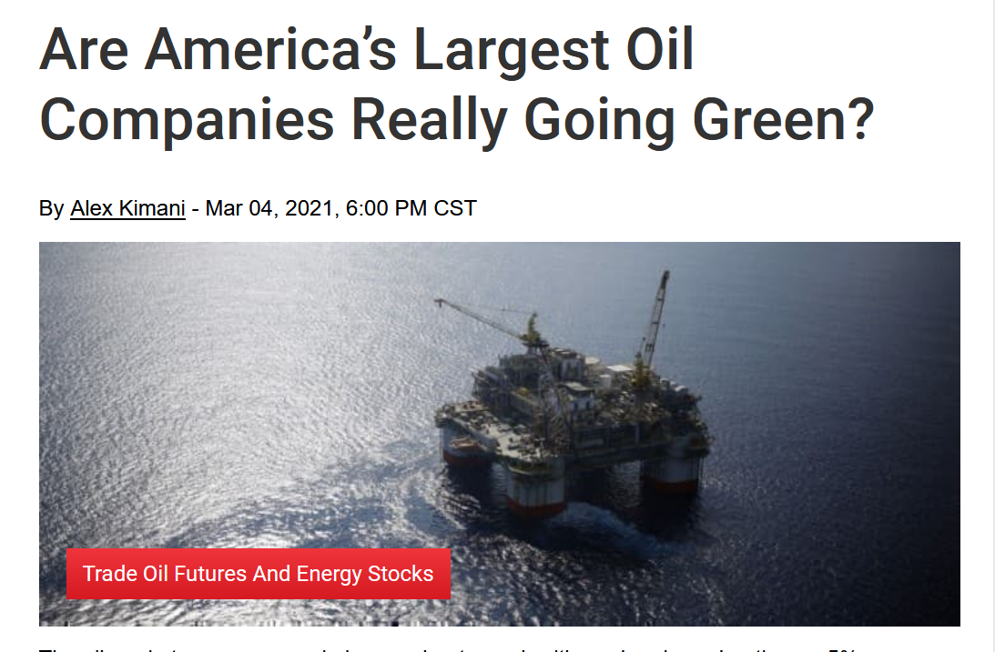
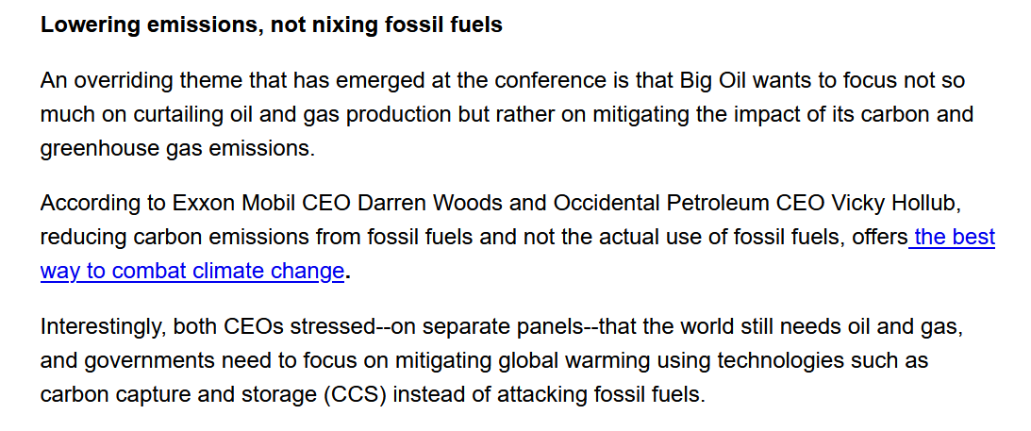
https://oilprice.com/Energy/Energy-General/Are-Americas-Largest-Oil-Companies-Really-Going-Green.html

Slide 38
Powerful actors in the private sector are concerned
Insurance
Finance
Auto makers

Slide 39
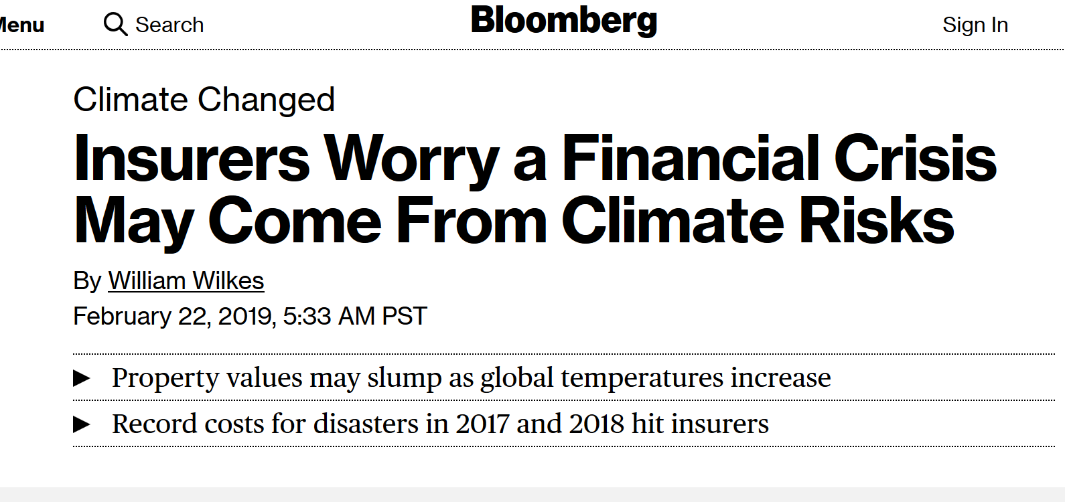

Slide 40
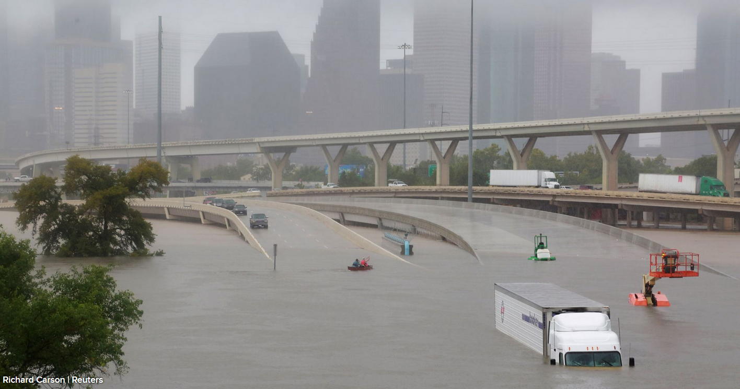
https://www.cnbc.com/2017/08/28/the-stunning-images-from-record-setting-flooding-in-houston-texas.html

Slide 41
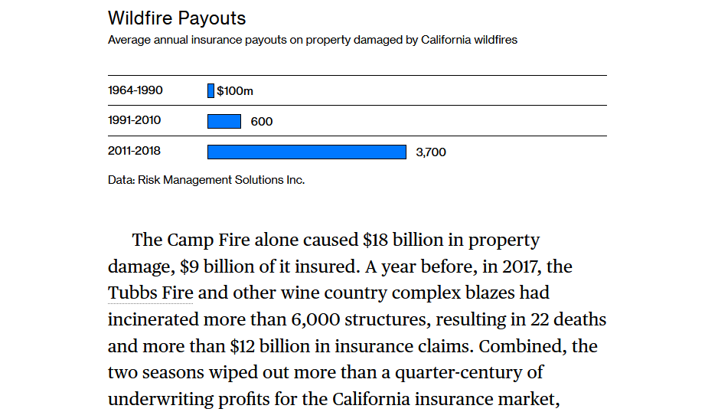
https://www.bloomberg.com/news/features/2020-11-10/wildfires-are-torching-california-s-insurance-industry-amid-climate-change

Slide 42
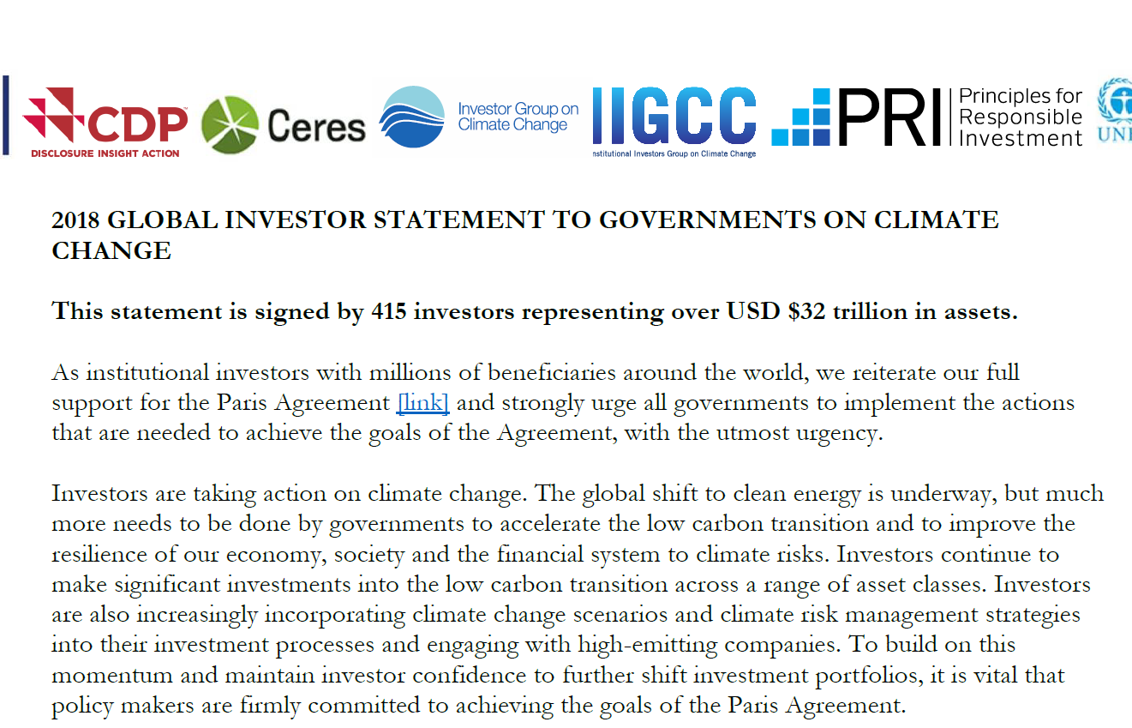
http://theinvestoragenda.org/wp-content/uploads/2018/12/GISGCC-FINAL-for-COP24-with-signatories_6-Dec-CORRECTION.pdf

Slide 43
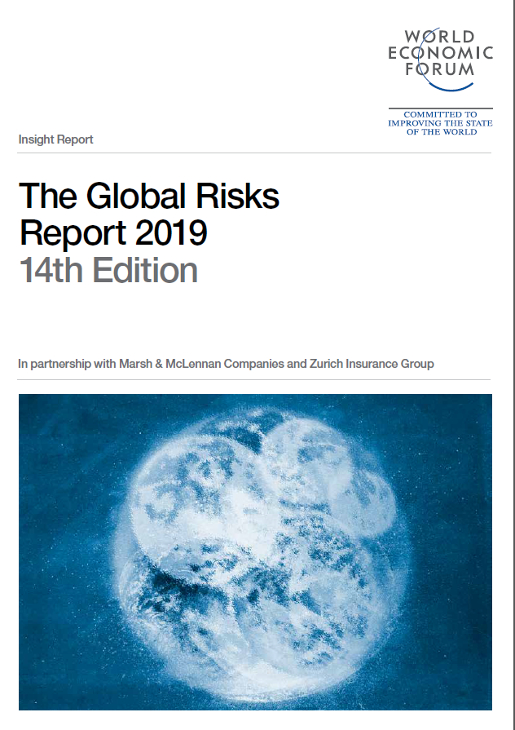

Slide 44
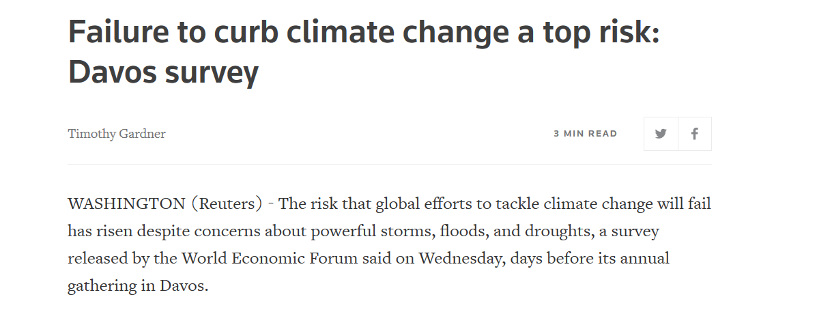
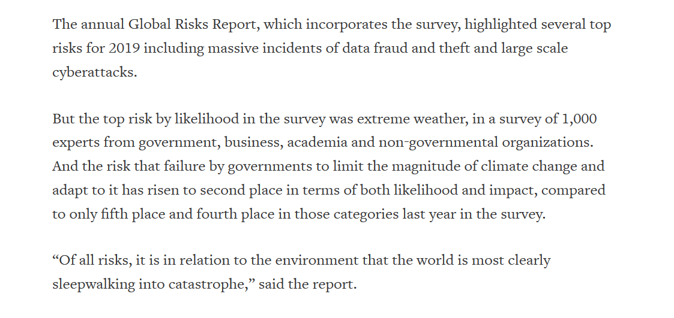
Reuters, January 16, 2019

Slide 45
Auto makers committed to making more electric cars
US: Ford, General Motors
Japan: Honda, Toyota, Nissan, Mazda, Mitsubishi
Germany: Volkswagen, BMW, Audi, Mercedes Benz South Korea: Hyundai, Kia

Slide 46
Societal responses to climate change
13 The science: discovery; communication; activism
14 Climate activism, the social movements
15 Climate denial, the counter-movement
16 Private sector actors, pro and con
17 Non-environmental “civil society” actors, pro and con
18 Traditional media – print (newspapers), network television
19 On line media – websites, blogs, social media
20 Public opinion
21 Policy – international; other nations
22 Policy – federal (US)
23 Policy – State, local (US)
24 Technological innovation (clean, renewable energy); green cities
25 “Plan B”: geoengineering

Slide 47
Social Movement Organizations

Slide 48
Religion; Faith Communities

Slide 49
Politically liberal religions:
The older, “mainline” Protestant Churches

Slide 50


Slide 51
Conservative Christian faiths
Evangelicals
Southern Baptists

Slide 52


Slide 53


Slide 54
Societal responses to climate change
13 The science: discovery; communication; activism
14 Climate activism, the social movements
15 Climate denial, the counter-movement
16 Private sector actors, pro and con
17 Non-environmental “civil society” actors, pro and con
18 Traditional media – print (newspapers), network television
19 On line media – websites, blogs, social media
20 Public opinion
21 Policy – international; other nations
22 Policy – federal (US)
23 Policy – State, local (US)
24 Technological innovation (clean, renewable energy); green cities
25 “Plan B”: geoengineering

Slide 55
Societal responses to climate change
13 The science: discovery; communication; activism
14 Climate activism, the social movements
15 Climate denial, the counter-movement
16 Private sector actors, pro and con
17 Non-environmental “civil society” actors, pro and con
18 Traditional media – print (newspapers), network television
19 On line media – websites, blogs, social media
20 Public opinion
21 Policy – international; other nations
22 Policy – federal (US)
23 Policy – State, local (US)
24 Technological innovation (clean, renewable energy); green cities
25 “Plan B”: geoengineering

Slide 56

Robert Brulle, personal communication

Slide 57


Slide 58
Societal responses to climate change
13 The science: discovery; communication; activism
14 Climate activism, the social movements
15 Climate denial, the counter-movement
16 Private sector actors, pro and con
17 Non-environmental “civil society” actors, pro and con
18 Traditional media – print (newspapers), network television
19 On line media – websites, blogs, social media
20 Public opinion
21 Policy – international; other nations
22 Policy – federal (US)
23 Policy – State, local (US)
24 Technological innovation (clean, renewable energy); green cities
25 “Plan B”: geoengineering

Slide 61




Slide 62


Slide 63


Slide 64


Slide 65
Societal responses to climate change
13 The science: discovery; communication; activism
14 Climate activism, the social movements
15 Climate denial, the counter-movement
16 Private sector actors, pro and con
17 Non-environmental “civil society” actors, pro and con
18 Traditional media – print (newspapers), network television
19 On line media – websites, blogs, social media
20 Public opinion
21 Policy – international; other nations
22 Policy – federal (US)
23 Policy – State, local (US)
24 Technological innovation (clean, renewable energy); green cities
25 “Plan B”: geoengineering

Slide 66

Gallup, March 25, 2019

Slide 67


Slide 68
Societal responses to climate change
13 The science: discovery; communication; activism
14 Climate activism, the social movements
15 Climate denial, the counter-movement
16 Private sector actors, pro and con
17 Non-environmental “civil society” actors, pro and con
18 Traditional media – print (newspapers), network television
19 On line media – websites, blogs, social media
20 Public opinion
21 Policy – international; other nations
22 Policy – federal (US)
23 Policy – State, local (US)
24 Technological innovation (clean, renewable energy); green cities
25 “Plan B”: geoengineering

Slide 69
Societal responses to climate change
13 The science: discovery; communication; activism
14 Climate activism, the social movements
15 Climate denial, the counter-movement
16 Private sector actors, pro and con
17 Non-environmental “civil society” actors, pro and con
18 Traditional media – print (newspapers), network television
19 On line media – websites, blogs, social media
20 Public opinion
21 Policy – international; other nations
22 Policy – federal (US)
23 Policy – State, local (US)
24 Technological innovation (clean, renewable energy); green cities
25 “Plan B”: geoengineering

Slide 70


Slide 71



Slide 72


Slide 73


Slide 74


Slide 75


Slide 76


Slide 77
Policy in other nations

Slide 78
Societal responses to climate change
13 The science: discovery; communication; activism
14 Climate activism, the social movements
15 Climate denial, the counter-movement
16 Private sector actors, pro and con
17 Non-environmental “civil society” actors, pro and con
18 Traditional media – print (newspapers), network television
19 On line media – websites, blogs, social media
20 Public opinion
21 Policy – international; other nations
22 Policy – federal (US)
23 Policy – State, local (US)
24 Technological innovation (clean, renewable energy); green cities
25 “Plan B”: geoengineering

Slide 79

CNNMoney.com

Slide 80


Slide 81


Slide 82



Slide 83
Societal responses to climate change
13 The science: discovery; communication; activism
14 Climate activism, the social movements
15 Climate denial, the counter-movement
16 Private sector actors, pro and con
17 Non-environmental “civil society” actors, pro and con
18 Traditional media – print (newspapers), network television
19 On line media – websites, blogs, social media
20 Public opinion
21 Policy – international; other nations
22 Policy – federal (US)
23 Policy – State, local (US)
24 Technological innovation (clean, renewable energy); green cities
25 “Plan B”: geoengineering

Slide 84
Commitment and Progress at the State level
“The United States Climate Alliance is a bipartisan coalition
of governors committed to reducing greenhouse gas emissions
consistent with the goals of the Paris Agreement.”
-- https://www.usclimatealliance.org/
Members: Governors of these States:
California Nevada
Colorado New Jersey
Connecticut New Mexico
Delaware New York
Hawaii North Carolina
Illinois Oregon
Maine Puerto Rico
Maryland Rhode Island
Massachusetts Vermont
Michigan Virginia
Minnesota Washington
Wisconsin

Slide 85
Commitment and Progress in American cities
“Across the U.S. over 90 cities … have adopted … 100% clean energy goals…”
:// -- https://www.sierraclub.org/ready-for-100/commitments
including some of the nation’s biggest cities:
Atlanta Portland
Chicago Salt Lake Citry
Cleveland San Diego
Denver San Francisco
Kansas City, MO San Jose
Minneapolis St. Louis
Pittsburgh St. Paul
“Numerous [other] U.S. cities have made public commitments to cut carbon and address climate change through initiatives like the Compact of Mayors, We Are Still In, or by establishing their own Climate Action Plans.”

Slide 86
Societal responses to climate change
13 The science: discovery; communication; activism
14 Climate activism, the social movements
15 Climate denial, the counter-movement
16 Private sector actors, pro and con
17 Non-environmental “civil society” actors, pro and con
18 Traditional media – print (newspapers), network television
19 On line media – websites, blogs, social media
20 Public opinion
21 Policy – international; other nations
22 Policy – federal (US)
23 Policy – State, local (US)
24 Technological innovation (clean, renewable energy); green cities
25 “Plan B”: geoengineering

Slide 87



Slide 88

https://www.nytimes.com/interactive/2021/05/28/climate/climate-wind-solar-energy-map.html

Slide 89

https://www.nytimes.com/interactive/2021/05/28/climate/climate-wind-solar-energy-map.html

Slide 90
Green, sustainable cities

Slide 91
Societal responses to climate change
13 The science: discovery; communication; activism
14 Climate activism, the social movements
15 Climate denial, the counter-movement
16 Private sector actors, pro and con
17 Non-environmental “civil society” actors, pro and con
18 Traditional media – print (newspapers), network television
19 On line media – websites, blogs, social media
20 Public opinion
21 Policy – international; other nations
22 Policy – federal (US)
23 Policy – State, local (US)
24 Technological innovation (clean, renewable energy); green cities
25 “Plan B”: geoengineering

Slide 92


Slide 96
Positive Developments
The work of the scientists
The continuing rise of climate activism
Powerful private sector actors
Activism in important faith communities
Increasing coverage in traditional media
Positive trends in public opinion
Nations implementing international agreements
Policy in the states and cities
Innovations in clean energy, green technology

