Slide 1
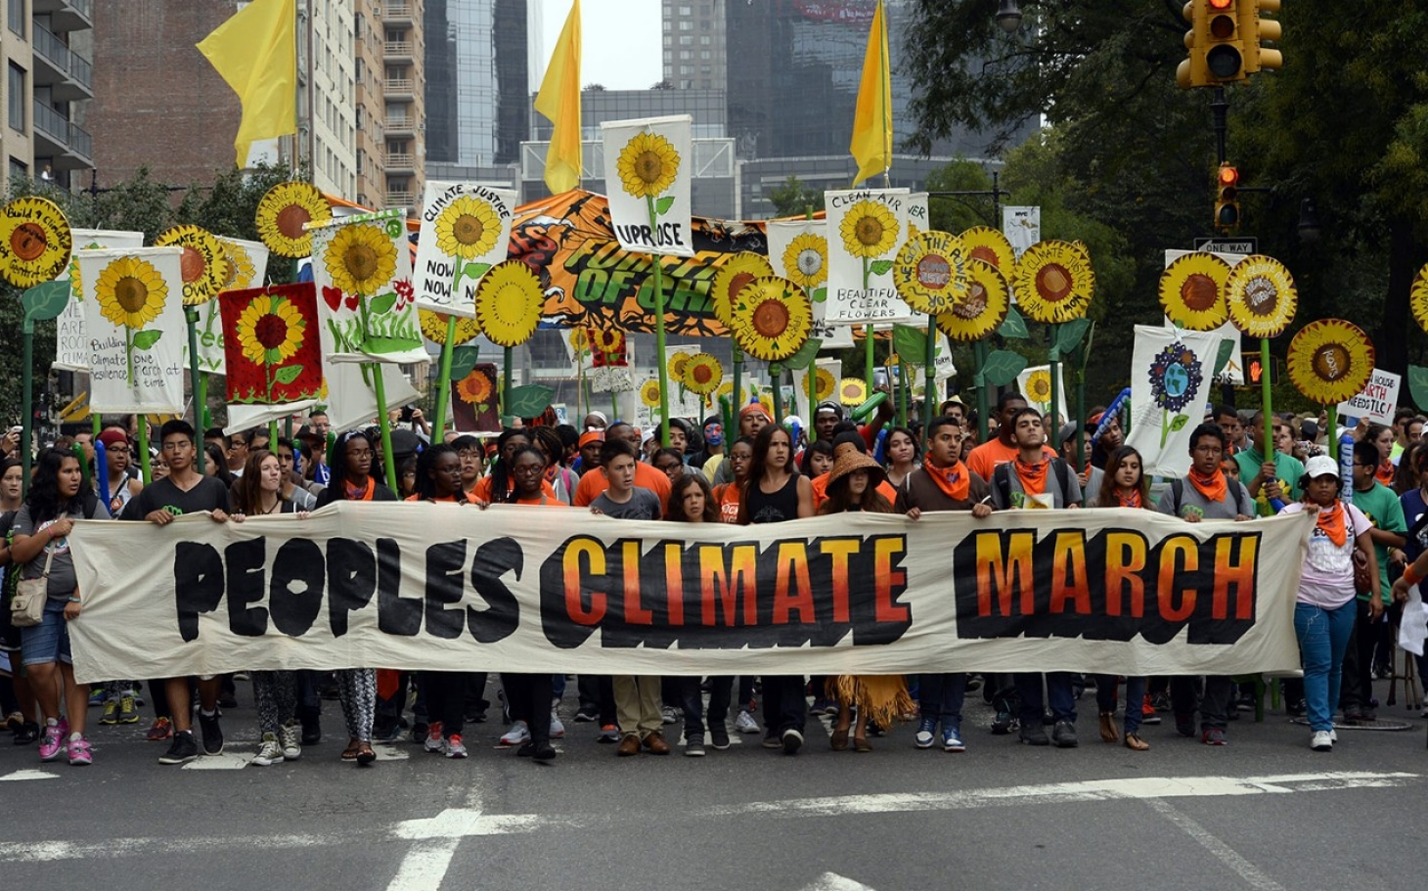
A Sociology of Climate Change: Introduction

Slide 2
What is
“A Sociology of Climate Change”?

Slide 3
A Sociology of Climate Change
Consists of three different, distinct inquiries
1 What are the social causes of, or drivers of, climate change?
2 What are the impacts of climate change on society?
3 How has society been responding to the climate threat?

Slide 4
Society
Climate Change

Slide 5
Causes
Society
Climate Change

Slide 6
Society
Climate Change
Impacts

Slide 7
Responses
Society
Climate Change

Slide 8
The Sociology of Climate Change
Societal causes of, or drivers of, climate change
1 Causes – in the “green” updating of Classical Theory
2 Causes – in today’s Environmental Sociology literature
Climate impacts on society
3 Extreme weather events
4 Food
5 Water
6 Health and Illness
7 Economic impacts, at the level of the nation (U.S.)
8 Political impacts
9 Unequal impacts, globally, among nations
10 Unequal impacts, in the U.S., by State and by region
11 Unequal impacts, in the U.S., by race and class
12 The potential for catastrophic impacts
Societal responses to climate change
13 The science: discovery; communication; activism
14 Climate activism, the social movements
15 Climate denial, the counter-movement
16 Private sector actors, pro and con
17 Non-environmental “civil society” actors, pro and con
18 Traditional media – print (newspapers), network television
19 On line media – websites, blogs, social media
20 Public opinion
21 Policy – international; other nations
22 Policy – federal (US)
23 Policy – State, local (US)
24 Technological innovation (clean, renewable energy); green cities
25 “Plan B”: geoengineering

