Slide 1
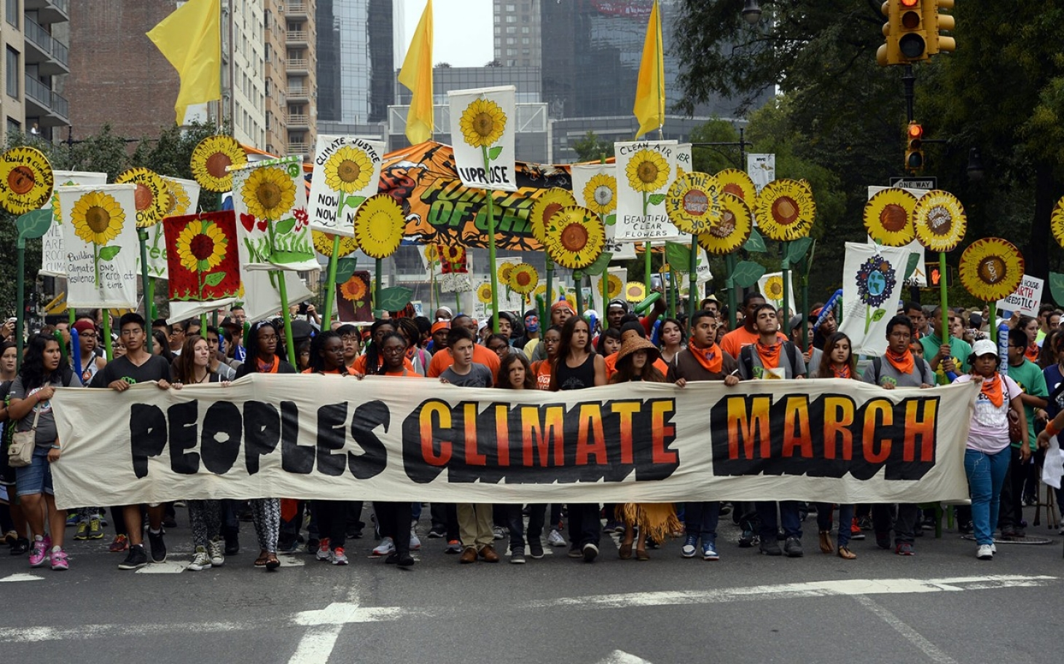


Slide 2
Society
Climate Change
Impacts

Slide 3
Climate impacts on society
3 Extreme weather events
4 Food
5 Water
6 Health and Illness
7 Economic impacts, at the level of the nation (U.S.)
8 Political impacts
9 Unequal impacts, globally, among nations
10 Unequal impacts, in the U.S., by State and by region
11 Unequal impacts, in the U.S., by race and class
12 The potential for catastrophic impacts

Slide 4
Climate impacts on society
3 Extreme weather events
4 Food
5 Water
6 Health and Illness
7 Economic impacts, at the level of the nation (U.S.)
8 Political impacts
9 Unequal impacts, globally, among nations
10 Unequal impacts, in the U.S., by State and by region
11 Unequal impacts, in the U.S., by race and class
12 The potential for catastrophic impacts

Slide 5
Extreme weather events
Higher temperatures
Drought
Wildfire
Heavy rains
Flooding
More powerful hurricanes

Slide 6
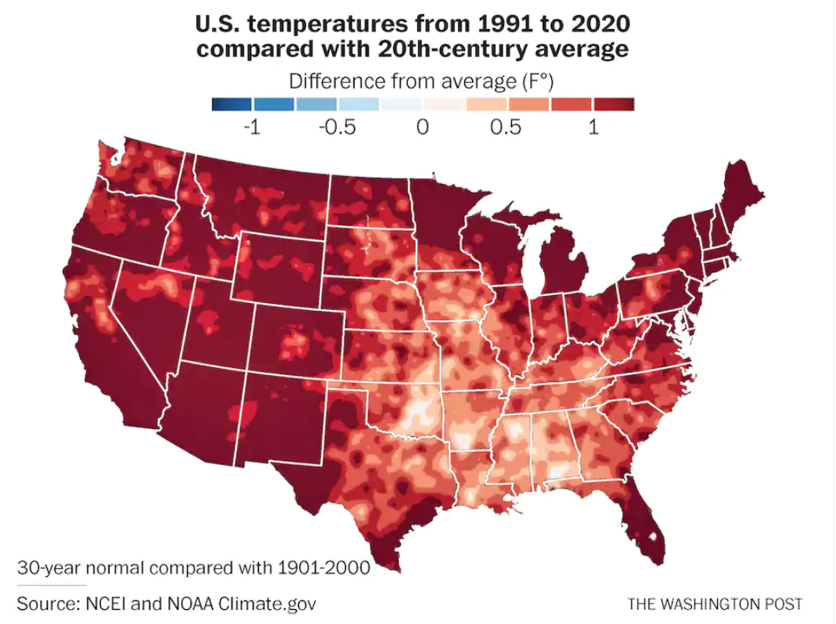

Slide 7
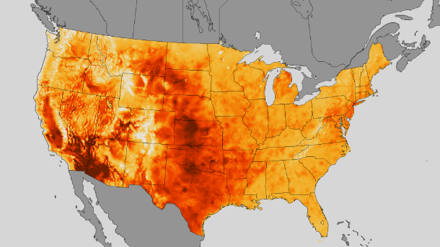
https://www.climatecentral.org/blogs/mid-july-heat-wave-bakes-the-us-from-coast-to-coast-16276

Slide 8
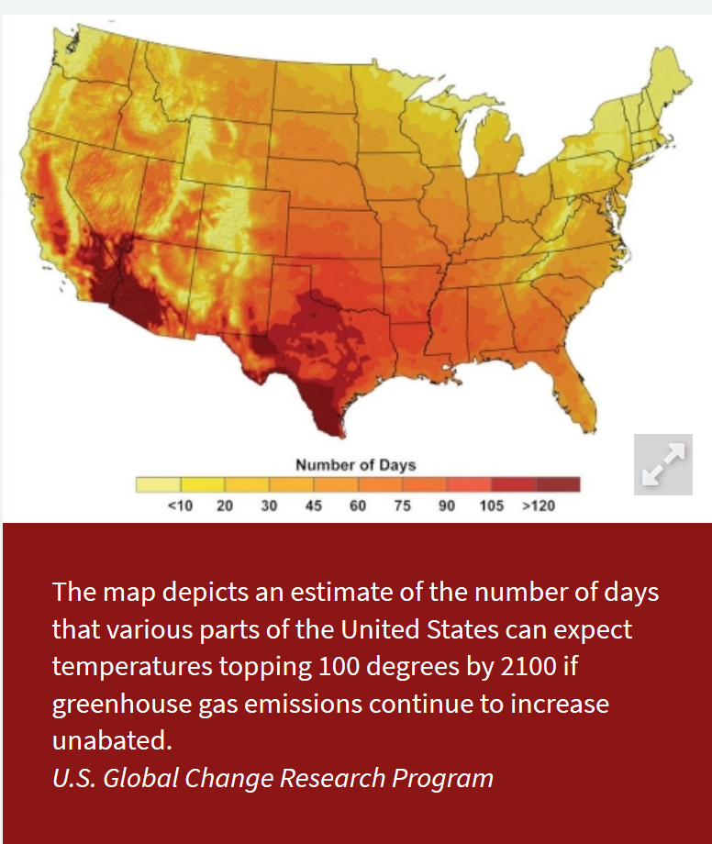

Slide 9
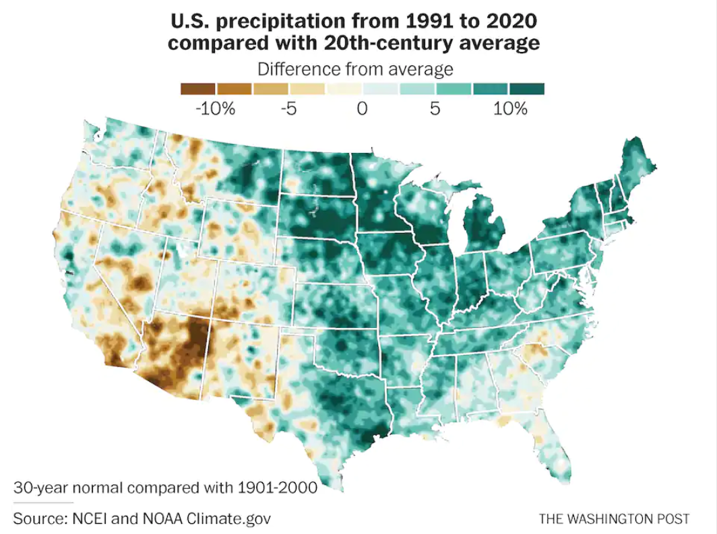
https://www.washingtonpost.com/weather/2021/05/04/noaa-new-climate-normals/

Slide 10
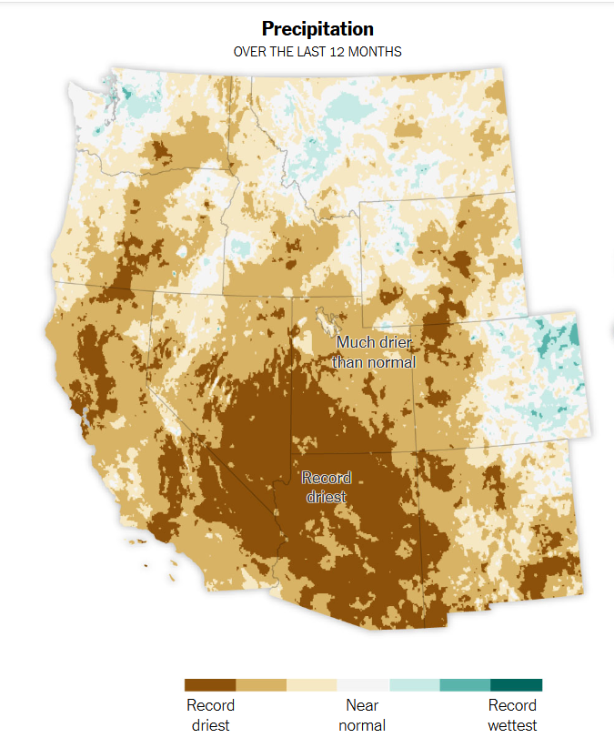
Source: PRISM via the West Wide Drought Tracker
New York Times, June 11, 2021

Slide 11
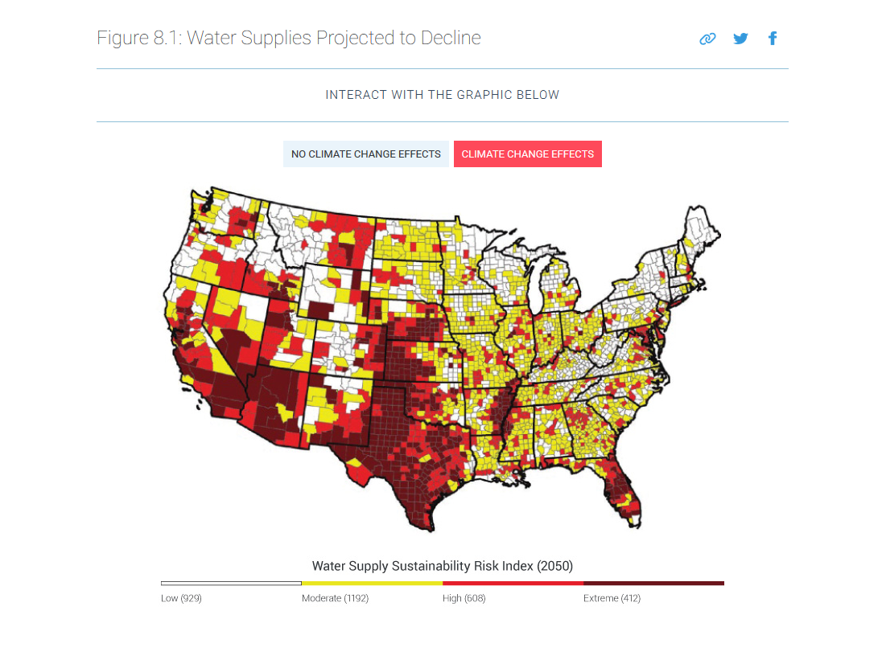

Slide 12
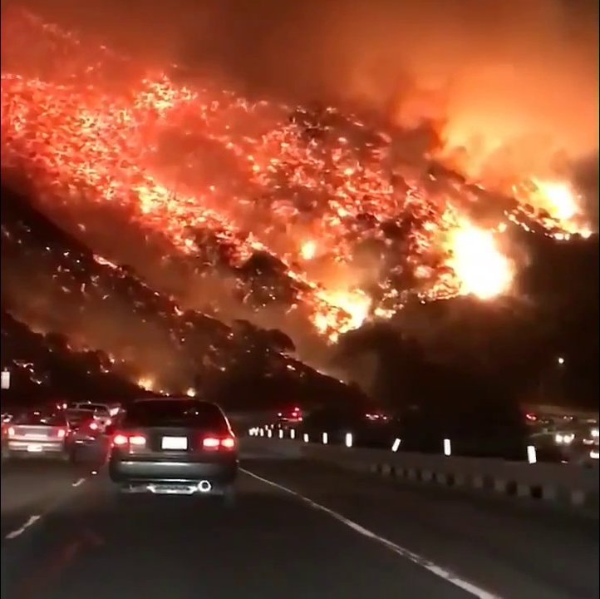

Slide 13
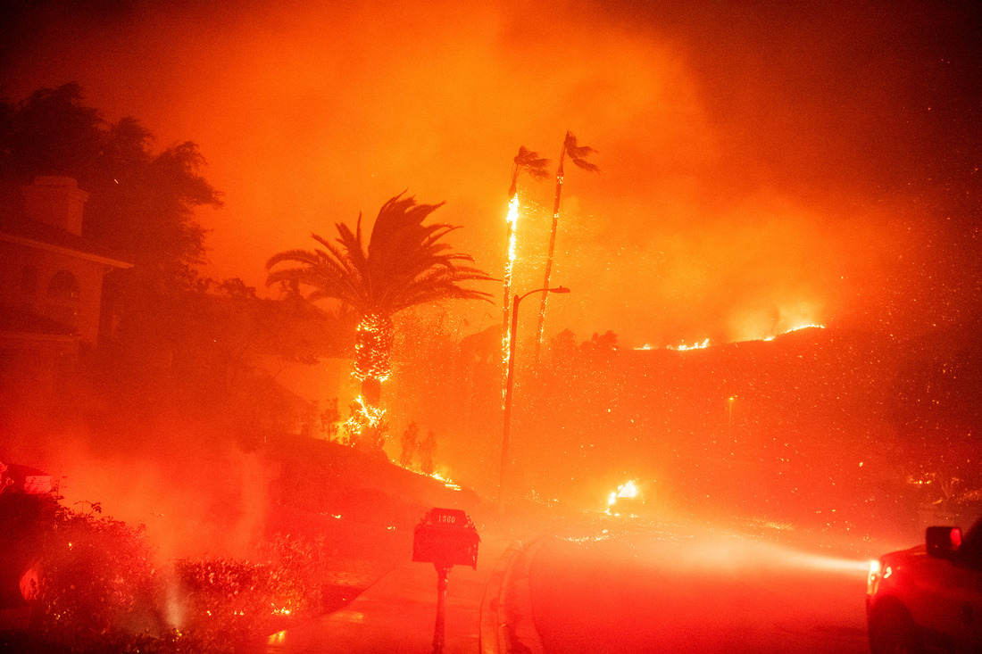

Slide 14
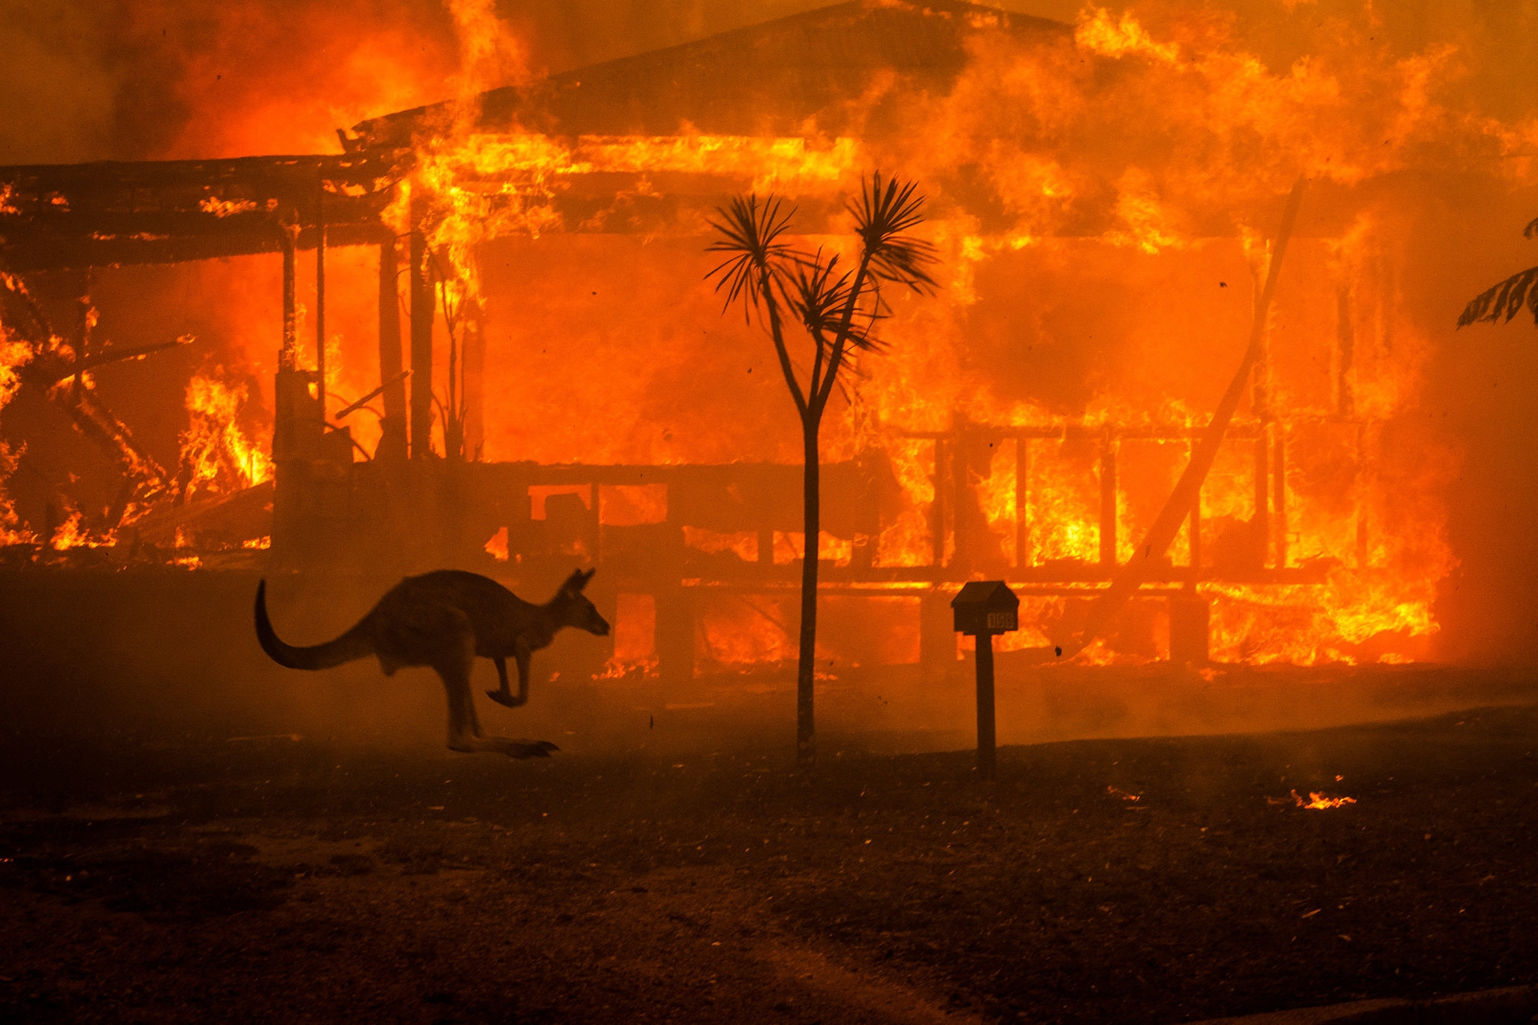

Slide 15
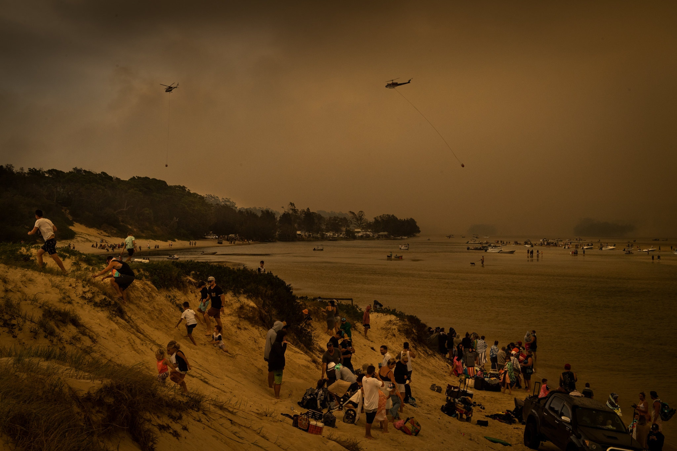

Slide 16
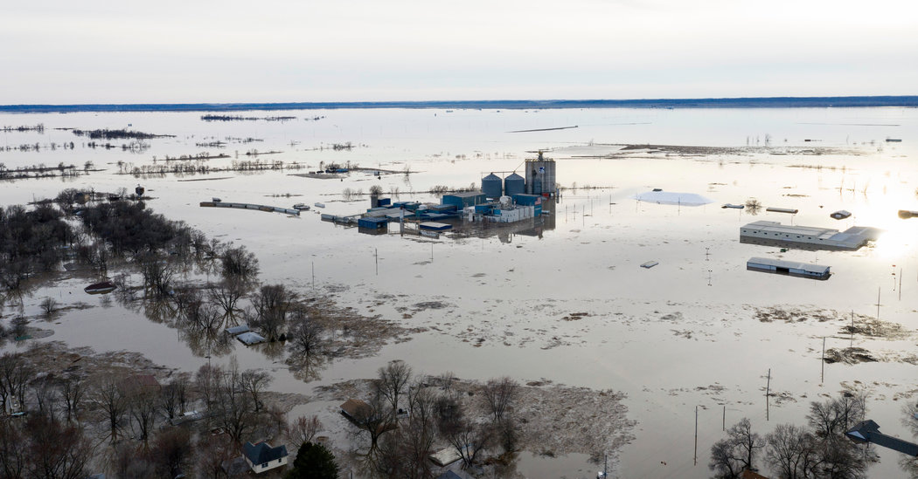

Slide 17
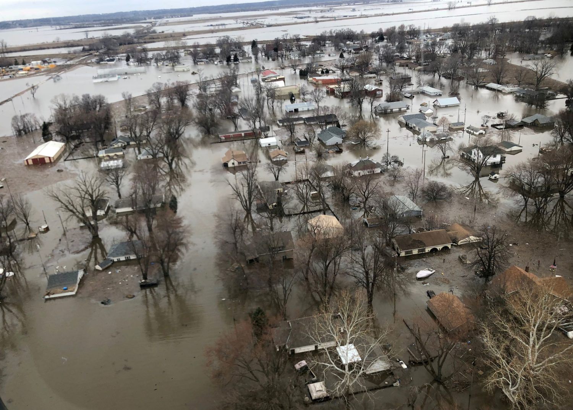

Slide 18
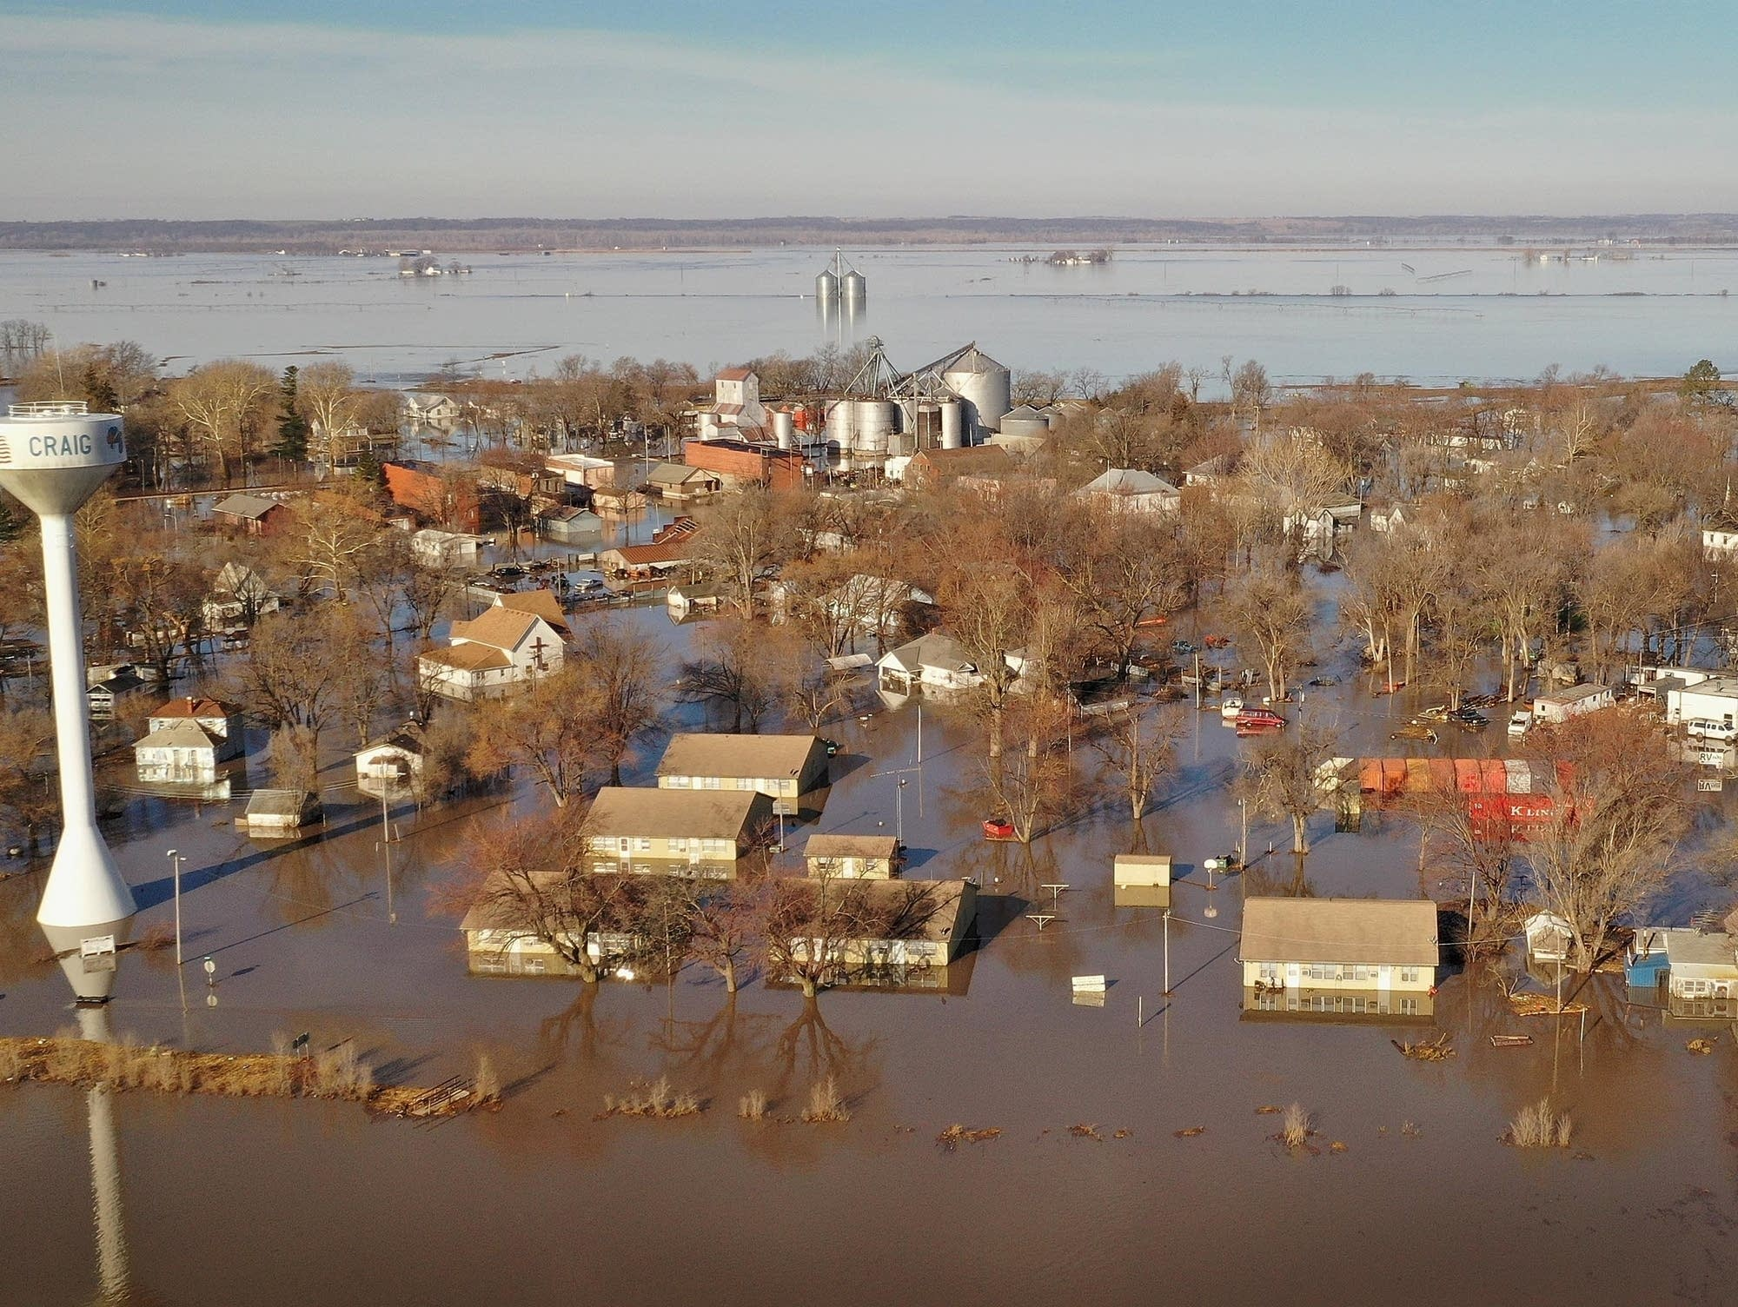

Slide 19
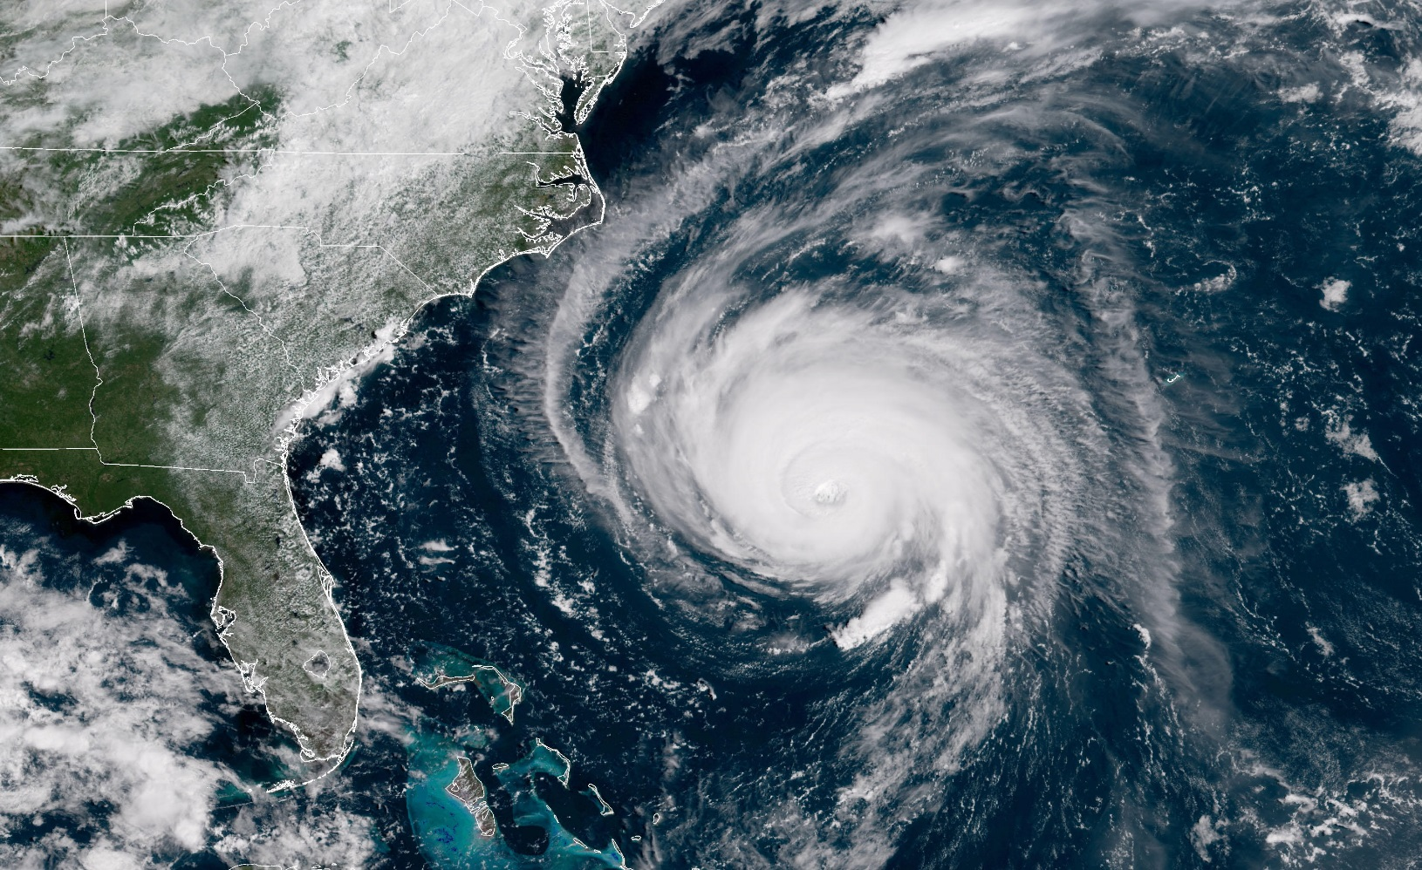

Slide 20
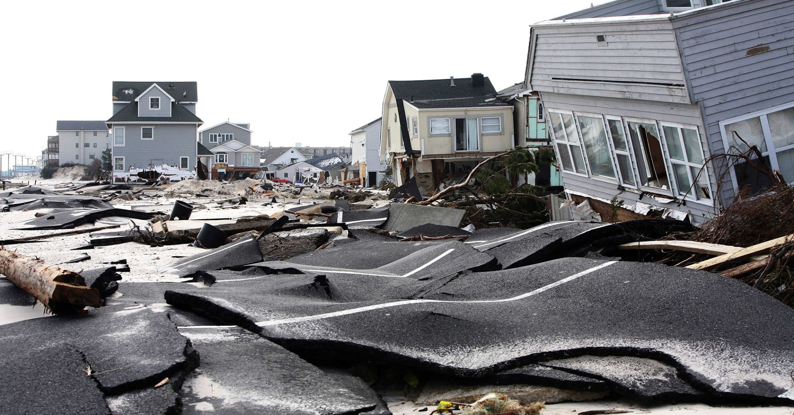
https://www.theatlantic.com/photo/2012/11/hurricane-sandy-the-long-recovery/100405/
Reuters/Tim Larsen/Governor's Office

Slide 21
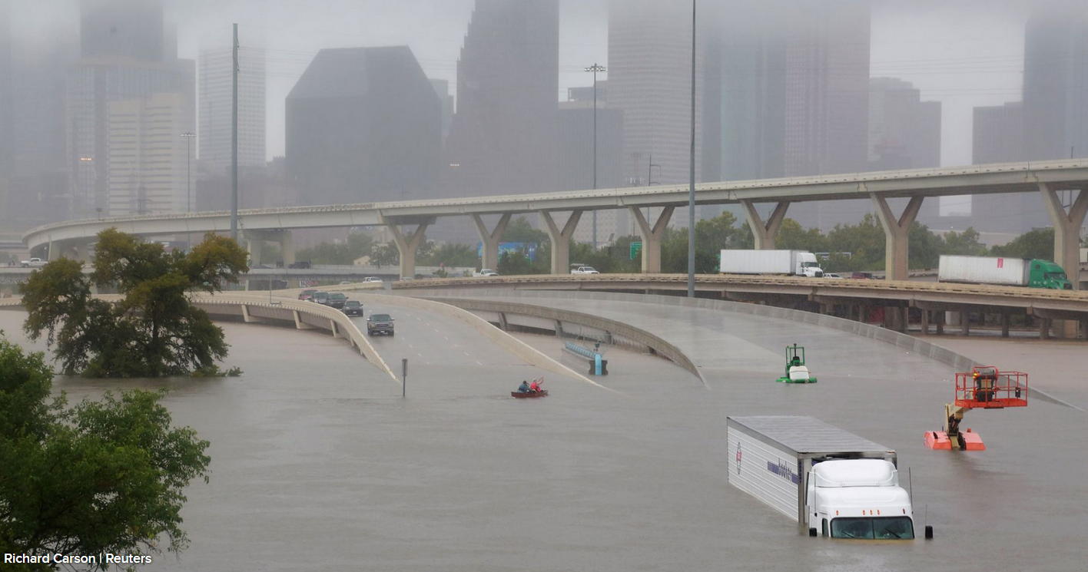
https://www.cnbc.com/2017/08/28/the-stunning-images-from-record-setting-flooding-in-houston-texas.html

Slide 22
Some consequences of extreme weather events:
disrupts agriculture, decreasing food supplies
pollutes water supplies
disrupts the local economy …

Slide 23
Climate impacts on society
3 Extreme weather events
4 Food
5 Water
6 Health and Illness
7 Economic impacts, at the level of the nation (U.S.)
8 Political impacts
9 Unequal impacts, globally, among nations
10 Unequal impacts, in the U.S., by State and by region
11 Unequal impacts, in the U.S., by race and class
12 The potential for catastrophic impacts

Slide 24
Climate impacts on society
3 Extreme weather events
4 Food
5 Water
6 Health and Illness
7 Economic impacts, at the level of the nation (U.S.)
8 Political impacts
9 Unequal impacts, globally, among nations
10 Unequal impacts, in the U.S., by State and by region
11 Unequal impacts, in the U.S., by race and class
12 The potential for catastrophic impacts

Slide 25
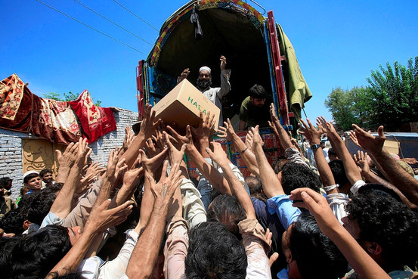
Reuters

Slide 26
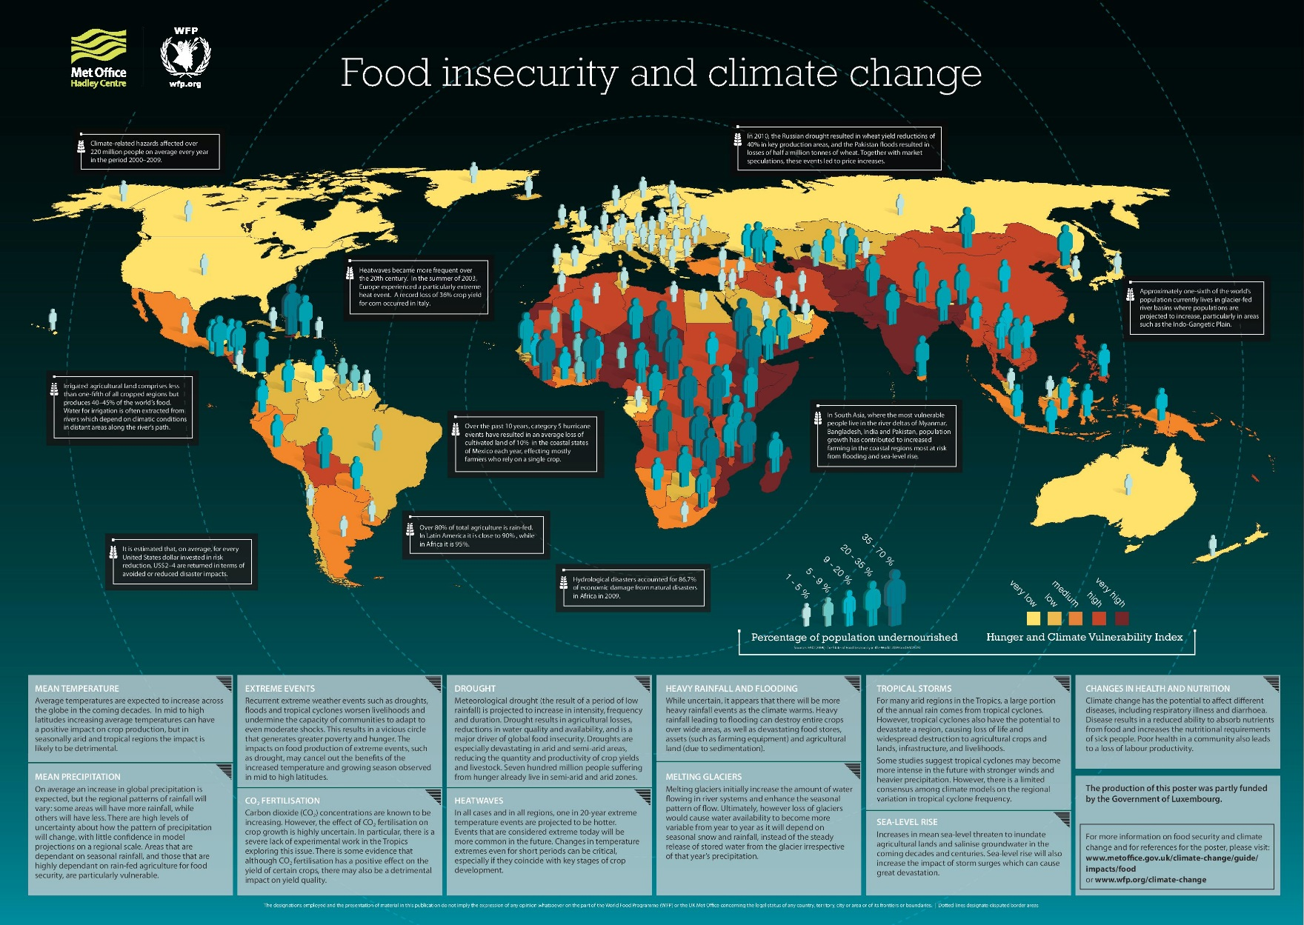
http://documents.wfp.org/stellent/groups/public/documents/newsroom/wfp229182.pdf

Slide 27
Climate impacts on society
3 Extreme weather events
4 Food
5 Water
6 Health and Illness
7 Economic impacts, at the level of the nation (U.S.)
8 Political impacts
9 Unequal impacts, globally, among nations
10 Unequal impacts, in the U.S., by State and by region
11 Unequal impacts, in the U.S., by race and class
12 The potential for catastrophic impacts

Slide 28
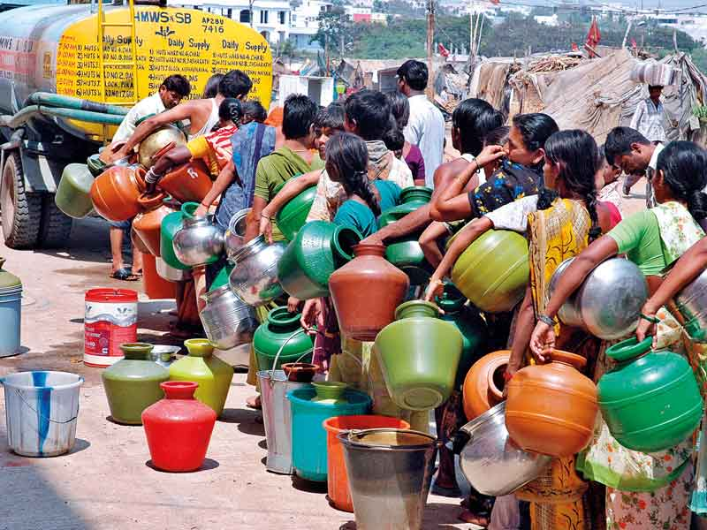

Slide 29
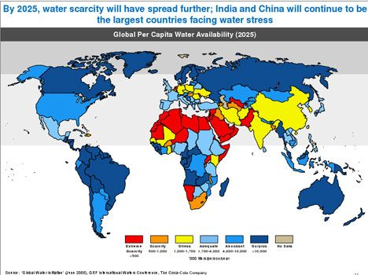

Slide 30
Climate impacts on society
3 Extreme weather events
4 Food
5 Water
6 Health and Illness
7 Economic impacts, at the level of the nation (U.S.)
8 Political impacts
9 Unequal impacts, globally, among nations
10 Unequal impacts, in the U.S., by State and by region
11 Unequal impacts, in the U.S., by race and class
12 The potential for catastrophic impacts

Slide 31
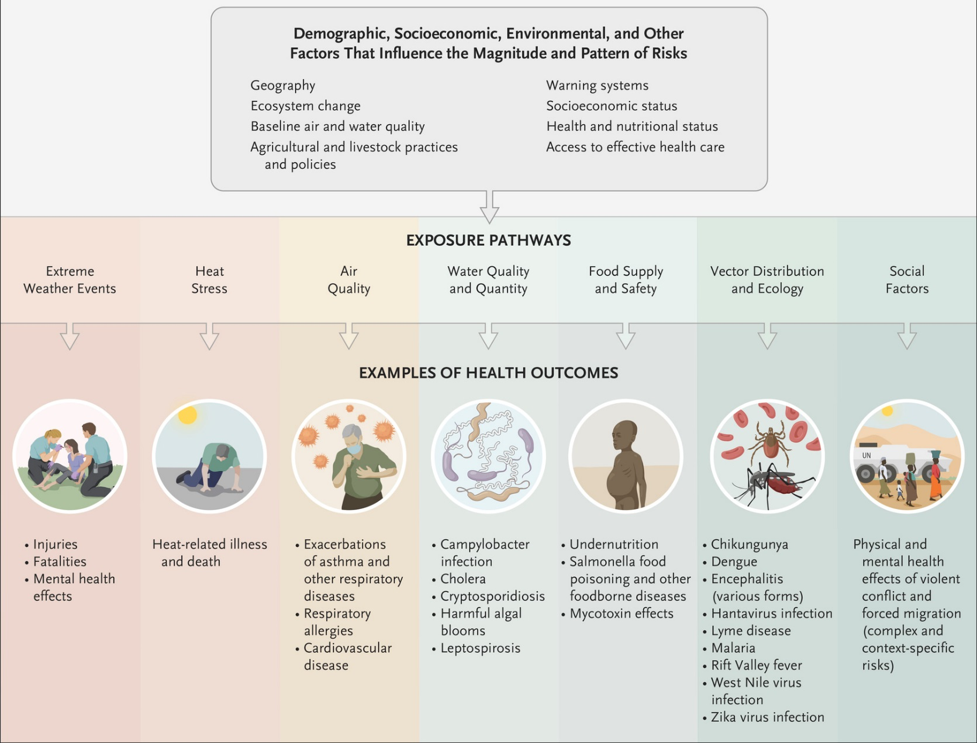
A Haines and K Ebi, “The Imperative for Climate Action to Protect Health,”
New England Journal of Medicine, 380:263-273, Jan 17, 2019

Slide 32
Climate impacts on society
3 Extreme weather events
4 Food
5 Water
6 Health and Illness
7 Economic impacts, at the level of the nation (U.S.)
8 Political impacts
9 Unequal impacts, globally, among nations
10 Unequal impacts, in the U.S., by State and by region
11 Unequal impacts, in the U.S., by race and class
12 The potential for catastrophic impacts

Slide 33
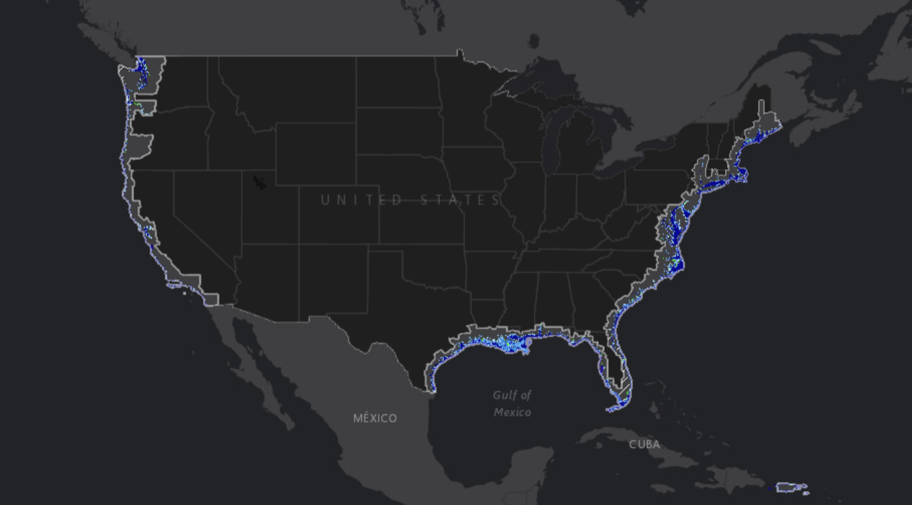
U.S. coast after sea level rise of 2 ft.
(https://coast.noaa.gov/slr/#/layer/slr)

Slide 34
Major US coastal cities – at risk from sea level rise
East Coast
Boston
New York City
Philadelphia
Washington, DC
Jacksonville
Gulf Coast
Houston
New Orleans
West Coast
San Diego
Los Angeles
San Francisco
Portland
Seattle

Slide 35
Climate impacts on society
3 Extreme weather events
4 Food
5 Water
6 Health and Illness
7 Economic impacts, at the level of the nation (U.S.)
8 Political impacts
9 Unequal impacts, globally, among nations
10 Unequal impacts, in the U.S., by State and by region
11 Unequal impacts, in the U.S., by race and class
12 The potential for catastrophic impacts

Slide 36
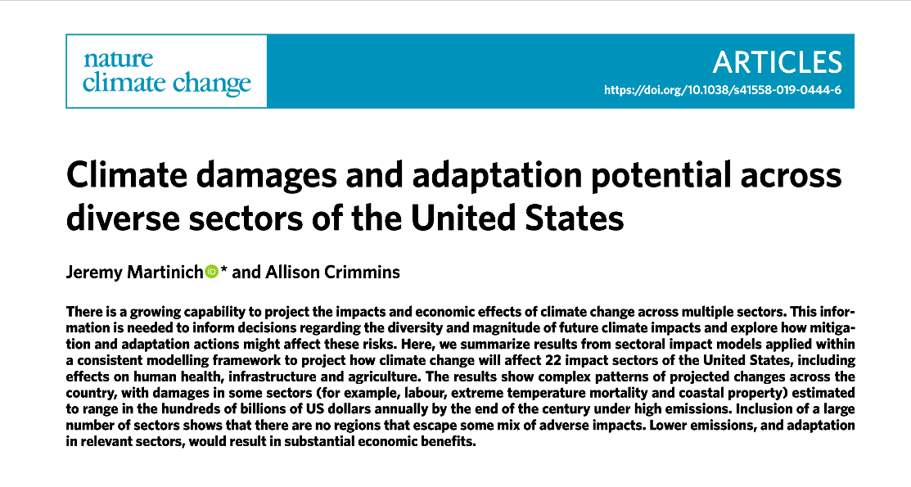
Nature climate change, April 8, 2019

Slide 37
“Global economic damages of climate change are projected to be … in 2100 for 1.5°C and 2°C … $54 and $69 trillion, respectively, relative to 1961–1990”
IPCC, “Special Report on Global Warming of 1.5 ºC,” 2018:264 (https://www.ipcc.ch/sr15/)

Slide 38
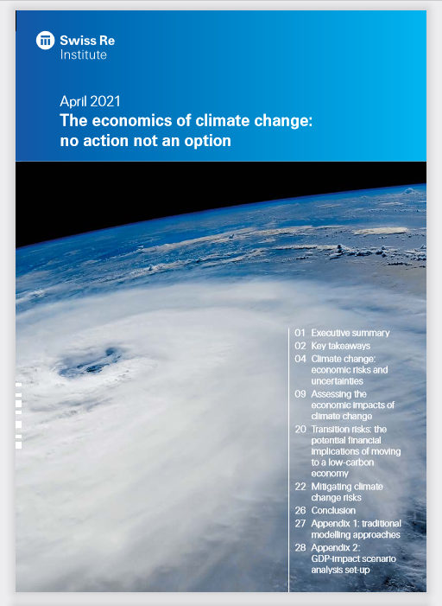

Slide 39
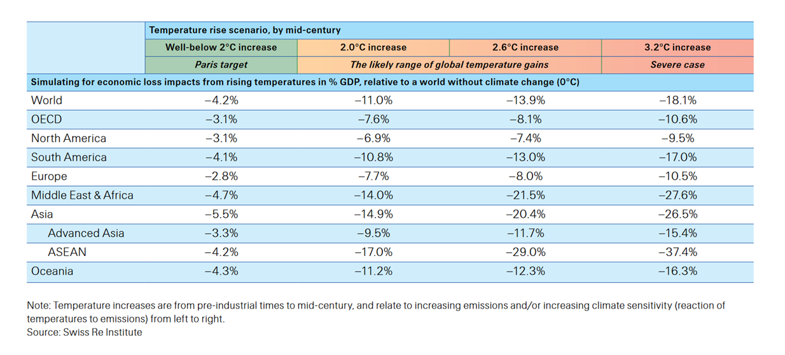

Slide 40
Climate impacts on society
3 Extreme weather events
4 Food
5 Water
6 Health and Illness
7 Economic impacts, at the level of the nation (U.S.)
8 Political impacts
9 Unequal impacts, globally, among nations
10 Unequal impacts, in the U.S., by State and by region
11 Unequal impacts, in the U.S., by race and class
12 The potential for catastrophic impacts

Slide 41
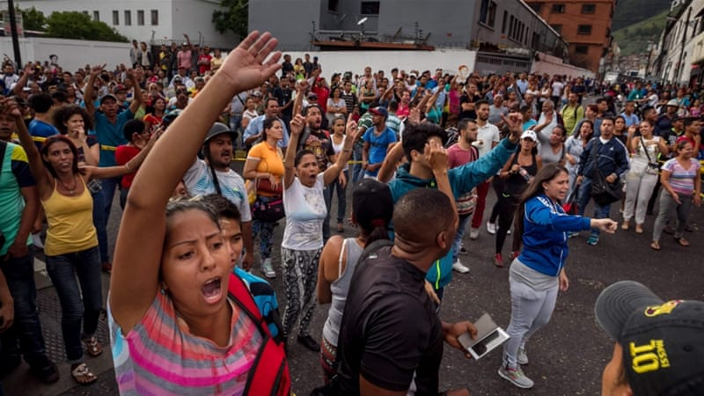

Slide 42
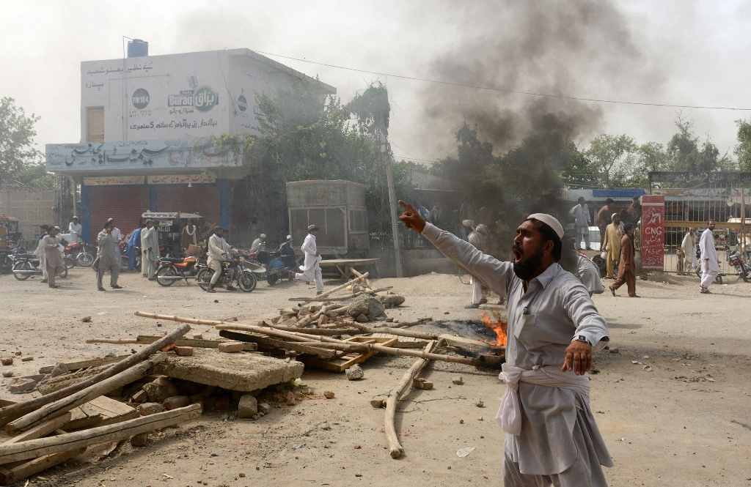
https://tribune.com.pk/story/726279/zarb-e-azb-operation-idps-protest-food-shortage/

Slide 43
“climate change … [will] seriously exacerbate already marginal living standards in many Asian, African, and Middle Eastern nations, causing widespread political instability ... foster[ing] the conditions for internal conflicts, … Climate change acts as a threat multiplier for instability in some of the most volatile regions of the world.”
-- “National Security and the Threat of Climate Change,” CNA Corporation, 2007

Slide 44
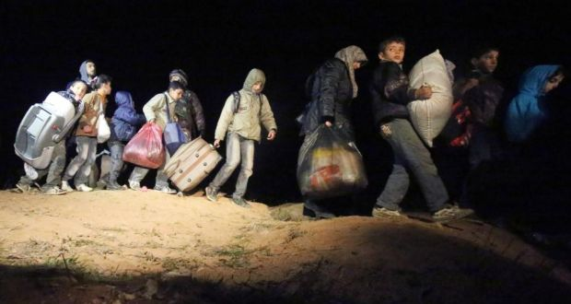
https://www.theguardian.com/global-development/2015/mar/11/syrian-refugees-asylum-seekers-unhcr

Slide 45
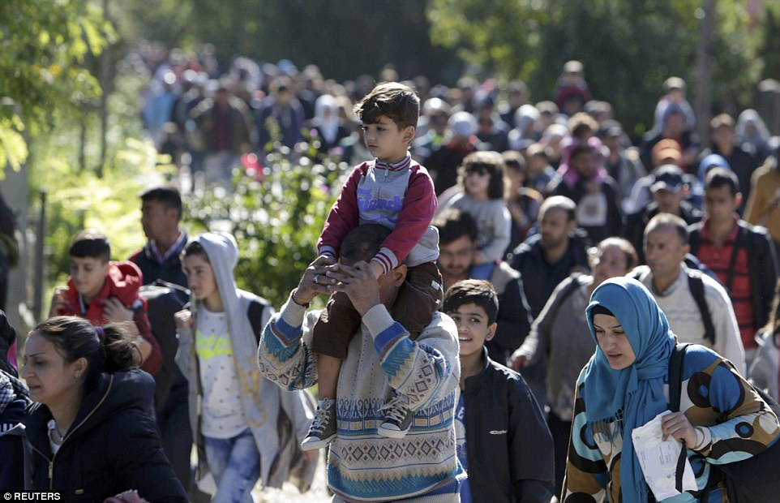
Reuters

Slide 46
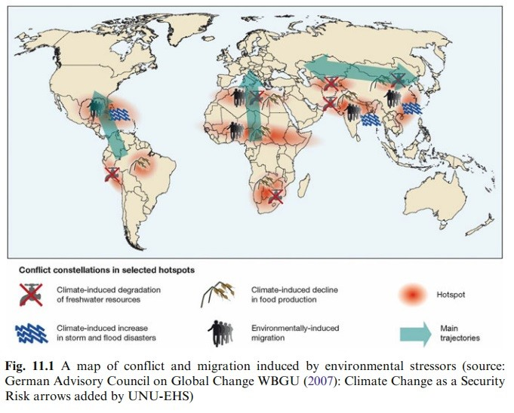

Slide 47
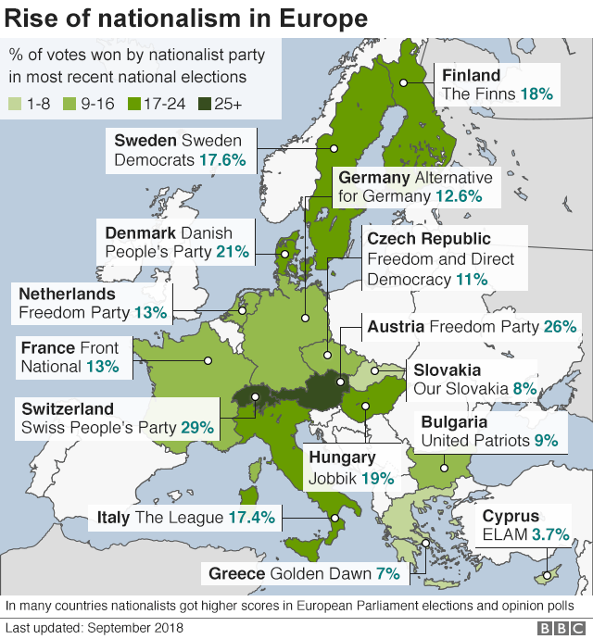

Slide 48

https://www.aljazeera.com/investigations/generationhate/

Slide 49
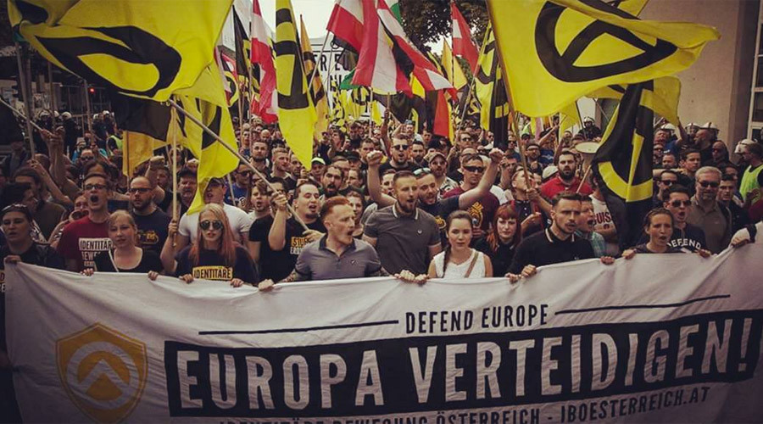
https://www.express.co.uk/news/world/679744/Far-right-Austria-anti-migrant-march

Slide 50
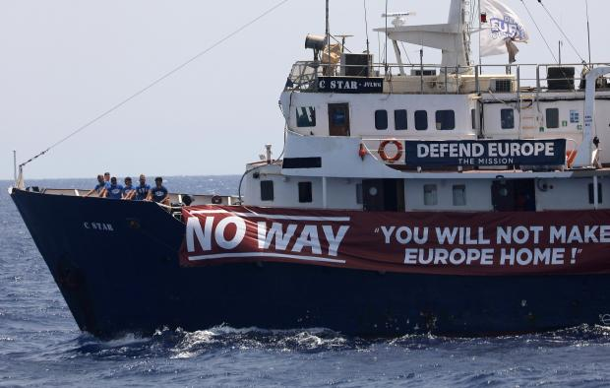
https://www.timesofmalta.com/articles/view/20170819/local/denied-cooperation-anti-migrant-ship-lashes-out-at-malta.655976

Slide 51
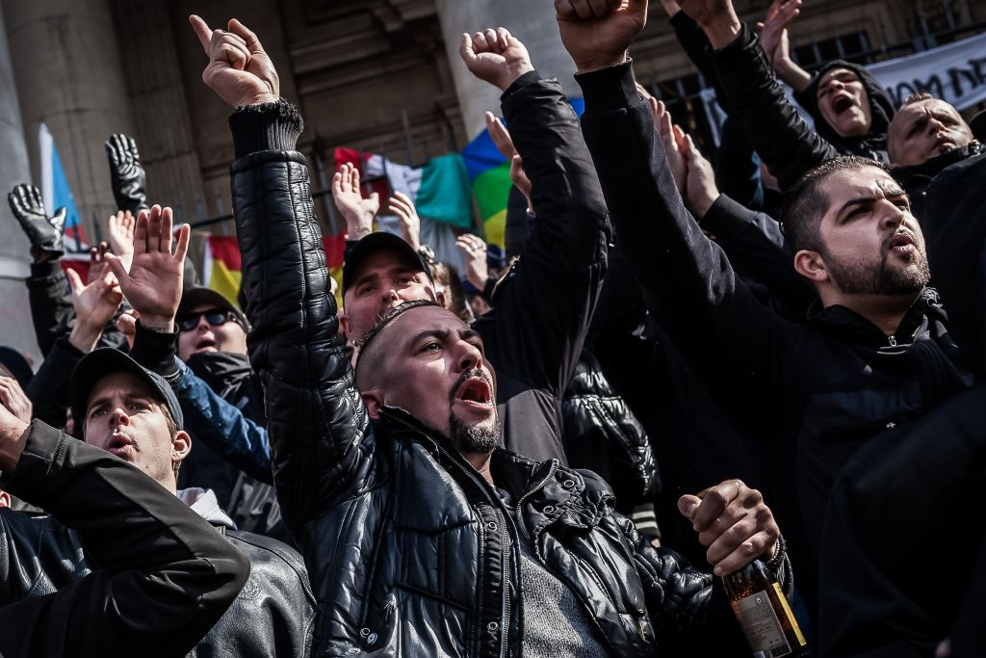

Slide 52
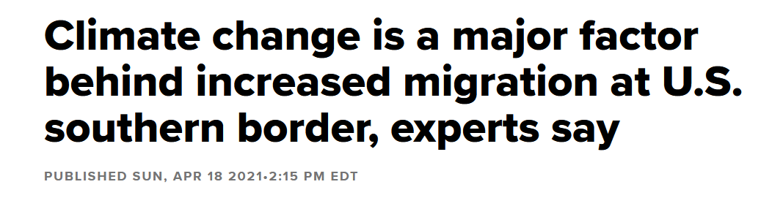
https://www.cnbc.com/2021/04/18/us-mexico-border-climate-change-factor-behind-increased-migration.html

Slide 53
Multiple, simultaneous impacts
Impacts can trigger other impacts

Slide 54
Some consequences of extreme weather events:
disrupts agriculture, decreasing food supplies
pollutes water supplies
disrupts the local economy …

Slide 55
decreased food supply → hunger → protest → political instability

Slide 56
decrease in availability of water → political conflict

Slide 57
Source: PRISM via the West Wide Drought Tracker
New York Times, June 11, 2021

Slide 58
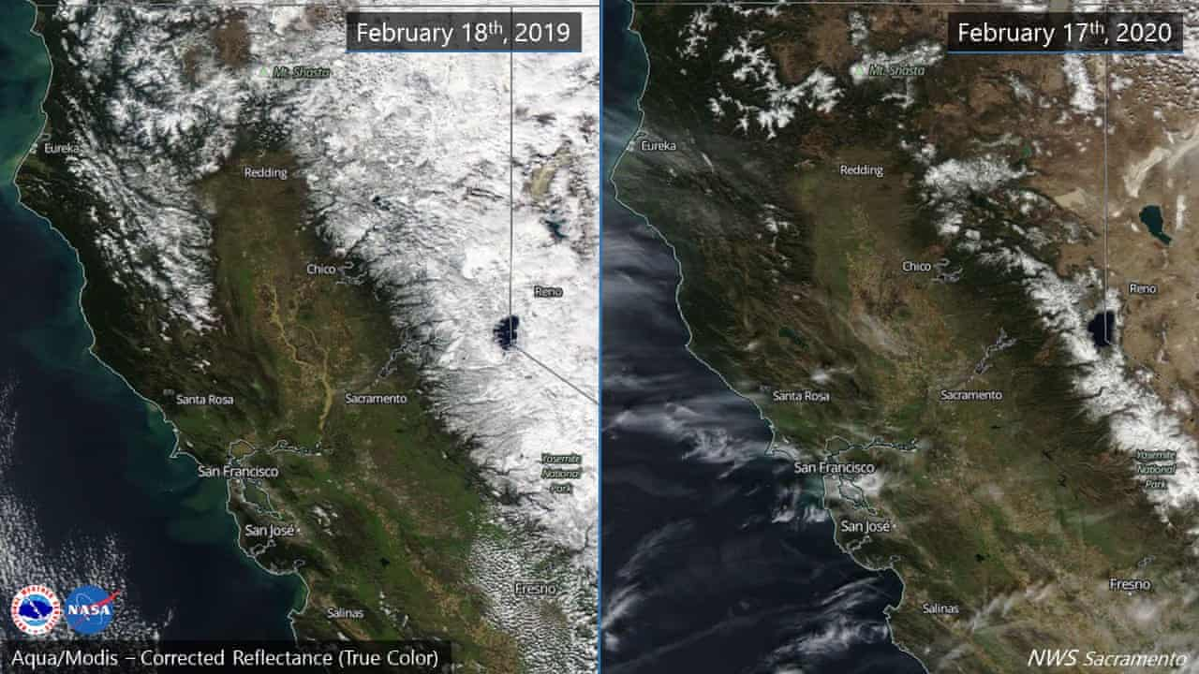

Slide 59
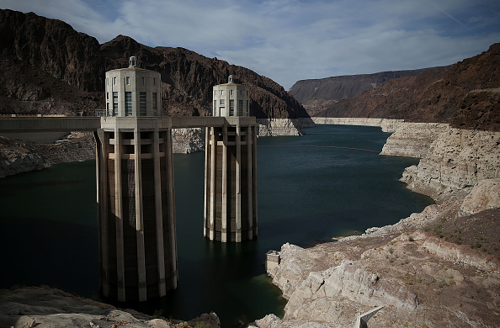

Slide 60
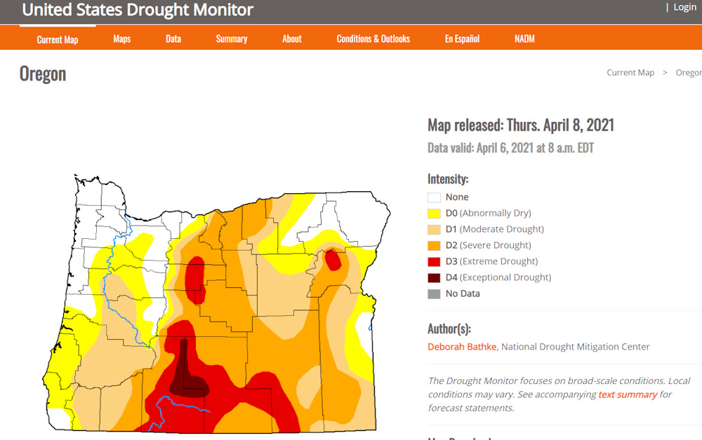

Slide 61
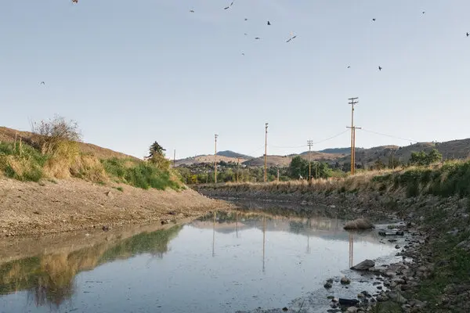

Slide 62
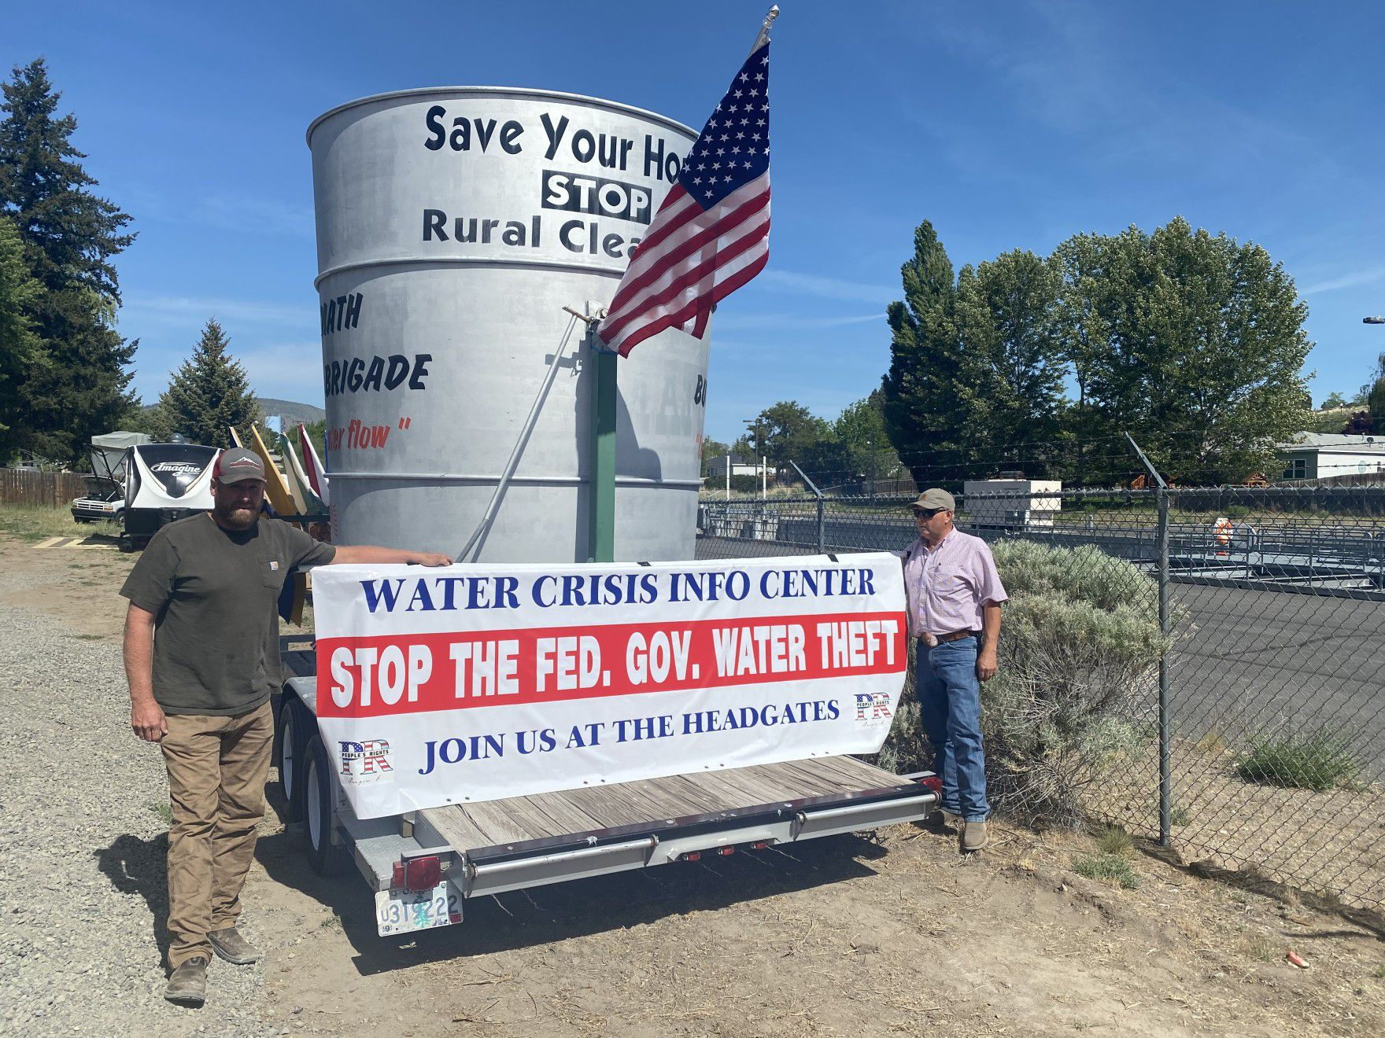

Slide 63
Climate impacts on society
3 Extreme weather events
4 Food
5 Water
6 Health and Illness
7 Economic impacts, at the level of the nation (U.S.)
8 Political impacts
9 Unequal impacts, globally, among nations
10 Unequal impacts, in the U.S., by State and by region
11 Unequal impacts, in the U.S., by race and class
12 The potential for catastrophic impacts

Slide 64
Climate impacts on society
3 Extreme weather events
4 Food
5 Water
6 Health and Illness
7 Economic impacts, at the level of the nation (U.S.)
8 Political impacts
9 Unequal impacts, globally, among nations
10 Unequal impacts, in the U.S., by State and by region
11 Unequal impacts, in the U.S., by race and class
12 The potential for catastrophic impacts

Slide 65
http://documents.wfp.org/stellent/groups/public/documents/newsroom/wfp229182.pdf

Slide 68
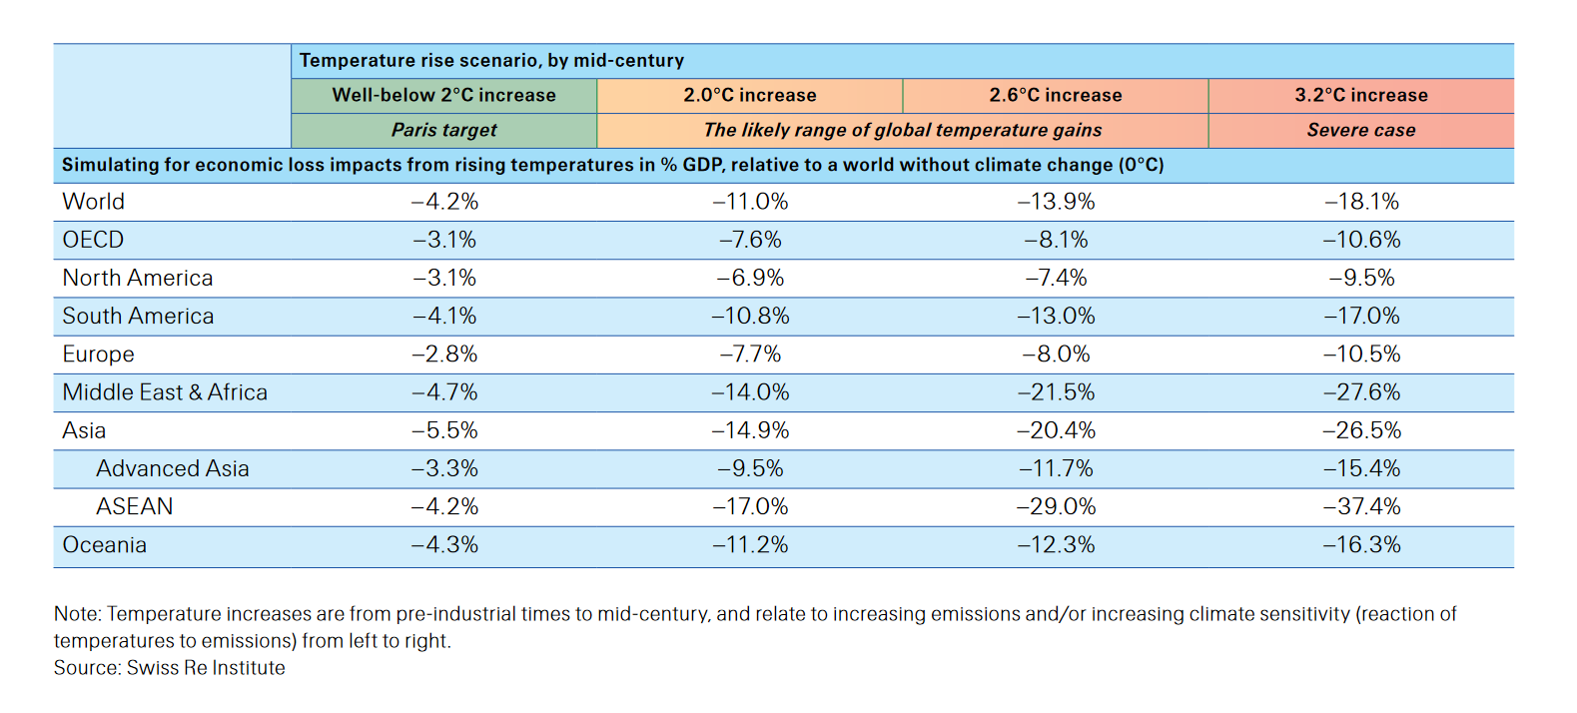

Slide 69
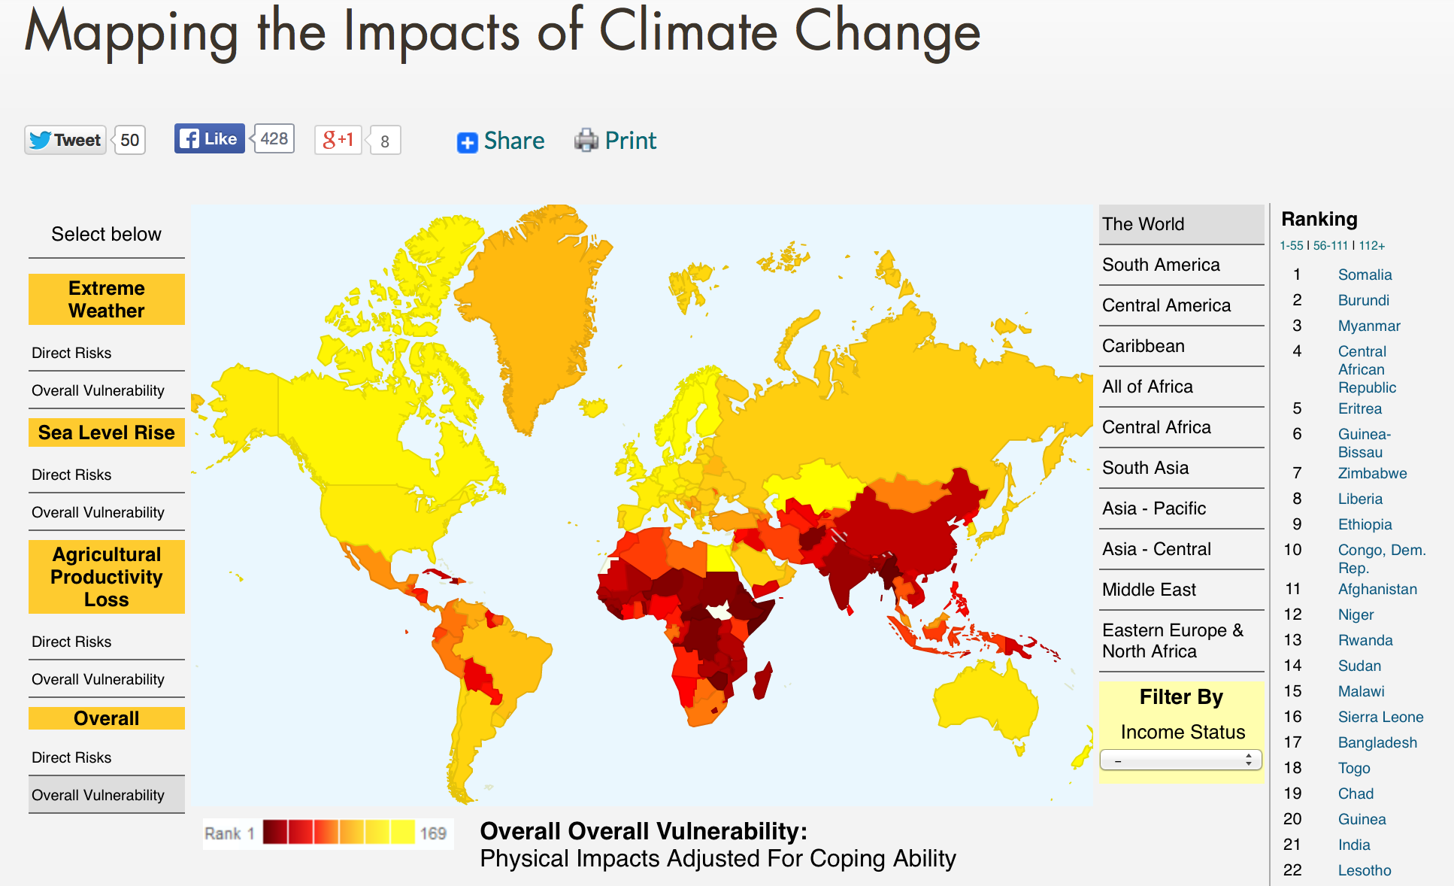

Slide 70
Climate impacts on society
3 Extreme weather events
4 Food
5 Water
6 Health and Illness
7 Economic impacts, at the level of the nation (U.S.)
8 Political impacts
9 Unequal impacts, globally, among nations
10 Unequal impacts, in the U.S., by State and by region
11 Unequal impacts, in the U.S., by race and class
12 The potential for catastrophic impacts

Slide 73
U.S. coast after sea level rise of 2 ft.
(https://coast.noaa.gov/slr/#/layer/slr)

Slide 74
Climate impacts on society
3 Extreme weather events
4 Food
5 Water
6 Health and Illness
7 Economic impacts, at the level of the nation (U.S.)
8 Political impacts
9 Unequal impacts, globally, among nations
10 Unequal impacts, in the U.S., by State and by region
11 Unequal impacts, in the U.S., by race and class
12 The potential for catastrophic impacts

Slide 75
Environmental Justice/
Environmental Inequalities

Slide 76
Climate Justice

Slide 77
Lesson from the study of “natural disasters”
Q: Why do “natural disasters” have unequal race/class impacts?
A: Differential Vulnerability
Those who have more resources can:
Avoid trouble before an event
Cope better during an event
Recover faster after an event

Slide 78
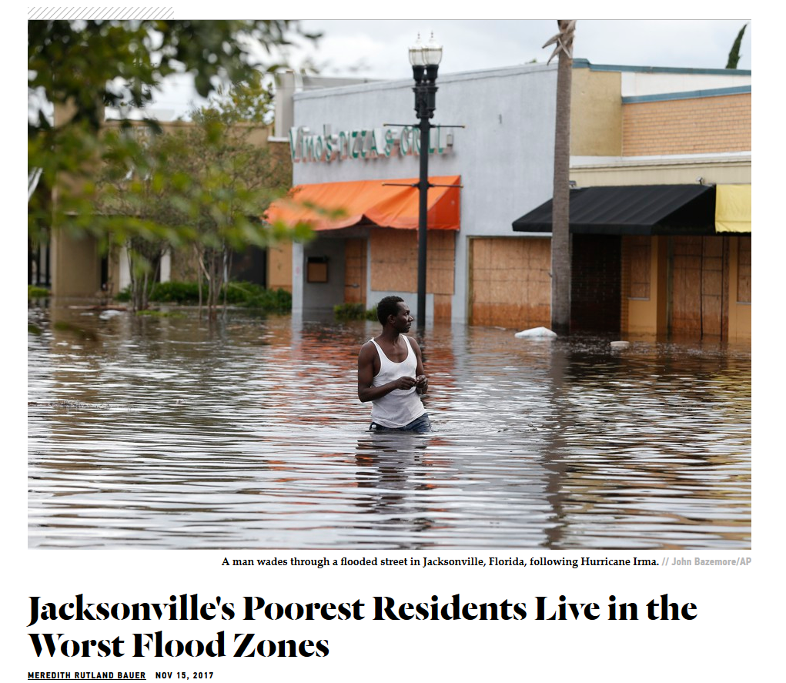

Slide 79
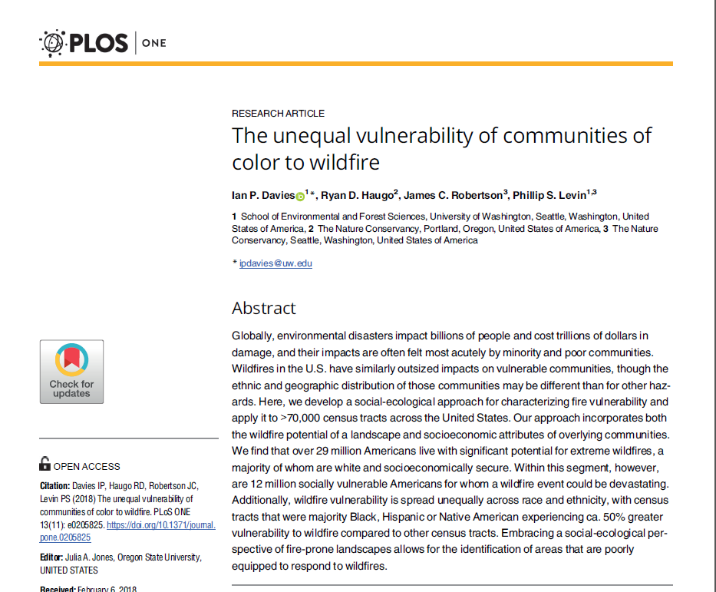

Slide 80
Studies show differential impacts already by race/ethnicity:
-- in cities, the heat island effect is more intense in minority neighborhoods
-- in coastal areas with high minority numbers, sea levels are rising faster
-- “natural” disasters cause more damage in poor communities of color

Slide 81
Climate impacts on society
3 Extreme weather events
4 Food
5 Water
6 Health and Illness
7 Economic impacts, at the level of the nation (U.S.)
8 Political impacts
9 Unequal impacts, globally, among nations
10 Unequal impacts, in the U.S., by State and by region
11 Unequal impacts, in the U.S., by race and class
12 The potential for catastrophic impacts

Slide 82
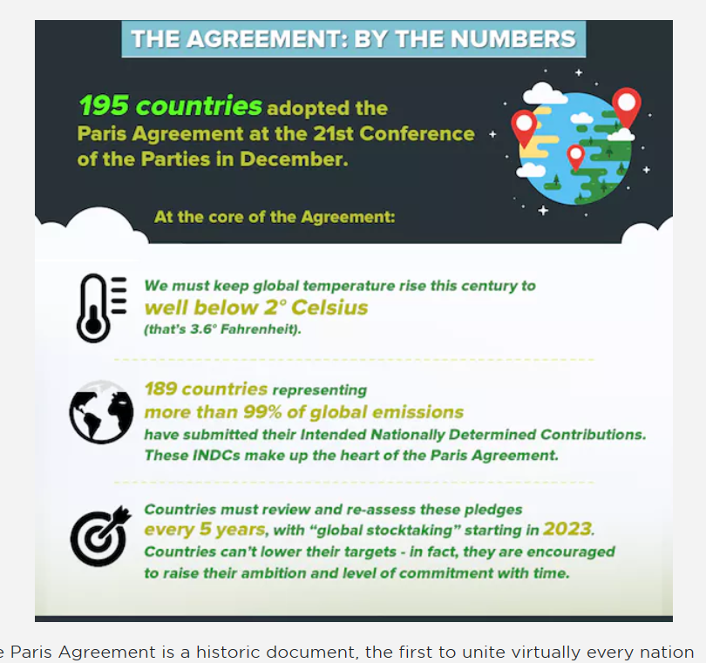

Slide 83
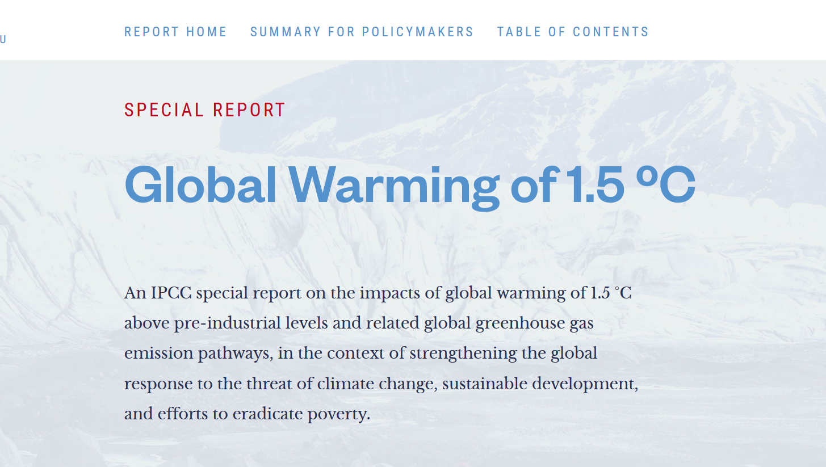

Slide 84
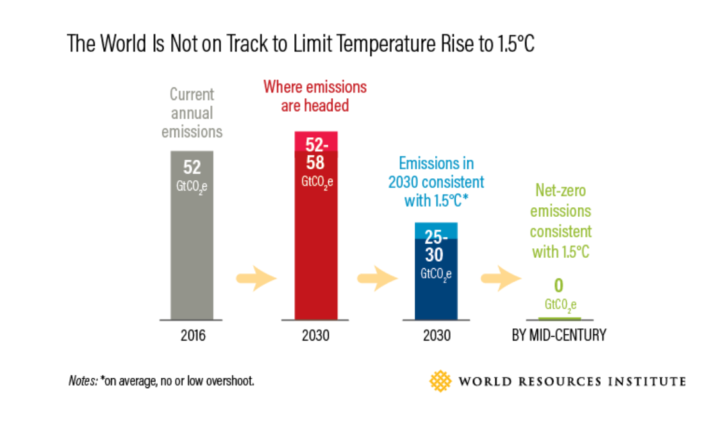

Slide 86
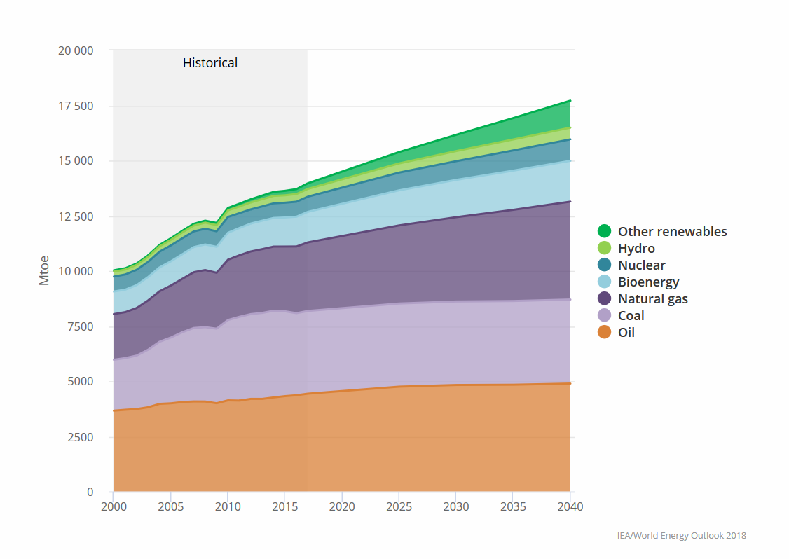
https://www.iea.org/weo/

Slide 87
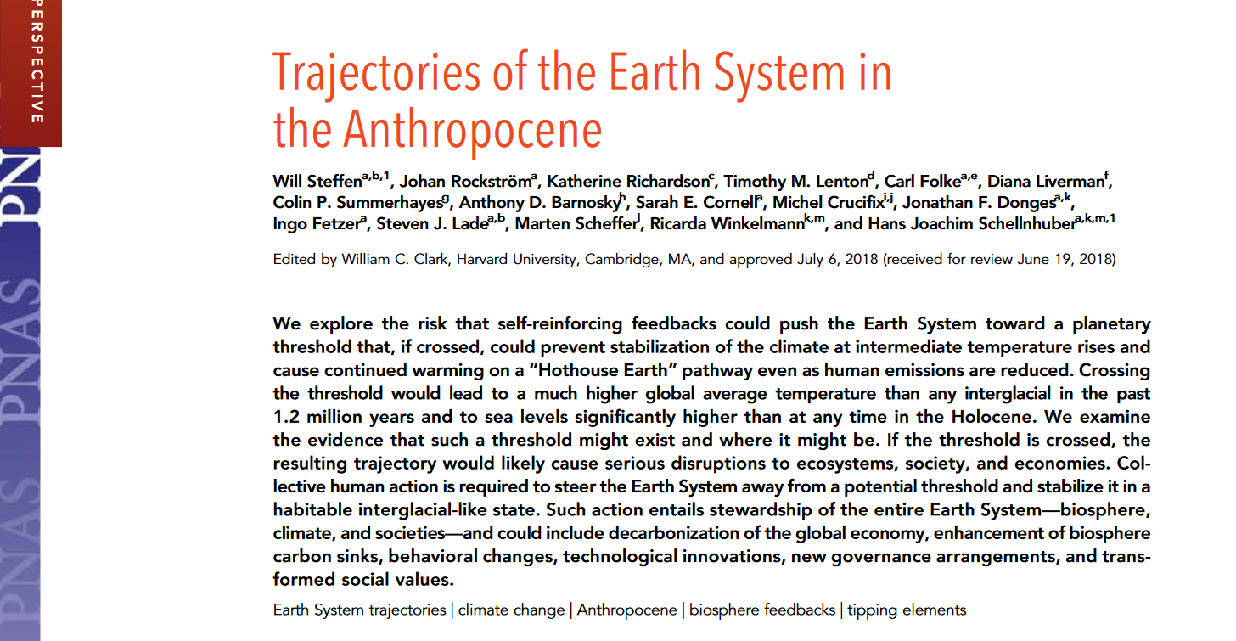

Slide 88

Steffen, et al, PNAS, August 14, 2018,
vol. 115, #33, p. 8253

Slide 89
Steffen, et al, PNAS, August 14, 2018,
vol. 115, #33, p. 8253

Slide 90
Steffen, et al, PNAS, August 14, 2018,
vol. 115, #33, p. 8253

Slide 91

www.pnas.org/cgi/doi/10.1073/pnas.1910114117

Slide 92

www.pnas.org/cgi/doi/10.1073/pnas.1910114117

Slide 93



Slide 94

www.pnas.org/cgi/doi/10.1073/pnas.1910114117

Slide 96

Steffen, et al, PNAS, August 14, 2018,
vol. 115, #33, p. 8253

