Slide 1
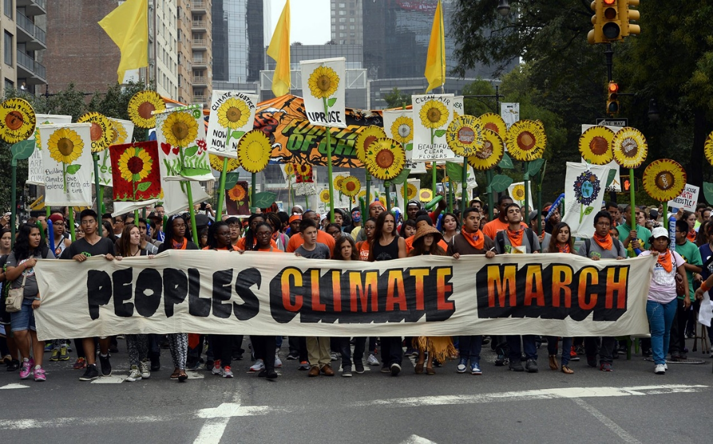
A Sociology of Climate Change: Causes

Slide 2

Causes
Society
Climate Change

Slide 3
Societal causes of, or drivers of, climate change
Causes – in a “green” updating of Classical Theory
Causes – in today’s Environmental Sociology literature

Slide 4
Societal causes of, or drivers of, climate change
Causes – in a “green” updating of Classical Theory
Causes – in today’s Environmental Sociology literature

Slide 5
from Feudalism to urban, industrial Capitalism

Slide 6
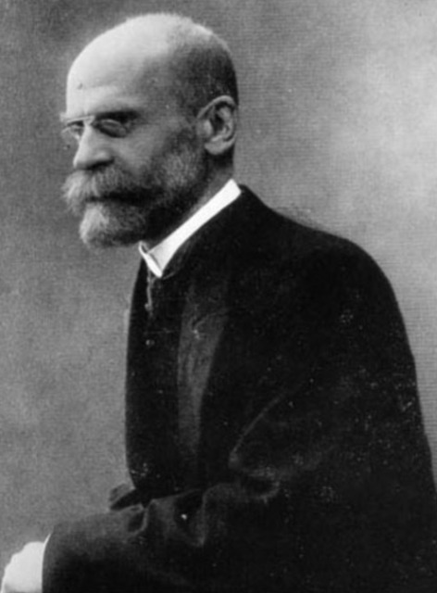
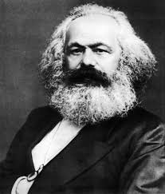
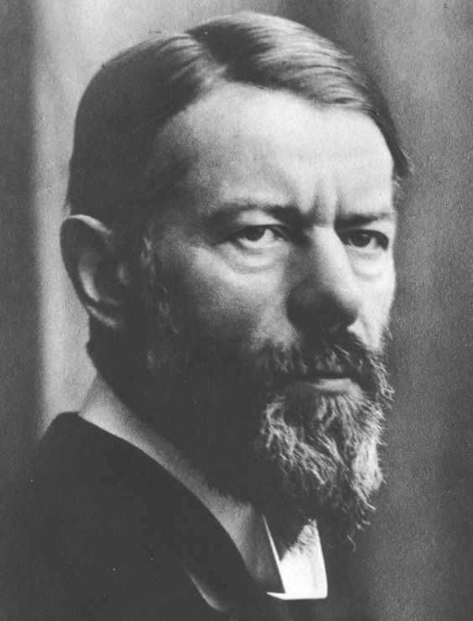
Emile Durkheim Karl Marx Max Weber

Slide 7
Why did Feudalism collapse?

Slide 8
What is this new kind of society?
What are its strengths?
What are its problems?

Slide 9
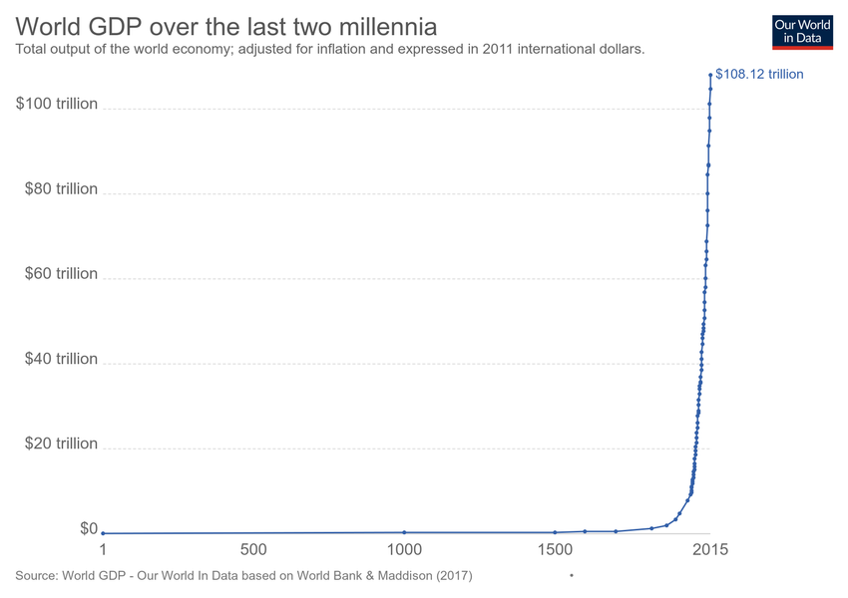

Slide 10
In “scarce one hundred years … more massive and more colossal productive forces than [ were created in all ] preceding generations together. … machinery, … steam-navigation, railways, electric telegraphs, clearing of whole continents for cultivation, canalisation of rivers, whole populations conjured out of the ground”
-- Karl Marx

Slide 11
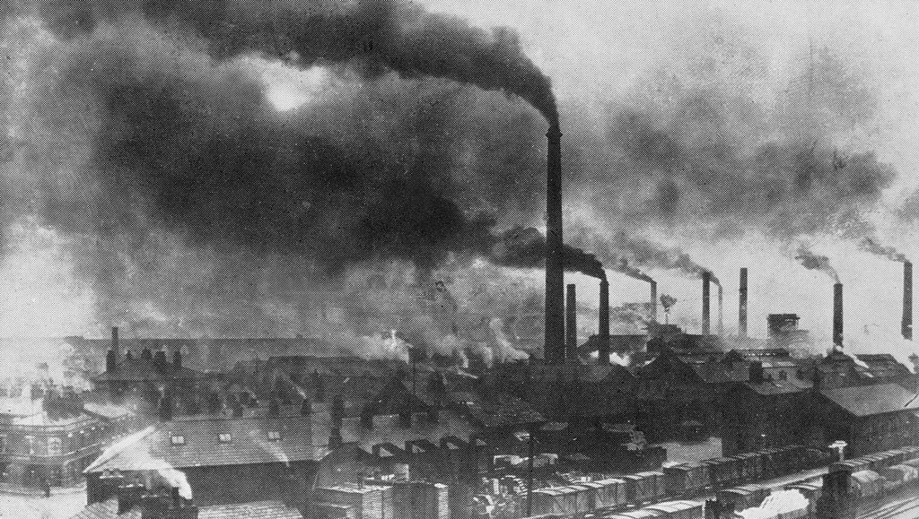

Slide 12
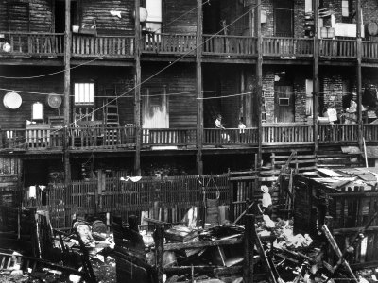

Slide 13
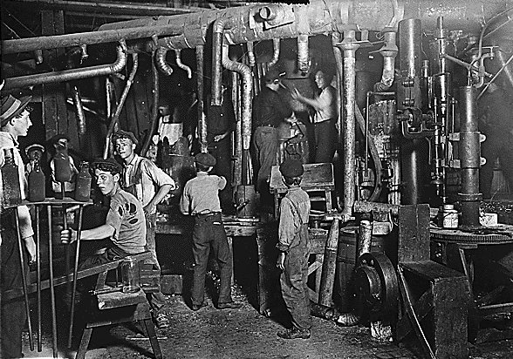

Slide 14
Today we would say these are “environmental” problems
But at the time, they were seen as “social” problems

Slide 15
“greening” Classical Theory
-- or --
re-narrating Classical Theory

Slide 16
Constructing a causal chain
from economic growth to CO2 emissions

Slide 18
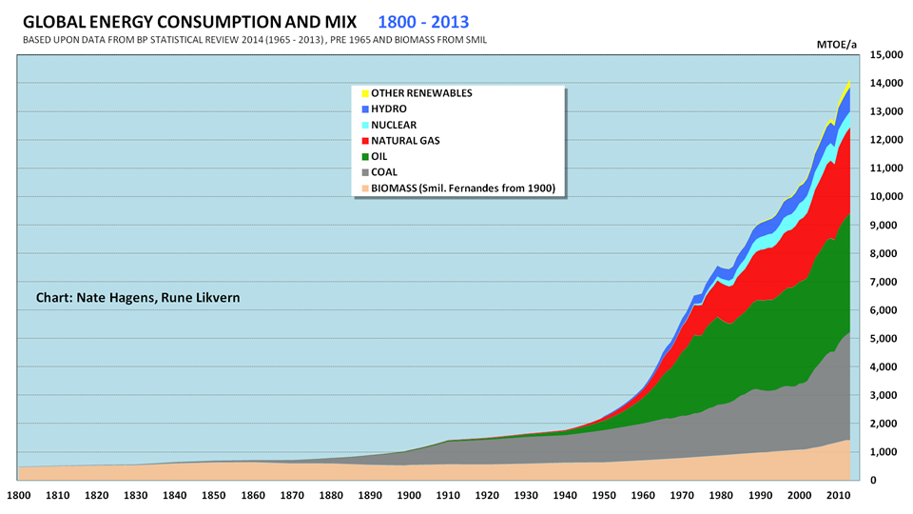
https://symphonywavepowerdotcom.files.wordpress.com/2015/12/energy-growth.png?w=525

Slide 19
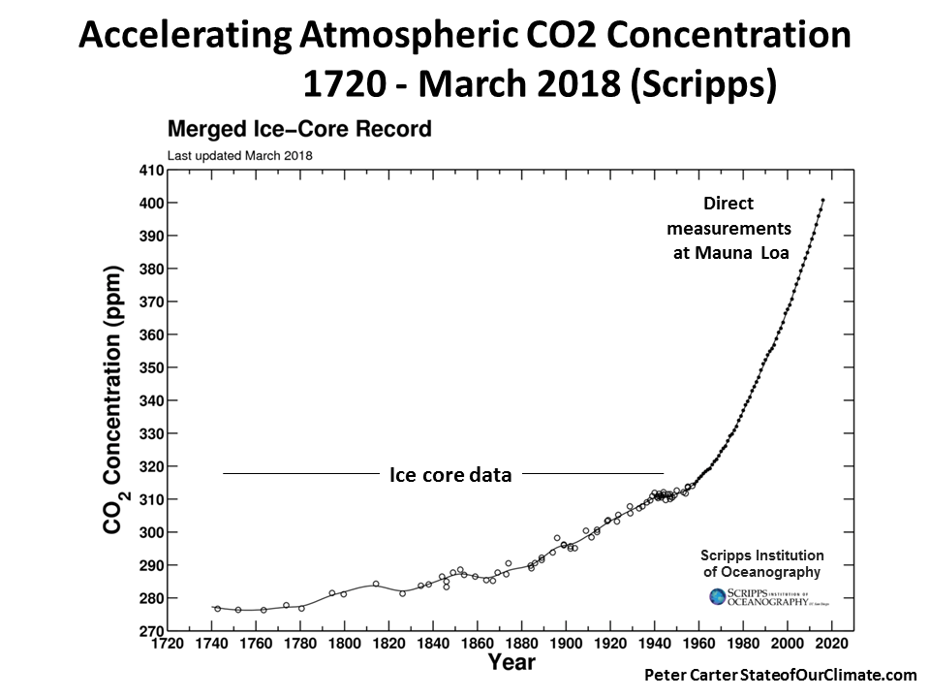

Slide 20
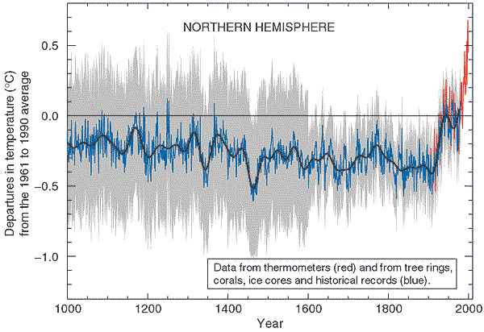

Slide 21
Societal causes of, or drivers of, climate change
Causes – in a “green” updating of Classical Theory
  → industrial production + fossil fuels
Causes – in today’s Environmental Sociology literature

Slide 22
Societal causes of, or drivers of, climate change
Causes – in a “green” updating of Classical Theory
  → the dynamics of capitalist society + fossil fuels
Causes – in today’s Environmental Sociology literature

Slide 23
industrial production, yes …
but also:
population
consumption

Slide 24
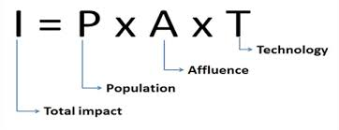
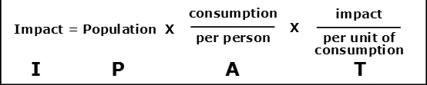

Slide 25
Population: Demography
Consumption: The Sociology of Consumption

Slide 26
industrial production, yes …
but also:
population
consumption

Slide 27
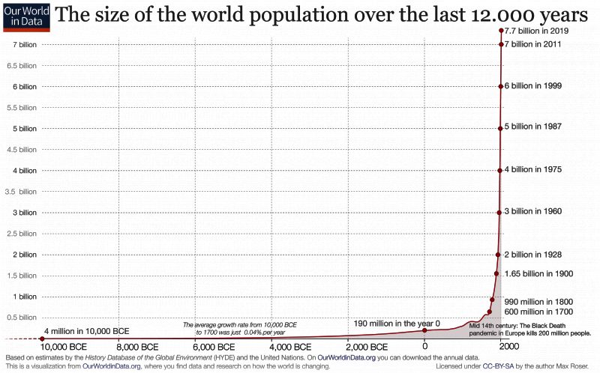

https://ourworldindata.org/world-population-growth

Slide 28
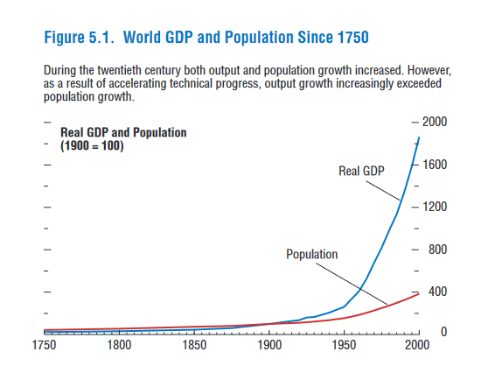

International Monetary Fund, “World Economic Outlook, May, 2000,” p. 150

Slide 29
Sociological study of population dynamics: Demography

Slide 30
industrial production, yes …
but also:
population
consumption

Slide 31
International Monetary Fund, “World Economic Outlook, May, 2000,” p. 150

Slide 32
The Sociology of Consumption

Slide 33
Beyond averages: wealth and income inequality
Social class/“Stratification”

Slide 34
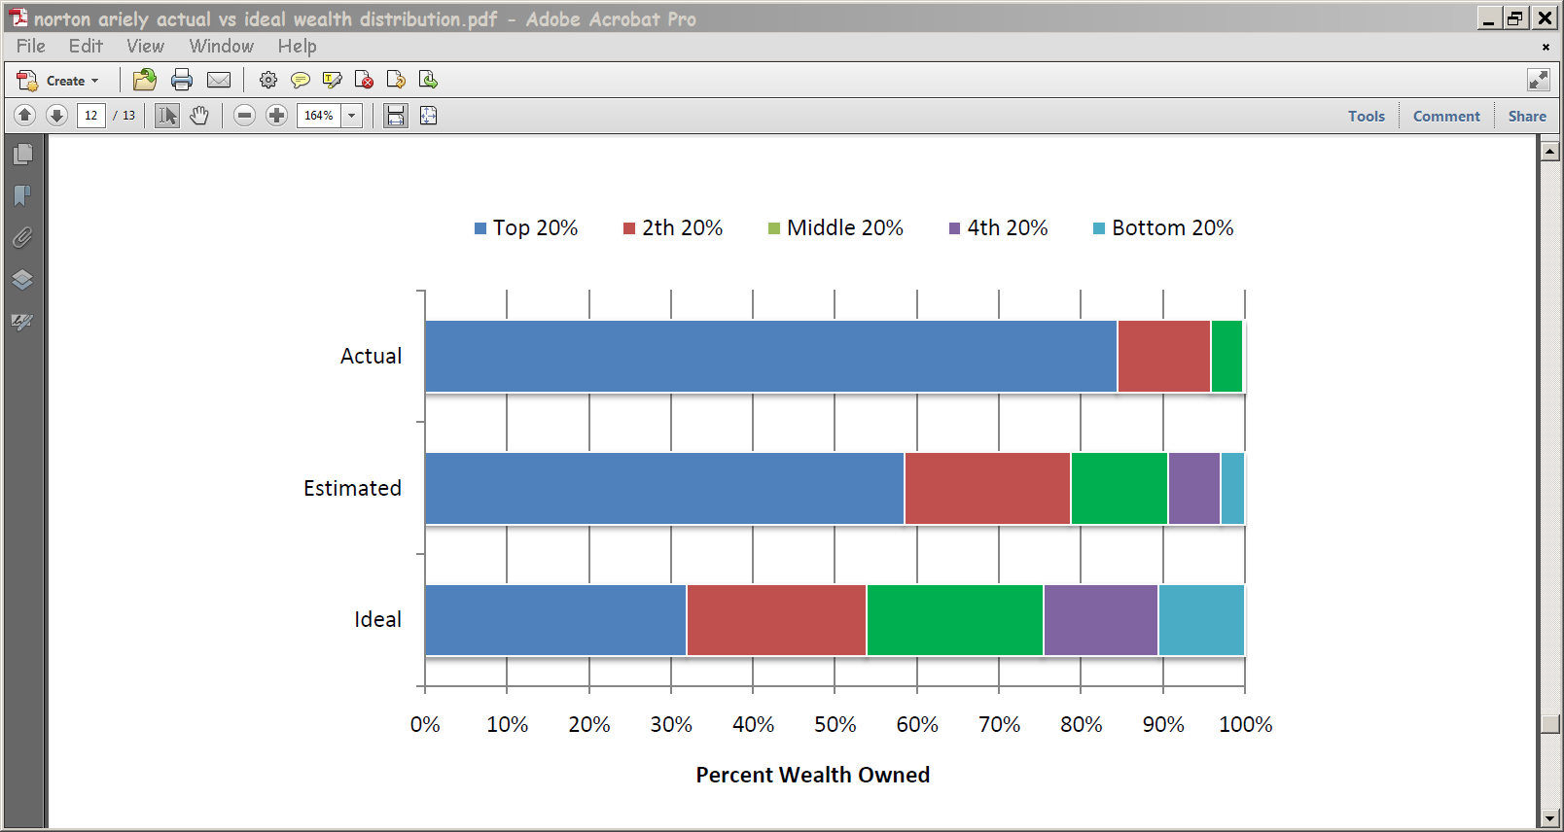
Norton and Ariely, “Building a Better America – One Wealth Quintile at a Time,” 2011

Slide 35
Norton and Ariely, 2011

Slide 36
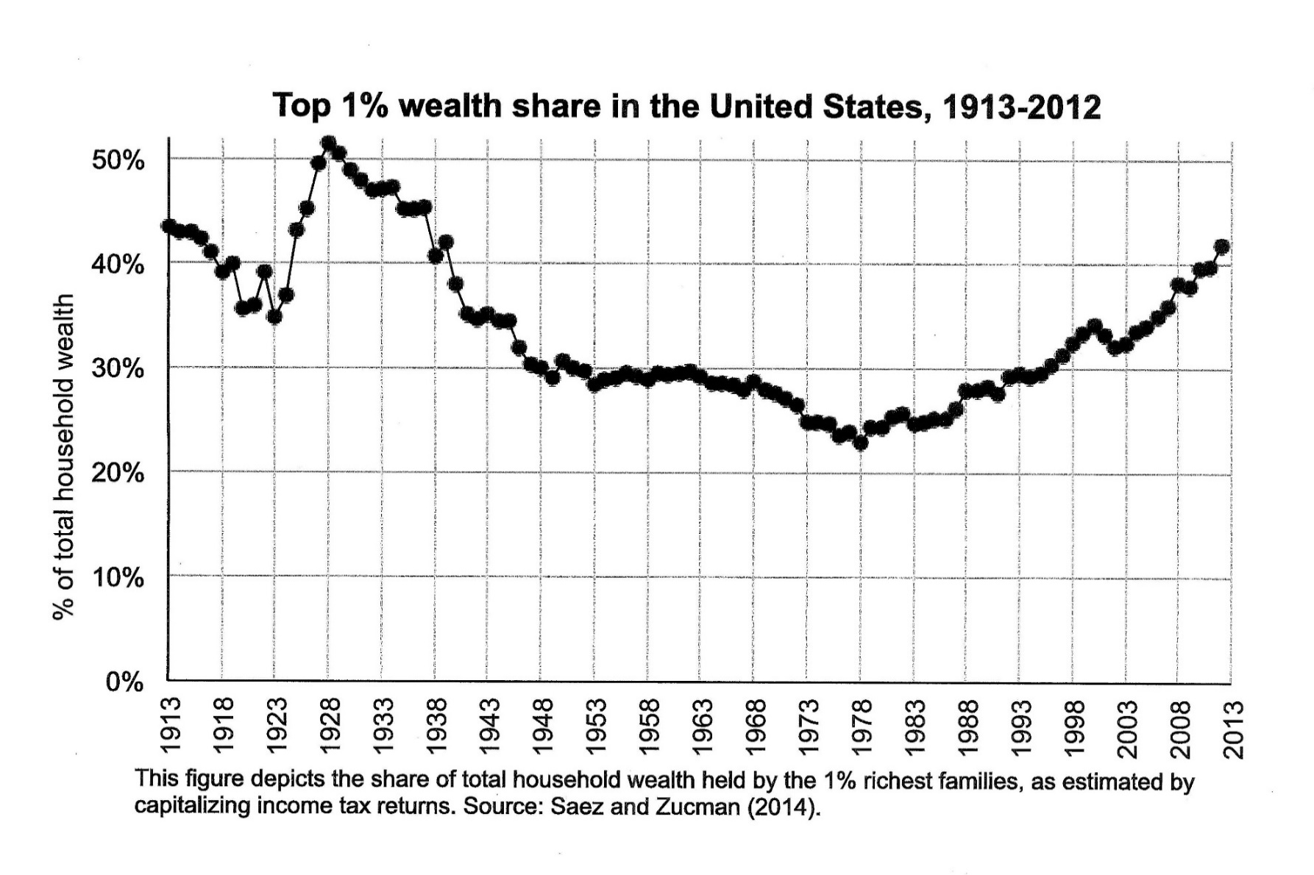
Saez, “Income and Wealth Inequality: Evidence and Policy Implications,” 2014

Slide 37
1 %
2 to 20 %
Norton and Ariely, 2011

Slide 38
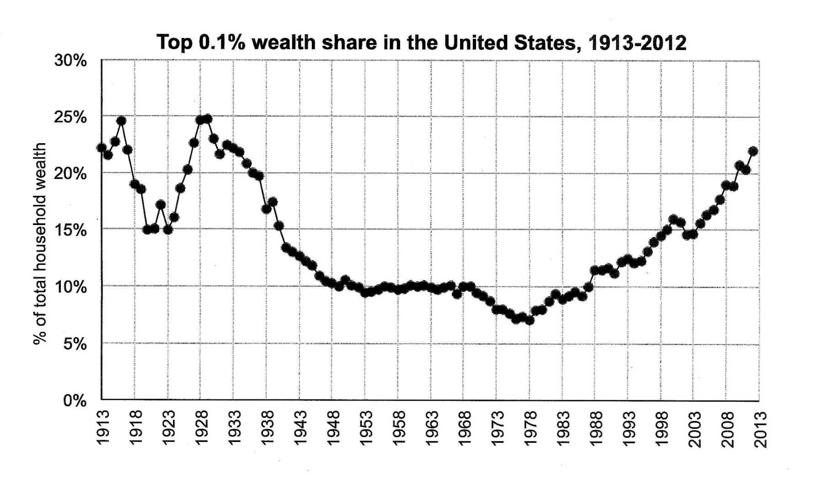
Saez, “Income and Wealth Inequality: Evidence and Policy Implications,” 2014
Saez, “Income and Wealth Inequality: Evidence and Policy Implications,” 2014

Slide 39
0.1 %
0.2 to 1 %
2 to 20 %
Norton and Ariely, 2011

Slide 40

Norton and Ariely, 2011

Slide 41
Norton and Ariely, 2011

Slide 42
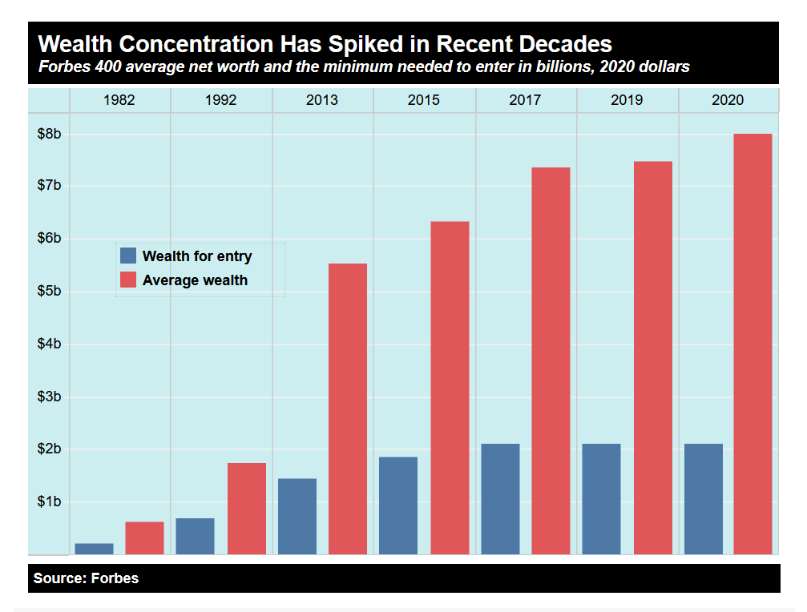
https://inequality.org/facts/wealth-inequality/

Slide 43
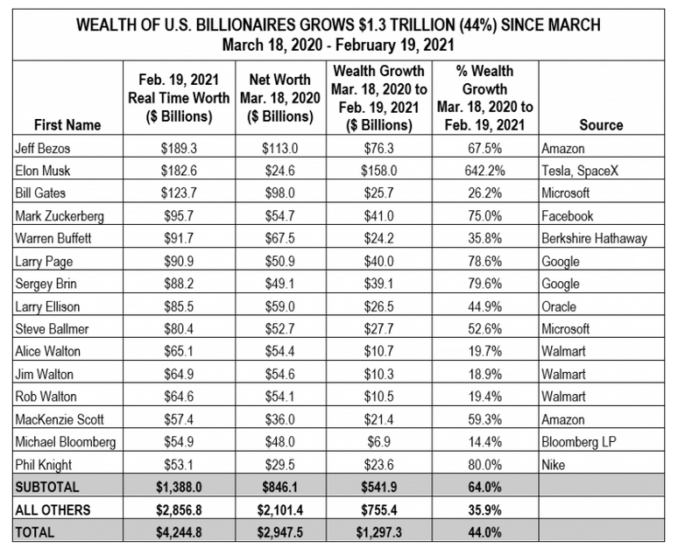

Slide 44
Social class (inequalities in wealth and income)
→ Inequalities in consumption
→ Inequalities in size of “carbon footprint”

Slide 45
the family home

Slide 46
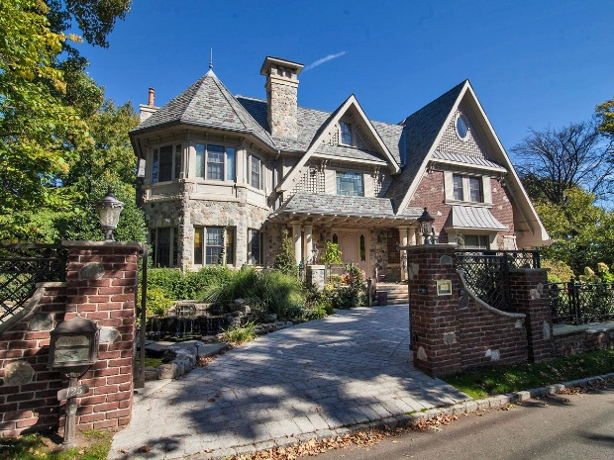
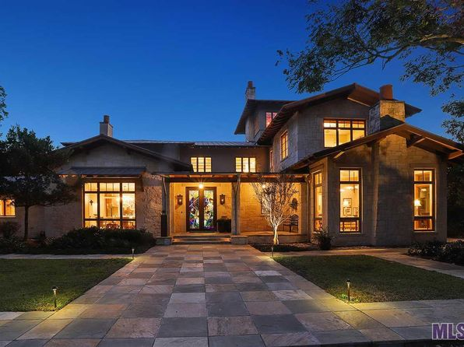
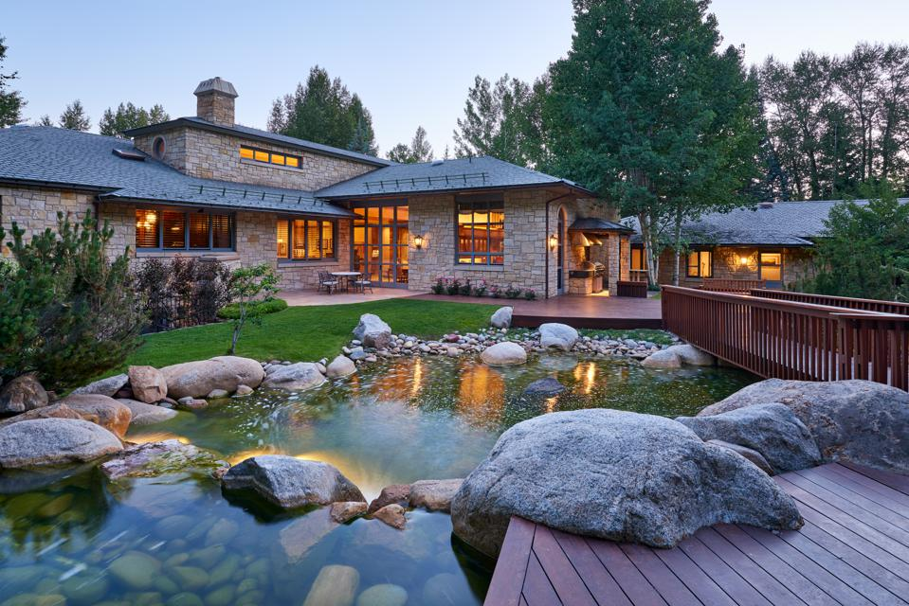

Slide 47
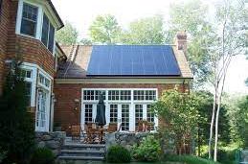
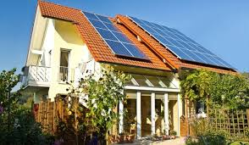
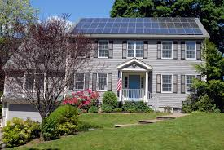

Slide 48
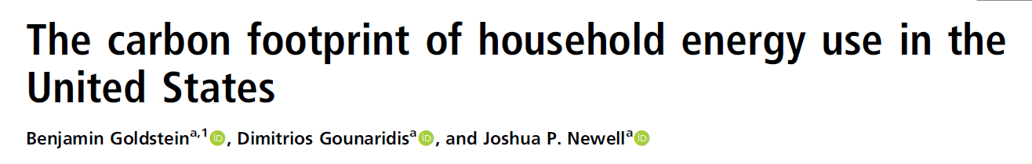
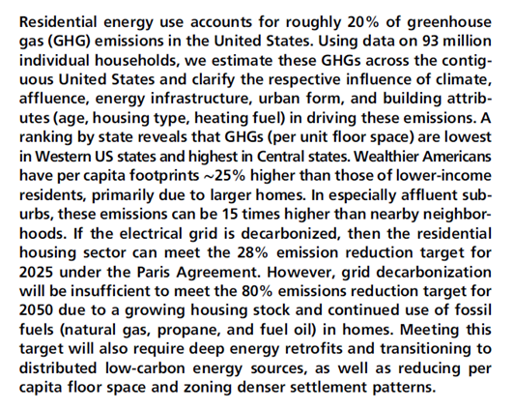
PNAS August 11, 2020 117 (32) 19122-19130

Slide 49
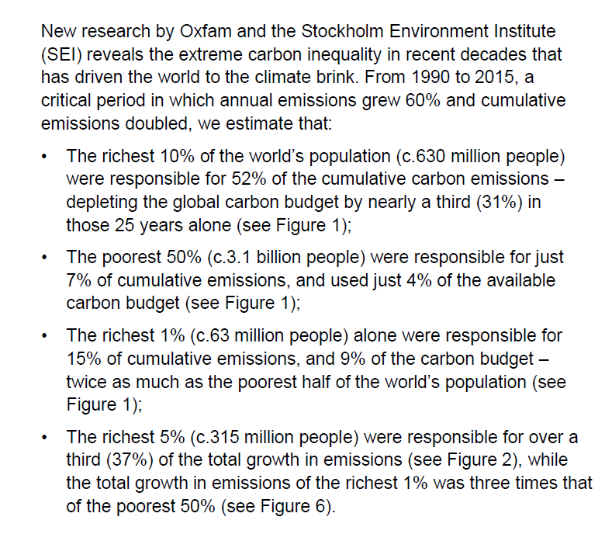
Confronting Carbon Inequality, Oxfam Media Briefing, Sept 21, 2020, www.oxfam.org

Slide 50
Sociological analysis of the causes of, or drivers of, climate change
Re-narrating Classical Theory – bring environment back in
Environmental Sociology
Demography
Sociology of Consumption
Stratification

